Slide 1
Year 3
English
Lesson 10 – using evaluative language to persuade

Slide 3
You will need
A pencil and paper.

Slide 4
Learning intention
To apply knowledge of persuasive language to write a persuasive text.

Slide 5
Let’s remember – contractions
A contraction is a shorter way of writing or saying 2 words.
We can contract two words into one word.
did not = didn’t
The missing letter, shown in red, is replaced by an apostrophe. ’
To be more persuasive, we might deliberately choose not use contractions.

Slide 6
For example
Don’t worry Mother, we will watch out for him. (do not)
I’ll huff and I’ll puff and I’ll blow your house down. (I will)
The house didn’t fall down. (did not)
The pig wasn’t called big and bad for nothing. (was not)

Slide 7
For example
When writers need to emphasise an important word, contractions are not used.
We shall build an even stronger house. (we’ll)
By the hair on our chinny-chin-chins, we will not let you in. (won’t)

Slide 8
Let’s remember – modal verbs
Modal verbs are verbs that tell us:​
​
how likely something is to happen, for example:​
The big bad pig might change.
The big bad pig will change.
​ or ​
​how much it needs to happen, for example:​
We may build a stronger house.
We must build a stronger house.

Slide 9
For example
"Don't worry, Mother we will watch out for him."
"By the hair on our chinny-chin-chins, we will not let you in.”
"We shall have to build a stronger house.”
In these sentences, the modal verbs express high modality.

Slide 10
Let’s remember – modal adverbs
Modal adverbs can be added to modal verbs to express low, medium or high modality.
The big bad pig possibly will change.
The big bad pig probably will change.
The big bad pig absolutely will change.

Slide 11
Let’s remember – adjectives
Adjectives are words that describe a noun (person, place or thing).
Some examples:
the big bad pig
the three cuddly little wolves
the little frightened wolves
a stronger house
some heavy metal padlocks
a generous kind-hearted rhinoceros.

Slide 12
Activity – adjectives
To check if a word is an adjective, say ‘thing’ after it. If makes sense, it is an adjective.
Which words are adjectives?
definitely
huffed
little
will
kind
said
beautiful

Slide 13
Answers
Which words are adjectives?
definitely
huffed
little
will
kind
said
beautiful

Slide 14
Listen for contractions, adjectives, modal verbs and modal adverbs.
Source: The three little wolves and the big bad pig – picture book read aloud on YouTube (Storytime with Shayne, 2022)
For your safety, watch this video in the slideshow without accessing YouTube.

Slide 15
Sort the evaluative words
Adjectives | Modal verbs | Modal adverbs
fragile
might
absolutely
trembling
will
extremely
stronger
quite
cuddly
possibly
shall
must
Hint: If you say ‘thing’ after the word and it makes sense, it is an adjective.

Slide 16
Answers
Adjectives | Modal verbs | Modal adverbs
fragile stronger cuddly trembling | will shall must might | extremely possibly absolutely quite
Which of these words are:
adjectives
modal verbs
modal adverbs?

Slide 17
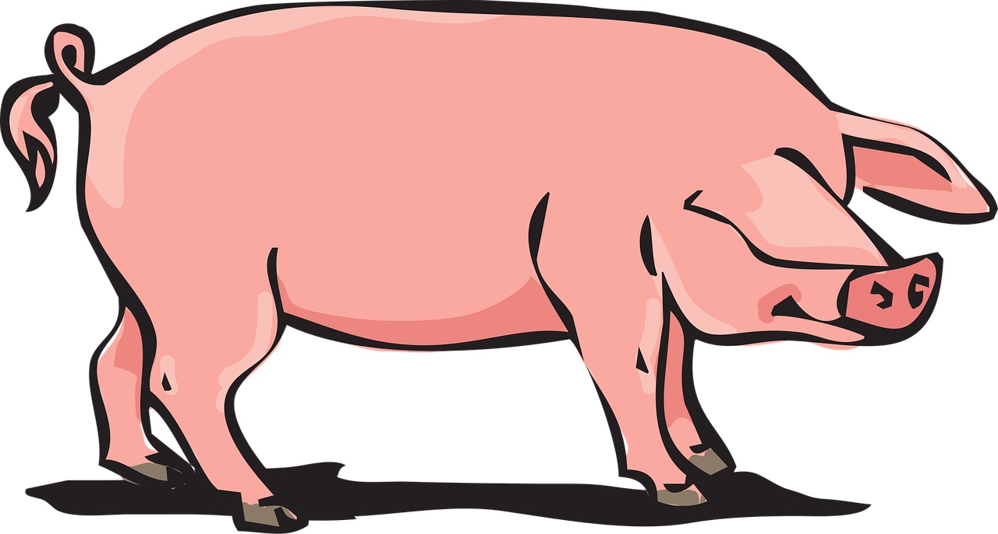
Time to write – from the point of view of the big bad pig
Pretend you are the big bad pig.
Write a letter to the three little wolves persuading them that you have indeed changed for good.
Remember to choose persuasive language including:
adjectives
modal verbs
modal adverbs
contractions (or the whole words).
Source: Pixabay

Slide 18
An example
Dear three little wolves,
I am completely embarrassed and extremely sorry for my recent actions. I’ve thought a lot about my shameful behaviour and the awful way I treated you. I now realise what a nasty, horrible pig I have been. I would not expect you to forgive me but I really hope you can. I will certainly promise that from now on I will be the most lovely and kind pig. You do not need to worry about me destroying your houses ever again. Hopefully you will be my friends. I can make it up to you by playing fun games and cooking yummy treats for you.
From the big bad good pig

Slide 19
Now it’s your turn.
Pretend you are the big bad pig.
Write a letter to the three little wolves persuading them that you have indeed changed for good.
Remember to choose persuasive language including:
adjectives
modal verbs
modal adverbs
contractions (or the whole words).
Source: Pixabay

Slide 20
Reflection
Knowing how to use evaluative language can help us choose adjectives, verbs (including modal verbs) and modal adverbs to create texts that persuade others.

Slide 21
Daily reading routine
Choose something to read.
Find a quiet, comfortable space to read.
Read for 15 to 20 minutes.
Have a chat about what you read with someone else.

