Slide 1
Year 3
English
Lesson 2 – exploring and comparing persuasive language

Slide 3
You will need
A pencil and paper.

Slide 4
Learning intention
To notice and compare persuasive language.

Slide 5
Let’s remember – what is persuasive language?
When you persuade someone, you are convincing them that what you think is right.
We choose persuasive words and language to convince another person.

Slide 6
Example
When I was looking after my nephew, he tried to persuade me to give him a later bedtime. He said he had to stay up later because his older sister was allowed to and he just had a birthday so he was older now. He told me that he really wanted to keep watching the movie and promised that he would not be tired in the morning.
Source: Pixabay

Slide 7
Let’s compare persuasive language – skatepark example
Which sounds more persuasive?
1. “I want to go to the skatepark today.”
2. “I would really love to go to the skatepark! It is such a beautiful day and I should really get outside to get some lovely fresh air. Skating is fantastic exercise and I need to practise my kickflip.”
Source: Pexels

Slide 8
I thought that number 2 was more persuasive
2. “I would really love to go to the skatepark! It is such a beautiful day and I should really get outside to get some lovely fresh air. Skating is fantastic exercise and I need to practise my kickflip.”
The words:
would, should and need make the child sound certain
beautiful, lovely and fantastic make the skatepark sound like a good idea
kickflip makes the child sound like an expert.
Source: Pexels

Slide 9
Let’s compare persuasive language – littering example
Which sounds more persuasive?
1. “There is a massive problem with littering at our school that must be fixed. We need to stop being so lazy and definitely can take more care of our wonderful school. The rubbish looks horrible and is not good for our beautiful environment”
2. “There is a problem with littering at our school.”
Source: Pixabay

Slide 10
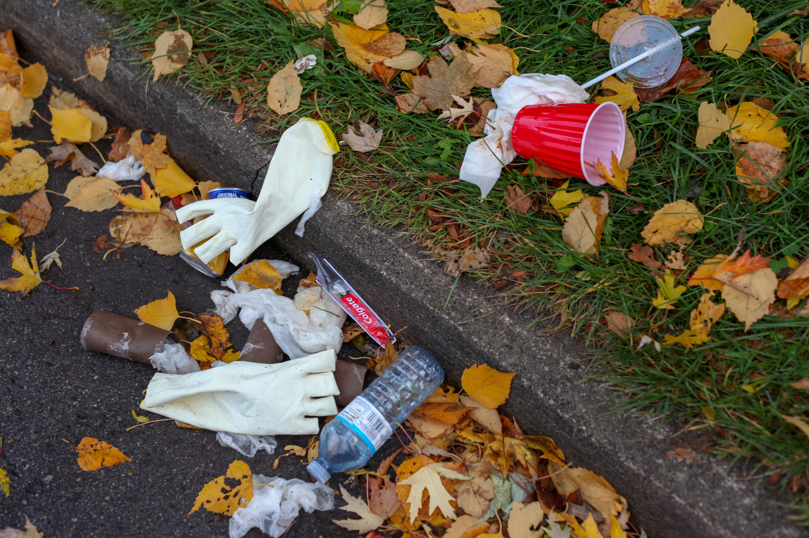
I thought that number 1 was more persuasive
“There is a massive problem with littering at our school that must be fixed. We need to stop being so lazy and definitely can take more care of our wonderful school. The rubbish looks horrible and is not good for our beautiful environment.”
The words:
massive, problem, horrible and lazy made the littering issue sound bad
must, need and definitely made the child sound very certain
wonderful school and beautiful environment made it sound like it is an important problem to fix.
Source: Unsplash

Slide 11
Reflection
The words we choose can make our ideas more persuasive.

Slide 12
Time to write
Write a list of the words that you thought made the two examples more persuasive. You might like to rule up a table like this one.
Can you think of any other persuasive words that you would use?
Add them to your table.
Skatepark example | Littering example
need beautiful … | massive definitely …
Source: Pexels
Source: Pixabay

Slide 13
Daily reading routine
Choose something to read.
Find a quiet, comfortable space to read.
Read for 15 to 20 minutes.
Have a chat about what you read with someone else.

