Slide 1
Year 3
English
Lesson 4 – understanding verb groups and verb tense

Slide 3
You will need
A pencil and paper.

Slide 4
Learning intention
To learn about verb groups and verb tense.

Slide 5
Let’s remember – what is a verb?
A verb is a word that can tell us what is happening or what something is or has.
Four types of verbs:
action or doing verbs
saying verbs
thinking, sensing or feeling verbs
relating verbs.

Slide 6
Verb groups
When a relating verb is with a main verb it is called a verb group.
For example:
He is skipping.
She has slept.

Slide 7
Tense
Tense helps us know whether something has:
already happened (past)
is happening right now (present)
will happen later (future).
Verbs and verb groups tell us the tense.

Slide 8
Example 1
Singular (one person or thing)
Plural (more than one person or thing)
Present tense | I am playing soccer now. | We are playing soccer now.
Future tense | I will play soccer tomorrow. | We will play soccer tomorrow.
Past tense | I played soccer yesterday. | We played soccer yesterday.

Slide 9
Example 2
Singular (one person or thing)
Plural (more than one person or thing)
Present tense | I am singing a song now. | We are singing a song now.
Future tense | I will sing a song tomorrow. | We will sing a song tomorrow.
Past tense | I sang a song yesterday. | We sang a song yesterday.

Slide 10
Example 3
Singular (one person or thing)
Plural (more than one person or thing)
Present tense | I am swimming now. | We are swimming now.
Future tense | I will swim tomorrow. | We will swim tomorrow.
Past tense | I swam yesterday. | We swam yesterday.

Slide 11
In the sentence
I played with my Lego.
What is the verb?
What is the tense?
How do you know?
Source: Pixabay

Slide 12
Answer
I played with my Lego.
The verb played tells us that this happened in the past.
Source: Pixabay

Slide 13
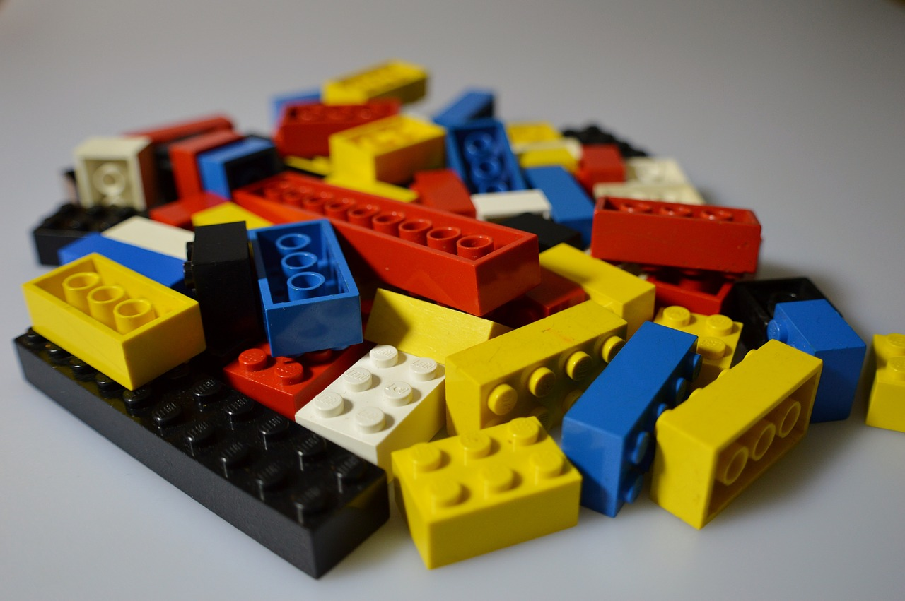
In the sentence
I am playing with my Lego.
What is the verb group?
What is the tense?
How do you know?
Source: Pixabay

Slide 14
Answer
I am playing with my Lego.
The verb group am playing tells us that this is happening in the present.
Source: Pixabay

Slide 15
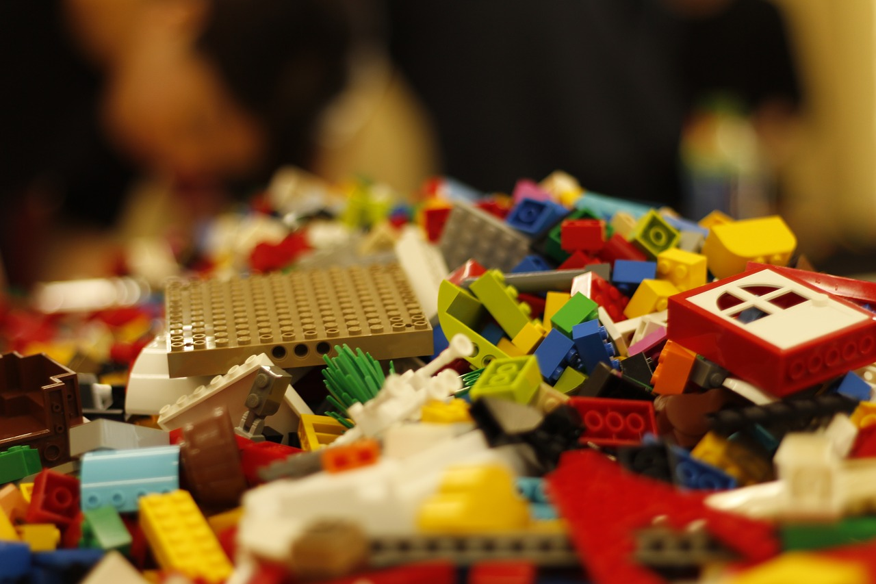
In the sentence
I will play with my Lego.
What is the verb group?
What is the tense?
How do you know?
Source: Pixabay

Slide 16
In the sentence
I will play with my Lego.
The verb group will play tells us that this has not happened yet. It will happen in the future.
Source: Pixabay

Slide 17
Practise changing the tense
Change the present tense verbs to past and future tense.
You might like to rule a table up like this one.
Can you add the past and future tense verbs to the table?
Past tense | Present tense | Future tense
Yesterday, I: | Now, I: | Tomorrow, I:
asked | am asking | will be asking
 | am playing
 | am dreaming
 | am whispering

Slide 18
Answer
Past tense | Present tense | Future tense
Yesterday, I: | Now, I: | Tomorrow, I:
asked | am asking | will be asking
played | am playing | will be playing
dreamed | am dreaming | will be dreaming
whispered | am whispering | will be whispering

Slide 19
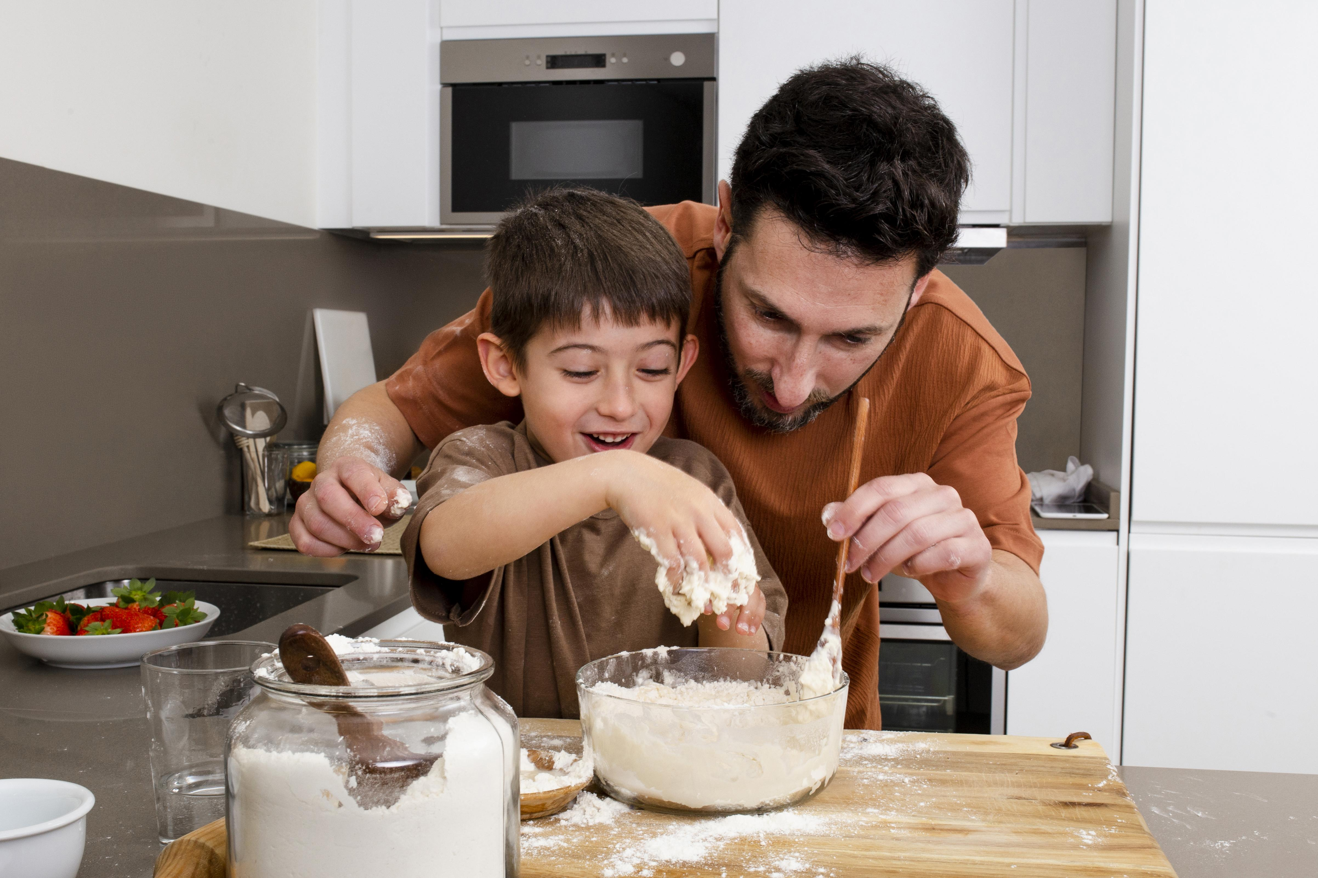
Time to write
Choose a verb and write it in a sentence using present tense.
For example:
Today I am cooking with my dad.
Can you write your sentence in past and future tense?
For example:
Yesterday I cooked with my dad.
Tomorrow I will cook with my dad.
Source: Freepik

Slide 20
Reflection
Verbs and verb groups tell us when something happens, which is called the tense.
The 3 main tenses are past tense, present tense and future tense.

Slide 21
Daily reading routine
Choose something to read.
Find a quiet, comfortable space to read.
Read for 15 to 20 minutes.
Have a chat about what you read with someone else.

