Slide 1
Year 3
English
Lesson 5 – exploring modal verbs

Slide 3
You will need
A pencil and paper.

Slide 4
Learning intention
To learn about modal verbs and how they can be more or less persuasive.

Slide 5
Let’s remember – verbs and verb groups tell us about tense
The verb or verb group tells us when something happened.
For example:
The cat climbed the tree.
I am eight years old.
The baby was happy.
We are having lunch.

Slide 6
Modal verbs
Modal verbs are verbs that tell us:
How likely something is to happen, for example:
I might go to the park.
I will go to the park.
or
How much it needs to happen, for example:
You may give it to me.
You must give it to me.

Slide 7
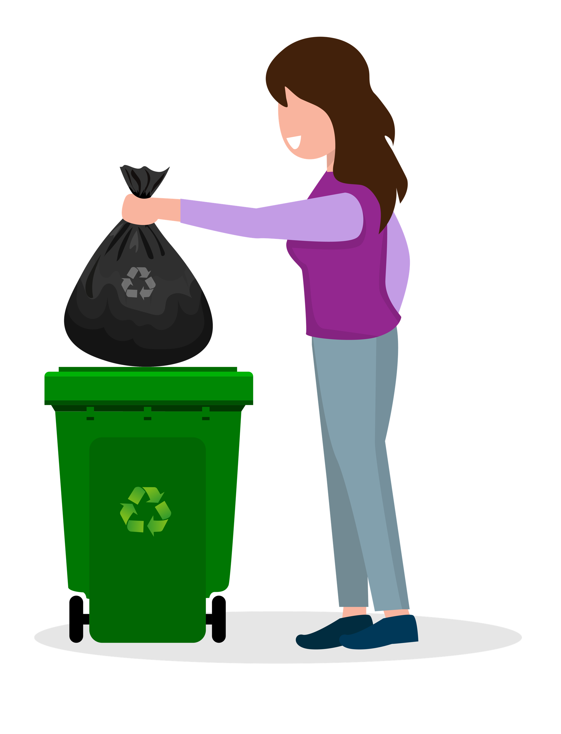
Modal verbs
Modal verbs can help us persuade people by showing how much they need to do or not do something. We can choose modal verbs to change the modality from low to high as in this example.
Low modality You may put your rubbish in the bin.
Medium modality You should put your rubbish in the bin.
High modality You must put your rubbish in the bin.
Source: Vecteezy, https://www.vecteezy.com/vector-art/ 5604583-a-housewife-carries-a-black-plastic-trash-bag-with-her-son-and-daughter-with-boxes-of-plastic-bottles-to-be-thrown-into-the-recycling-bins

Slide 8
Sort the verb groups
You will love it.
You might like it.
You can use it.
You could use it.
You should buy it.
You may use it.
You must buy it.
You ought to buy it.
You must not buy it.
Low modality | Medium modality | High modality

Slide 9
Possible answers
You will love it.
You might like it.
You can use it.
You could use it.
You should buy it.
You may use it.
You must buy it.
You ought to buy it.
You must not buy it.
Low modality | Medium modality | High modality
You may use it. You could use it. You might like it. | You can use it. You should buy it. | You will love it. You must buy it. You must not buy it. You ought to buy it.

Slide 10
Low to high modality
We can add other words to help verbs, called adverbs. Try adding these adverbs to these verbs to help them to be more forceful and convincing.
definitely
certainly
surely
clearly
absolutely
really
could
should
may
will
shall
must

Slide 11
Some possible answers
definitely
certainly
surely
clearly
absolutely
really
could
should
may
will
shall
must

Slide 12
Change or add words to make these sentences more forceful
Words you could use:
Modal verbs:
could, would, should, might, may, ought to, will, shall, must
Modal adverbs:
definitely, certainly, surely, clearly, possibly, probably, maybe, perhaps
You possibly could help.
Perhaps we may get a pet.
I might do my homework.
I may clean up my room.
They may not litter.

Slide 13
Some possible answers
You possibly could help.
Perhaps we may get a pet.
I might do my homework.
I may clean up my room.
They may not litter.
Possible answers
You definitely should help.
Surely we will get a pet.
I certainly will do my homework.
I must clean up my room.
They must not litter.

Slide 14
Time to write
Choose from these modal verbs and adverbs to write your own sentences persuading someone in your home to do something.
Perhaps you could read it to them when they are available?
For example:
We clearly ought to tidy up the shed.
Words you could use:
Modal verbs:
could, would, should, might, may, ought to, will, shall, must
Modal adverbs:
definitely, certainly, surely, clearly, possibly, probably, maybe, perhaps

Slide 15
Reflection
We can choose low, medium or high modality verbs and verb groups.
When we use high modality words, our writing becomes more forceful and persuasive.

Slide 16
Daily reading routine
Choose something to read.
Find a quiet, comfortable space to read.
Read for 15 to 20 minutes.
Have a chat about what you read with someone else.

