Slide 1
Year 3
English
Lesson 7 – exploring evaluative words

Slide 3
You will need
A pencil and paper.

Slide 4
Learning intention
To recognise evaluative language and how it can be used to persuade.

Slide 5
Let’s remember – contractions
A contraction is a shorter way of writing or saying 2 words.
We can contract two words into one word.
did not = didn’t
The missing letter, shown in red, is replaced by an apostrophe. ’
Sometimes 2 or more letters are removed.
we will = we’ll
we would = we’d

Slide 6
Let’s remember – modal verbs and adverbs
We can choose modal verbs and verb groups and add modal adverbs to express low, medium or high modality.
Low modality:
I might clean my room. I possibly might clean my room.
Medium modality:
I should clean my room. I probably should clean my room.
High modality:
I will clean my room. I definitely will clean my room.

Slide 7
What is evaluative language?
Words that help to show a judgement, opinion or point of view about a person, character, place or thing.
Sometimes evaluative words are adjectives and sometimes they can be verbs or adverbs.
Evaluative language can be positive or negative.

Slide 8
Adjectives
Words that describe a noun (person, place, thing).
Adjectives can be evaluative words that express a judgement on what they are describing.
They can have a positive or negative effect. For example:
incredible
fantastic
terrible
disgusting.

Slide 9
Sort the adjectives into positive or negative evaluative words
Positive evaluative words | Negative evaluative words
amazing | lovely
terrible | disgusting
wonderful | horrific
beautiful | awesome
revolting | dreadful

Slide 10
Answers
Positive evaluative words | Negative evaluative words
amazing wonderful beautiful lovely awesome | terrible revolting disgusting horrific dreadful

Slide 11
Let's watch
Listen for positive or negative adjectives in the story.
Source: The Three Little Pigs – Read aloud on YouTube (Buddy Son Storytime, 2021)
For your safety, watch this video in the slideshow without accessing YouTube.

Slide 12
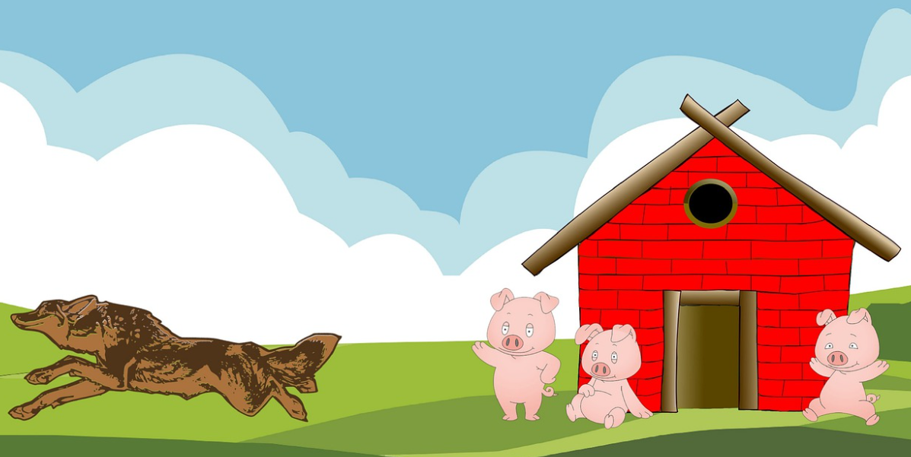
Activity – The Three Little Pigs
On the next slide, listen for evaluative words that help the reader judge or evaluate the characters.
Write down the adjectives that you hear.
Think about how they make you feel about the three little pigs and the big bad wolf.
Source: Pixabay

Slide 13
The Three Little Pigs
Once upon a time there were three lovely, kind and innocent little pigs who set out to build their own houses. The lazy first little pig built his house of straw. The sluggish second little pig built his house of sticks. The clever and proud third little pig built his house of strong bricks. The three content little pigs lived happily until one awful day a horrible, nasty, scary and very hungry big bad wolf came to town…
Source: Pixabay

Slide 14
Possible answers
I heard these adjectives used as evaluative words:
lovely, kind, innocent and little help us judge that the three little pigs are harmless and could be easy victims.
horrible, nasty, scary, hungry, big and bad help us judge that the wolf is a villain.
Once upon a time there were three lovely, kind and innocent little pigs who set out to build their own houses. The lazy first little pig built his house of straw. The sluggish second little pig built his house of sticks. The clever and proud third little pig built his house of strong bricks. The three content little pigs lived happily until one awful day a horrible, nasty, scary and very hungry big bad wolf came to town…

Slide 15
Add evaluative words
Add evaluative adjectives to the sentence below to make the reader think about the wolf in a negative way.
The ________ , ________ wolf chased the pigs.
Source: Pixabay

Slide 16
I added
I added the adjectives awful and mean to the noun 'wolf' to make the reader think of the wolf in a negative way.
The awful, mean wolf chased the pigs.
Source: Pixabay

Slide 17
Add evaluative words
Add evaluative adjectives to the sentence below to make the reader think of the three pigs in a positive way.
The wolf chased the ______ ,______ pigs.
Source: Pixabay

Slide 18
I added
I added the adjectives kind and friendly to the noun 'pig' to make the reader think of the three pigs in a positive way.
The wolf chased the kind, friendly pigs.
Source: Pixabay

Slide 19
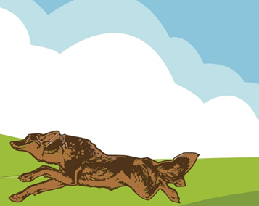
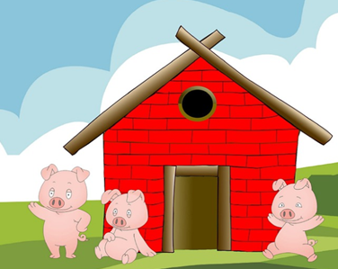
Write down as many evaluative words that you can think of to describe the:
Big bad wolf
Three little pigs
Source: Pixabay
Source: Pixabay

Slide 20
Possible evaluative words
Big bad wolf
cunning
ferocious
sly
fierce
cruel
vicious
Three little pigs
nice
happy
cheery
trusting
young
smart

Slide 21
Time to write
Write a short letter to the big bad wolf persuading him to leave the little pigs alone using:
evaluative adjectives such as amazing, interesting and kind.
modal verbs such as should, must, could, may, can and will.
modal adverbs such as certainly, possibly and maybe.
Example
Dear Big Bad Wolf,
We are extremely concerned about your recent terrible behaviour that is definitely making the lovely three little pigs feel scared. You certainly must stop, as the way you are acting is mean, nasty and threatening. We believe that if you possibly can change, you might just become a caring and kind wolf.
Kind regards

Slide 22
Reflection
Evaluative words help to show a judgement, opinion or point of view about a person, character, place or thing.
Evaluative words can be adjectives, verbs or adverbs.
Evaluative language can be positive or negative.
We can use evaluative words to make our writing more persuasive.

Slide 23
Daily reading routine
Choose something to read.
Find a quiet, comfortable space to read.
Read for 15 to 20 minutes.
Have a chat about what you read with someone else.

