Slide 1
Year 3
English
Lesson 9 – evaluative language in narratives

Slide 3
You will need
A pencil and paper.

Slide 4
Learning intention
To understand how evaluative language can be used to persuade readers to make judgements in narratives.

Slide 5
Let’s remember – evaluative language
Evaluative language can express a judgement, opinion or point of view about a person, character, place or thing.
Adjectives, modal verbs and modal adverbs can be carefully chosen to persuade.

Slide 6
Let’s remember – adjectives
Adjectives are words that describe a noun (person, place or thing).
Some examples:
big bad wolf
scared little pig
strong house.

Slide 7
Let’s remember – verbs
A verb is a word that can tell us what is happening or what something is or has.

Slide 8
Let’s remember – 4 types of verbs
action
The wolf huffed and puffed.
“Let me in!” shouted the wolf.
He decided to build a brick house.
The wolf was hungry.
saying
thinking
relating

Slide 9
Let’s remember – modal adverbs
Modal adverbs can be added to verbs to express low, medium or high modality.
All the pigs should build brick houses.
All the pigs definitely should build brick houses.

Slide 10
Listen for evaluative language in the story.
Source: The three little wolves and the big bad pig – picture book read aloud on YouTube (Storytime with Shayne, 2022)
For your safety, watch this video in the slideshow without accessing YouTube.

Slide 11
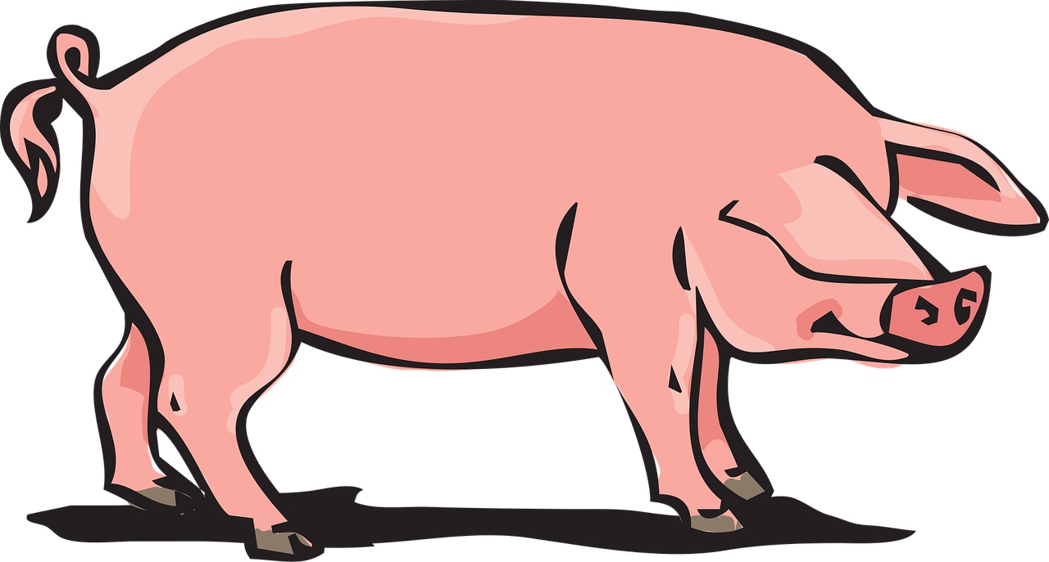
A message
This story persuades us to agree that it is better to be kind and friendly than mean and nasty.
It also persuades us to believe that people can change for the better when they see things differently.
Source: Pixabay

Slide 12
Verb types – examples from the story
action
I’ll blow your house down.
“Please will you give us some bricks?” asked the wolves.
“Certainly,” said the kangaroo.
They saw the big bad pig.
He realised how horrible he had been.
There were three little wolves. The first was black.
saying
thinking
relating

Slide 13
Activity – sort the verbs from the story
grunted | decided | fetched
saw | said | asked
shouted | had | smelled
was | realised | were
be | smashed | knocked
action
saying
thinking
relating

Slide 14
Answers
fetched smashed knocked | shouted said asked grunted | decided realised smelled saw | was be had were
action
saying
thinking
relating

Slide 15
Modal verbs – examples from the story
"Don't worry, Mother we will watch out for him."
"By the hair on our chinny-chin-chins, we will not let you in.”
"We shall have to build a stronger house.”
In these sentences, the modal verbs express high modality.

Slide 16
Modal adverbs – examples from the story
It was the strongest, securest house one could possibly imagine.
They felt very relaxed and absolutely safe.
But soon they realised that the pig had truly changed.
In these sentences the modal adverbs express high modality.

Slide 17
Activity
Imagine if the three little wolves were not convinced that the big bad pig had truly changed.
To show this, choose a low modality adverb to replace ‘truly’ in this sentence:
But soon they realised that the pig had truly changed’.

Slide 18
Possible answers
But soon they realised that the pig had somewhat changed.
But soon they realised that the pig had possibly changed.
But soon they realised that the pig had slightly changed.

Slide 19
Adjectives – examples from the story:
big bad pig
three cuddly little wolves
little frightened wolves
a stronger house
heavy metal padlocks
generous kind-hearted rhinoceros.

Slide 20
Time to write – choose your own adjectives
The ________ smell of the flowers made him realise that he had been a ________ , ________ pig for most of his life. Somehow, the smell of the ________ flowers made him realise that he was missing out on having ________ times with his new friends, the ________ , ________ wolves.
This text is an adaption from The Three Little Wolves and the Big Bad Pig (Trivizas, 1997).

Slide 21
An example – choose your own adjectives
The _lovely_ smell of the flowers made him realise that he had been a _frightful_ , _nasty_ pig for most of his life. Somehow, the smell of the _delicate_ flowers made him realise that he was missing out on having __fun_ times with his new friends, the _kind_ , _gentle_ wolves.
This text is an adaption from The Three Little Wolves and the Big Bad Pig (Trivizas, 1997).

Slide 22
Now it’s your turn.
The ________ smell of the flowers made him realise that he had been a ________ , ________ pig for most of his life. Somehow, the smell of the ________ flowers made him realise that he was missing out on having ________ times with his new friends, the ________ , ________ wolves.
This text is an adaption from The Three Little Wolves and the Big Bad Pig (Trivizas, 1997).

Slide 23
Reflection
Evaluative language can be used to persuade readers to make judgements about characters and actions in narratives.
Adjectives, modal verbs and modal adverbs can be carefully chosen to persuade.

Slide 24
Daily reading routine
Choose something to read.
Find a quiet, comfortable space to read.
Read for 15 to 20 minutes.
Have a chat about what you read with someone else.

