Slide 1
Year 5 English
.
Examining media texts
Lesson 2 – examine feature and news articles

Slide 3
Get ready
.
You will need:
pen or pencil
paper or a notebook
or a digital device
notes from Lesson 1.
© Department for Education, the Government of South Australia, Learning at home, 2022

Slide 4
Review – how did you go?
.
Feature articles
News articles
have a point of view to persuade the reader
are longer than news articles
include more detail and explanations about any facts used
are written any time after an event.
focus on facts
tell what the main news and facts are early in the article
use a simple structure
are written straight after an event.
Similarities
both have a heading, paragraphs and images
both can include facts.
© Department for Education, the Government of South Australia, Learning at home, 2022

Slide 5
Learning intention
.
To understand how media texts manipulate an audience and can present points of view.
© Department for Education, the Government of South Australia, Learning at home, 2022

Slide 6
Vocabulary
Word | Definition
Manipulate | To change a reader’s point of view by including language and structural features and evidence to persuade.
Point of view | An opinion or an attitude.
Structural features | How an article is structured using features such as headings, paragraphs, sentences and images.
© Department for Education, the Government of South Australia, Learning at home, 2022

Slide 7
Vocabulary continued
.
Word | Definition
Evidence | Details used to support a point of view such as an expert’s comments or facts.
Language features | Features of language that support meaning such as expanded noun groups and emotive language.
© Department for Education, the Government of South Australia, Learning at home, 2022

Slide 8
Manipulating point of view
Authors of media texts can manipulate our point of view. This means influencing the way we think or feel about a topic.
Our point of view can be manipulated through different media texts. Media texts can include:
radio
television
texts on the internet
posters
feature articles
news articles.
© Department for Education, the Government of South Australia, Learning at home, 2022

Slide 9
Manipulating point of view continued
Sometimes authors can even make us change our point of view about a topic. They can do this by using:
language features such as emotive language
structural features including headings, conclusions and images
evidence to support their point of view such as an expert’s comments or facts.
© Department for Education, the Government of South Australia, Learning at home, 2022

Slide 10
Manipulating point of view continued
Two authors can write about the same topic but create a very different effect on the reader or viewer because of the different language, images and structure they use.
Look at the examples on the following slide…
© Department for Education, the Government of South Australia, Learning at home, 2022

Slide 11
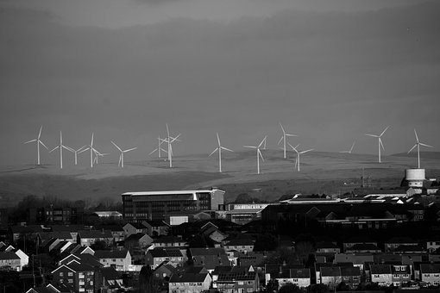
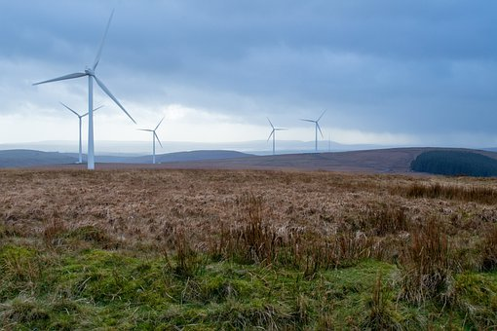
Two different points of view
Maureen
‘Many, ugly and noisy wind farms are spoiling our precious and beautiful South Australian coastline.’
Source: Pixabay.com
Arthur
‘Wind farms are a vital energy resource that allow us
to build for a sustainable future, using our natural environment.’
Source: Pixabay.com
© Department for Education, the Government of South Australia, Learning at home, 2022

Slide 12
Your turn
On paper or a device, record your answers for the following two questions.
What is Maureen’s
point of view on
wind farms and how have you come to this
conclusion?
What is Arthur’s
point of view on
wind farms and how have you come to this
conclusion?
© Department for Education, the Government of South Australia, Learning at home, 2022

Slide 13
How did you go?
Maureen’s point of view on wind farms is negative. The image and emotive language choices such as the words, ugly, noisy and spoiling is evidence of this. The positive words such as precious and beautiful persuade the reader that the coastline is worth protecting.
Maureen
‘Many, ugly and noisy wind farms spoiling our precious and beautiful South Australian coastline.’
Source: Pixabay.com
Arthur’s point of view on wind farms is positive. He uses a brighter image and the word vital which builds a sense of urgency and to persuade the reader to agree with him. He also states a positive long term purpose of wind farms.
Arthur
‘Wind farms are a vital energy resource that allow us to build for a sustainable future, using our natural environment.’
Source: Pixabay.com
© Department for Education, the Government of South Australia, Learning at home, 2022

Slide 14
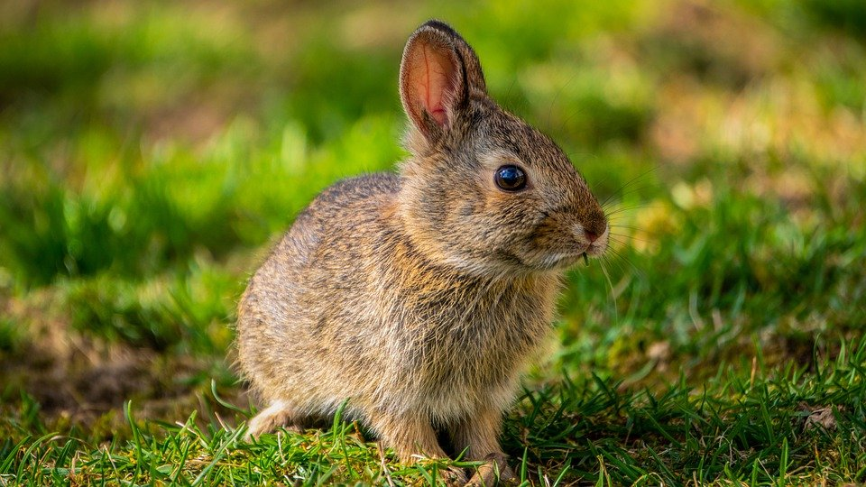
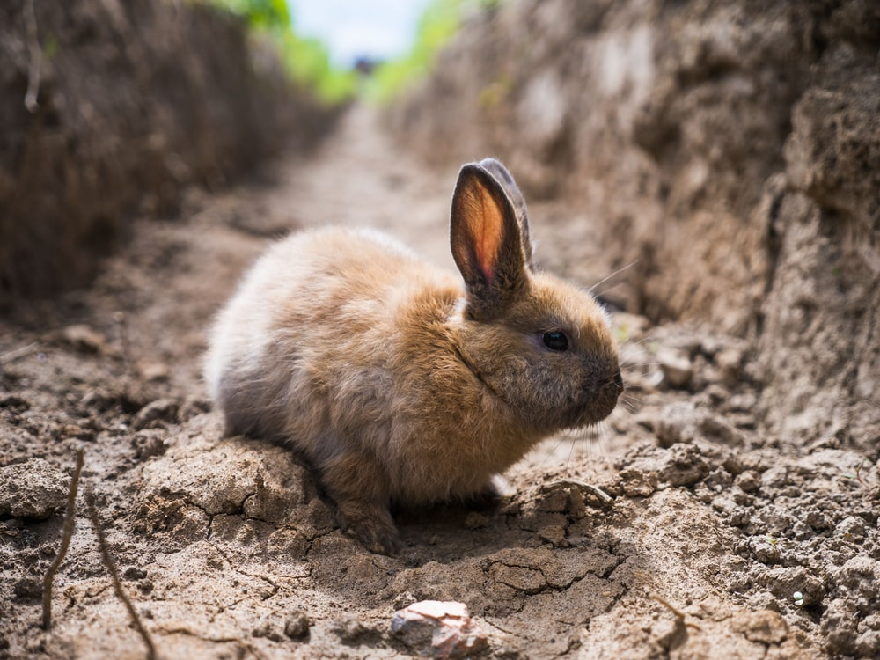
Two different points of view
Jane
‘Sadly, many tiny, defenceless rabbits have been removed by a cruel and heartless council.’
Source: Pixabay.com
John
‘The local council recently carried out a rabbit removal program to avoid environmental problems caused by an overpopulation of rabbits.’
Source: Unsplash.com
© Department for Education, the Government of South Australia, Learning at home, 2022

Slide 15
Your turn
On paper or a device, record your answers for the following two questions.
What is Jane’s point of view on the council removing the rabbits
and how have you come to this
conclusion?
What is John’s point of view on the council removing the rabbits
and how have you come to this
conclusion?
© Department for Education, the Government of South Australia, Learning at home, 2022

Slide 16
How did you go?
Jane’s point of view on the council removing the rabbits is negative. The image and highly emotive language such as the words, sadly, many tiny, defenceless and cruel and heartless tell the reader of Jane’s point of view.
Jane
‘Sadly, many tiny, defenceless rabbits have been
removed by a cruel and heartless council.’
Source:Pixabay.com
John’s point of view on the council removing the rabbits is positive. He uses an image showing their destruction and gives a reason why they need to be removed. He uses more evidence based language rather than emotive language.
John
‘The local council recently carried out a rabbit removal program to avoid environmental problems caused by an overpopulation of rabbits.’
Source: unsplash.com
© Department for Education, the Government of South Australia, Learning at home, 2022

Slide 17
Presenting a point of view
.
Identify evidence in the excerpt from the feature article ‘Should every classroom have a pet?’ for presenting a point of view.
Find at least one example for each of the following:
language features such as emotive language
structural features, such as headings and images
evidence to support the author’s point of view.
On paper or a device record your findings.
© Department for Education, the Government of South Australia, Learning at home, 2022

Slide 18
Should every classroom have a pet?
An award-winning Porcelain Bantam hen named Ice Cream has a very important job.
The speckled grey hen is part of a special needs classroom giving some clucky encouragement to the students. Year 2 teacher Candace Fitzgerald said Ice Cream has made a huge difference to her class.
‘They regularly put Ice Cream in the middle of their group of friends and actively show her their work, or whisper secrets to her, or wake her up to partake in an educational video,’ Ms Fitzgerald said.
‘She is a very resilient chicken and has plenty of patience when working within the class.’
Source: https://www.abc.net.au
© Department for Education, the Government of South Australia, Learning at home, 2022

Slide 19
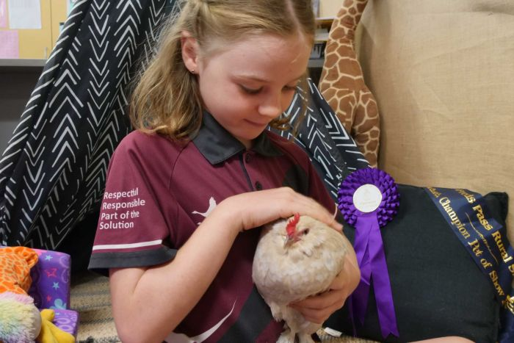
Should every classroom have a pet? continued
Source: https://www.abc.net.au
Cream's owner and trainer Pam Barrett says the Porcelain Bantam is a prize favourite at local agricultural shows.
Senior Scientific Officer at RSPCA Australia, Dr Sarah Zito said it's important for children to interact with animals.
‘If it is not possible for a family to have pets then it might be possible for children to still be able to interact with animals volunteering with a shelter or a welfare organisation,’ she said.
Source: https://www.abc.net.au
© Department for Education, the Government of South Australia, Learning at home, 2022

Slide 20
How did you go?
Language feature – A pun (play on words) creates humour and grabs the reader’s attention.
Language feature – language that describes the quality of Ice Cream and the importance of her job.
An award-winning Porcelain Bantam hen named Ice Cream has a very important job. ​
The speckled grey hen is part of a special needs classroom giving some clucky encouragement to the students. ​
Year 2 teacher Candace Fitzgerald said Ice Cream has made a huge difference to her class. ​
‘They regularly put Ice Cream in the middle of their group of friends and actively show her their work, or whisper secrets to her, or wake her up to partake in an educational video,’ Ms Fitzgerald said. ​
‘She is a very resilient chicken and has plenty of patience when working within the class.’ ​
Evidence of a point of view/opinion that helps to persuade the reader that class pets are beneficial.
Further evidence of the teacher’s point of view that helps to persuade.
© Department for Education, the Government of South Australia, Learning at home, 2022

Slide 21
How did you go? continued
Structural features - This article is written in paragraphs with a variety of sentence types.
An image to support the author’s point of view . This helps to manipulate the reader’s opinion.
Source: https://www.abc.net.au
Cream's owner and trainer Pam Barrett says the Porcelain Bantam is a prize favourite at local agricultural shows.
Senior Scientific Officer at RSPCA Australia, Dr Sarah Zito said it's important for children to interact with animals.
‘If it is not possible for a family to have pets then it might be possible for children to still be able to interact with animals volunteering with a shelter or a welfare organisation,’ she said.
Evidence of an expert supporting the author’s point of view to build credibility.
© Department for Education, the Government of South Australia, Learning at home, 2022

Slide 22
Your turn – true or false
The text, ‘Should every classroom have a pet?’ is a feature article because
it presents a point of view about a topic
it is written to persuade the reader
it is not a news article.
True
False
Click on a card to show the answer. Were you correct?
© Department for Education, the Government of South Australia, Learning at home, 2022

Slide 23
Your turn This is your take away task to do independently.
What is your point of view in relation to the topic, ‘ Should every classroom have a pet?’
On paper or a device, record your thinking.
© Department for Education, the Government of South Australia, Learning at home, 2022

Slide 24
Daily reading routine
.
Choose something to read.​
Find a quiet, comfortable space to read.​
Read for 15 to 20 minutes.​
Have a chat about what you read with someone else.
© Department for Education, the Government of South Australia, Learning at home, 2022

Slide 25
.

Slide 26
© Department for Education, the Government of South Australia, Learning at home, 2022

