Slide 1
Year 5 English
.
Examining media texts
Lesson 3 – exploring language used to persuade

Slide 3
Get ready
.
You will need:
pen or pencil
paper or a notebook
or a digital device
notes from lesson 2.
© Department for Education, the Government of South Australia, Learning at home, 2022

Slide 4
Review
.
I think it's really important for every classroom to have a pet because of the many benefits they bring such as helping to calm everyone.
Experts say that children are happier with pets and that they teach them to be responsible.
A class pet would help me to get to school on time because I would be rushing to see it and to cuddle it especially if it was a chicken, rabbit, puppy or a kitten.
© Department for Education, the Government of South Australia, Learning at home, 2022

Slide 5
Review continued
It could help me to read and write better too because I could write stories about it and then I could read my stories to it. My reading and writing would definitely improve with this type of practise.
The class pet could enjoy outside time with my teacher when she's on duty. This would really help to make her feel calm before the next lesson.
Due to the many benefits of having pets, every classroom should have one.
© Department for Education, the Government of South Australia, Learning at home, 2022

Slide 6
Learning intention
.
To understand how language is used to persuade.
© Department for Education, the Government of South Australia, Learning at home, 2022

Slide 7
Vocabulary
.
Word | Definition
Emotive language | Emotive language is language that creates an emotional response in the reader. For example, using words such as precious or ferociously.
Language features | Features of language that support meaning such as expanded noun groups and emotive language.
Noun group | A noun group is a group of words relating to, or building on, a noun. It is a type of language feature.
© Department for Education, the Government of South Australia, Learning at home, 2022

Slide 8
Vocabulary
.
Word | Definition
Persuade | To influence the way we think or feel about a topic with the aim to have the reader agree with the author’s point of view.
Point of view | An opinion or an attitude.
Verb group | A verb group is a group of words relating to, or building on, a verb. It is a type of language feature.
© Department for Education, the Government of South Australia, Learning at home, 2022

Slide 9
Language used in a feature article to persuade
.
The text, Should every classroom have a pet? is a feature article that includes language features to persuade.
Author’s use the following language and structural features to persuade:
noun groups
precise use of verbs
emotive language.
© Department for Education, the Government of South Australia, Learning at home, 2022

Slide 10
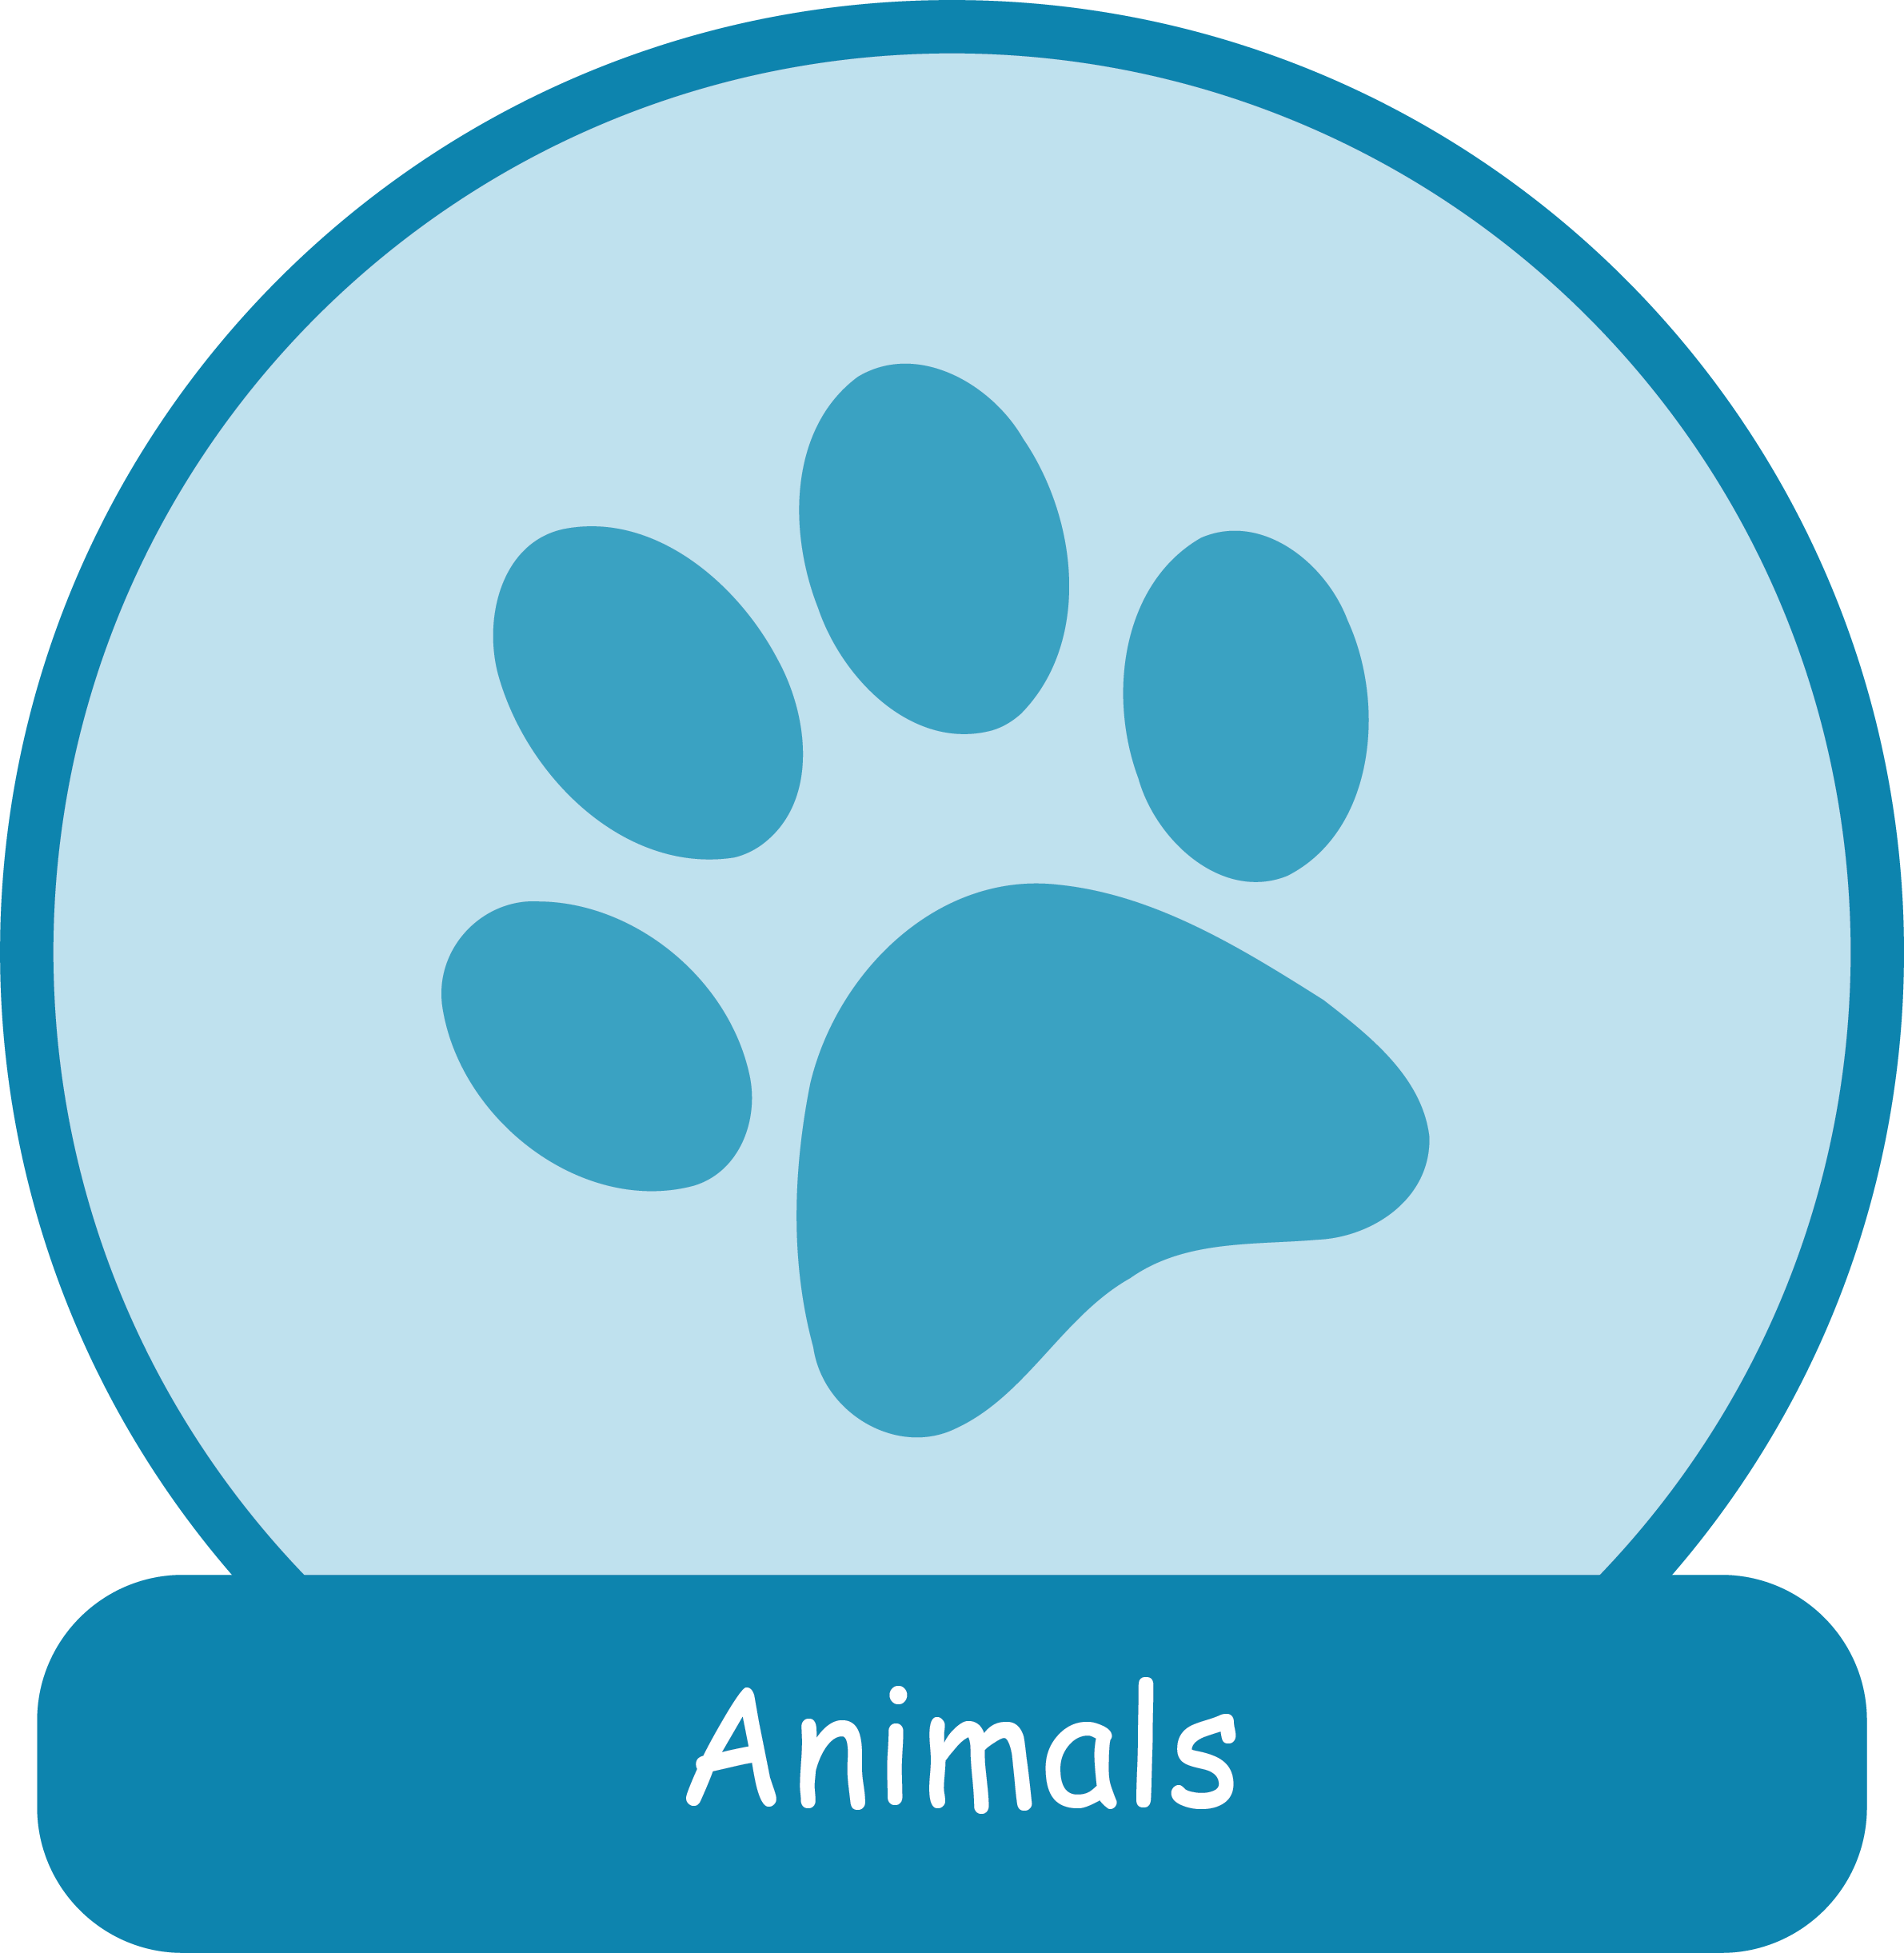
Noun groups
A noun group is a group of words that contain a main or head noun. The other words in the group tell us more about the noun.
Noun groups can be used to provide more information about:
people and characters
animals
places
things, including ideas.
Images source: Department for Education, the Government of South Australia
© Department for Education, the Government of South Australia, Learning at home, 2022

Slide 11
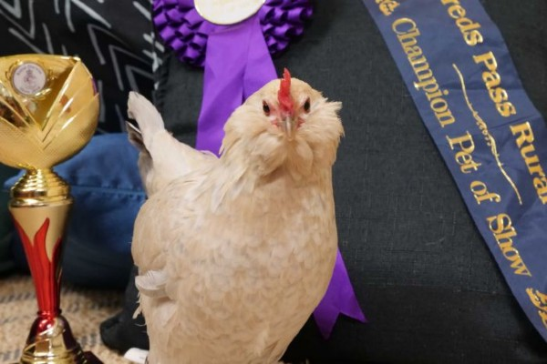
Noun groups
Noun groups can be simple:
a hen
Detail can be added to describe and expand the noun group:
a very soft, white hen named Ice cream
Source: ABC News: Gabrielle Lyons
© Department for Education, the Government of South Australia, Learning at home, 2022

Slide 12
Understanding and building noun groups
Noun groups can be short or long. Noun groups can be organised by different categories. There can more than one noun group in the same sentence.
Pointer or determiner | Counter or numerative | Intensifier | Describers | Classifiers | Noun (the head noun) | Qualifier
What the noun refers to. For example: the, a, an, this, those, its, their. | How many? For example: many, some, eight, one, several, a few. | To what degree? For example: really, largely, quite, rather, very. | What is it like? For example: small, fierce, popular, strong, intelligent, blue. No more than 3 describers used in a sentence. | What type? For example: nocturnal, female, Australian. | It can be human or not human. For example: who or what is being described? | It presents more information about the noun. For example: with bright feathers
a |  | very | soft, white |  | hen | named Ice cream
© Department for Education, the Government of South Australia, Learning at home, 2022

Slide 13
Your turn
Create your own noun group table. Create a noun group example or find an example from the feature article excerpt on the next slide that includes emotive language and add it to this chart.
Pointer or determiner | Counter or numerative | Intensifier | Describers | Classifiers | Noun (the head noun) | Qualifier
a |  |  | huge |  | difference
the | three | really | enormous, fluffy | bantam | hens | made us laugh
On paper or a device, record your noun group.
© Department for Education, the Government of South Australia, Learning at home, 2022

Slide 14
Should every classroom have a pet? excerpt
An award-winning Porcelain Bantam hen named Ice Cream has a very important job.
The speckled grey hen is part of a special needs classroom giving some clucky encouragement to the students. Year 2 teacher Candace Fitzgerald said Ice Cream has made a huge difference to her class.
‘She is a very resilient chicken and has plenty of patience when working within the class.’
Source: https://www.abc.net.au
© Department for Education, the Government of South Australia, Learning at home, 2022

Slide 15
Your turn
In bold at the bottom of the chart is an example of a noun group with emotive language. This example came from the feature article slide. The words very and resilient support the point of view that Ice Cream the chicken has special qualities that make her a good class pet.
Pointer or determiner | Counter or numerative | Intensifier | Describers | Classifiers | Noun (the head noun) | Qualifier
a |  |  | huge |  | difference
the | three | really | enormous, fluffy | bantam | hens | made us laugh
a |  | very | resilient |  | chicken
© Department for Education, the Government of South Australia, Learning at home, 2022

Slide 16
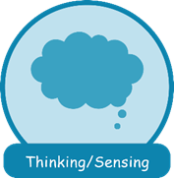
Verbs and verb groups
Verbs and verb groups can help us build understanding of how characters are developed by revealing the precise ways that characters are saying, thinking, doing and how they are relating. For example, slowing and working.
Images source: Department for Education, the Government of South Australia
© Department for Education, the Government of South Australia, Learning at home, 2022

Slide 17
Verb groups
Verb groups can have auxiliary verbs that help create the tense of writing:
is going
had jumped
was watching.
Modal verbs help express degree of certainty:
very resilient
plenty of patience.
The choice of verbs help to develop a point of view to persuade such as gently, ferociously, urgently or very.
© Department for Education, the Government of South Australia, Learning at home, 2022

Slide 18
Your turn – verbs to persuade
Identify the verbs in each sentence and the words around them that help to persuade that every classroom should have a pet.
On paper or a device, record your answers.
‘The touch of an animal, feeling how soft they are, slowing down a child’s heart rate helps everyone to relax.’
‘They regularly put Ice Cream the chicken in the middle of their group of friends and actively show her their work.’
The speckled grey hen is part of a special needs classroom giving some clucky encouragement to the students.
© Department for Education, the Government of South Australia, Learning at home, 2022

Slide 19
Your turn
‘The touch of an animal, feeling how soft they are, slowing down a child’s beat rate helps everyone to relax.’
‘They regularly put Ice Cream the chicken in the middle of their group of friends and actively show her their work.’
The speckled grey hen is part of a special needs classroom giving some clucky encouragement to the students.
© Department for Education, the Government of South Australia, Learning at home, 2022

Slide 20
Emotive language to persuade
.
Emotive language is language that creates an emotional response in the reader.
Authors often use emotive language to strengthen their point of view to persuade the reader to agree with them.
Which words, noun groups or verb groups, in the passage on the next slide, are written to create an emotional response?
© Department for Education, the Government of South Australia, Learning at home, 2022

Slide 21
Emotive language to persuade
‘She is a very resilient chicken and has plenty of patience when working within the class.’
‘The touch of an animal, feeling how soft they are, slowing down a child's heart rate, meaning they lose that anxiety and feel more confident in a classroom.’
Source: https://www.abc.net.au
On paper or on a device, record your answers.
© Department for Education, the Government of South Australia, Learning at home, 2022

Slide 22
Emotive language
‘She is a very resilient chicken and has plenty of patience when working within the class.’
‘The touch of an animal, feeling how soft they are, slowing down a child's heart rate, meaning they lose that anxiety and feel more confident in a classroom.’
Source: https://www.abc.net.au
© Department for Education, the Government of South Australia, Learning at home, 2022

Slide 23
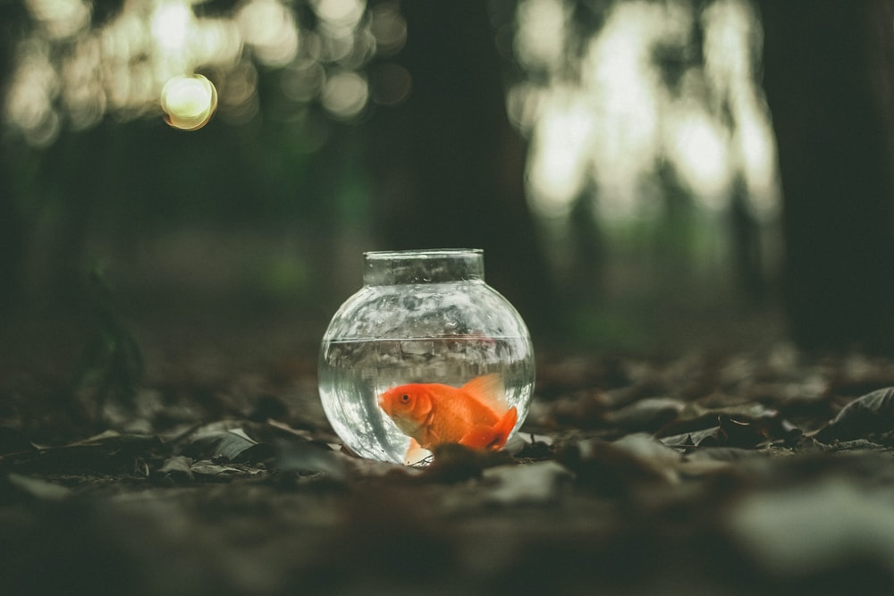
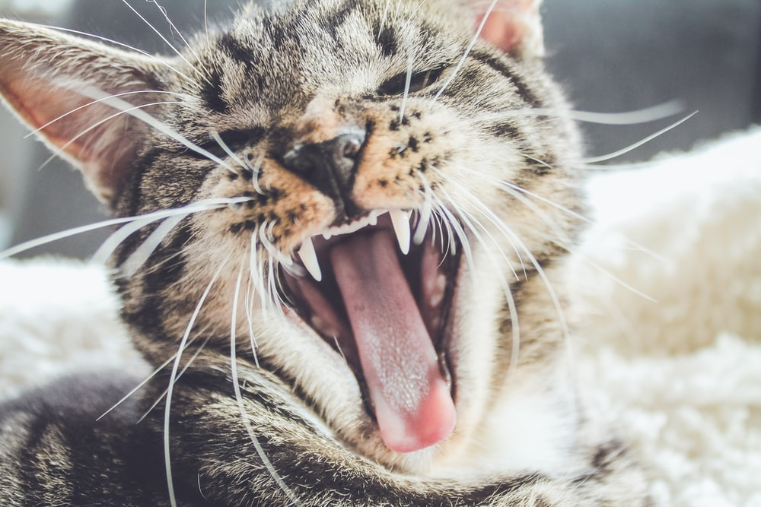
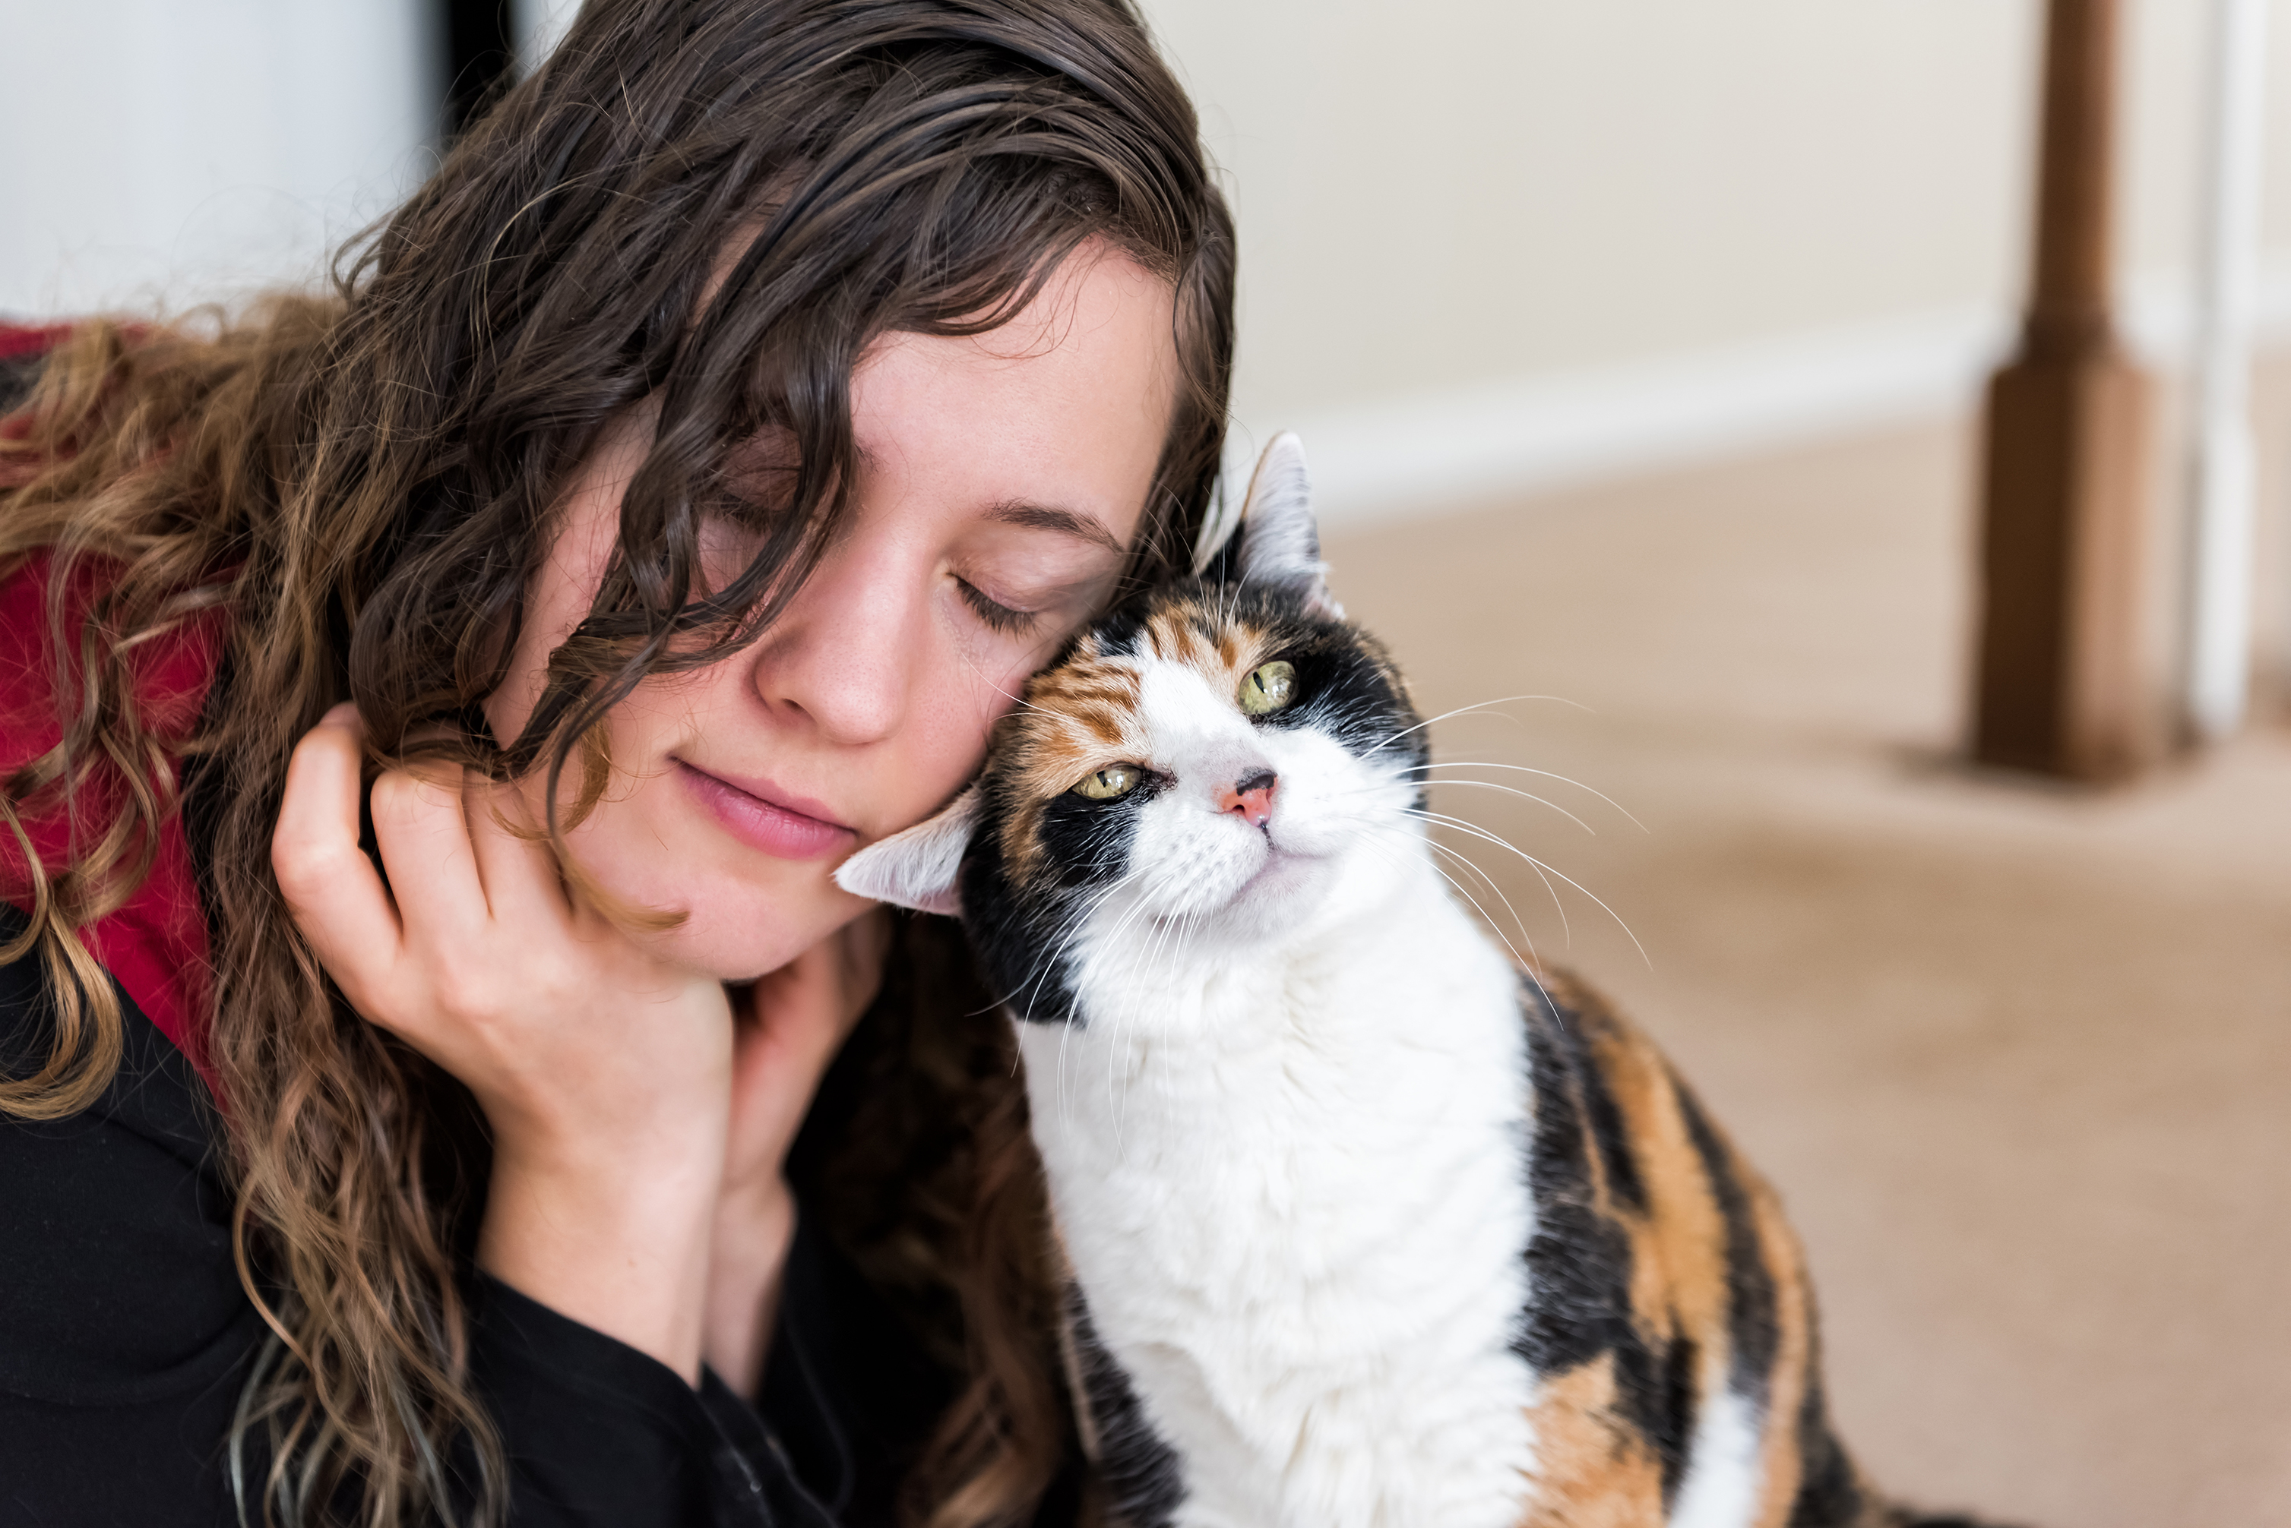
Independent learning – images to persuade
.
Which image or images may persuade you to agree with the point of view: pets make us feel happy?
On paper or a device, record your thinking.
Source: Microsoft PP stock photo
Source: unsplash.com
Source: unsplash.com
Source: Microsoft PP stock photo
© Department for Education, the Government of South Australia, Learning at home, 2022

Slide 24
Daily reading routine
.
Choose something to read.​
Find a quiet, comfortable space to read.​
Read for 15 to 20 minutes.​
Have a chat about what you read with someone else.
© Department for Education, the Government of South Australia, Learning at home, 2022

Slide 25
.

