Slide 1

Year 5 English
.
Examining media texts
Lesson 4 – understanding degrees of formality

Slide 3
Get ready
.
You will need:
pen or pencil
paper or a notebook
or a digital device.
© Department for Education, the Government of South Australia, Learning at home, 2022

Slide 4
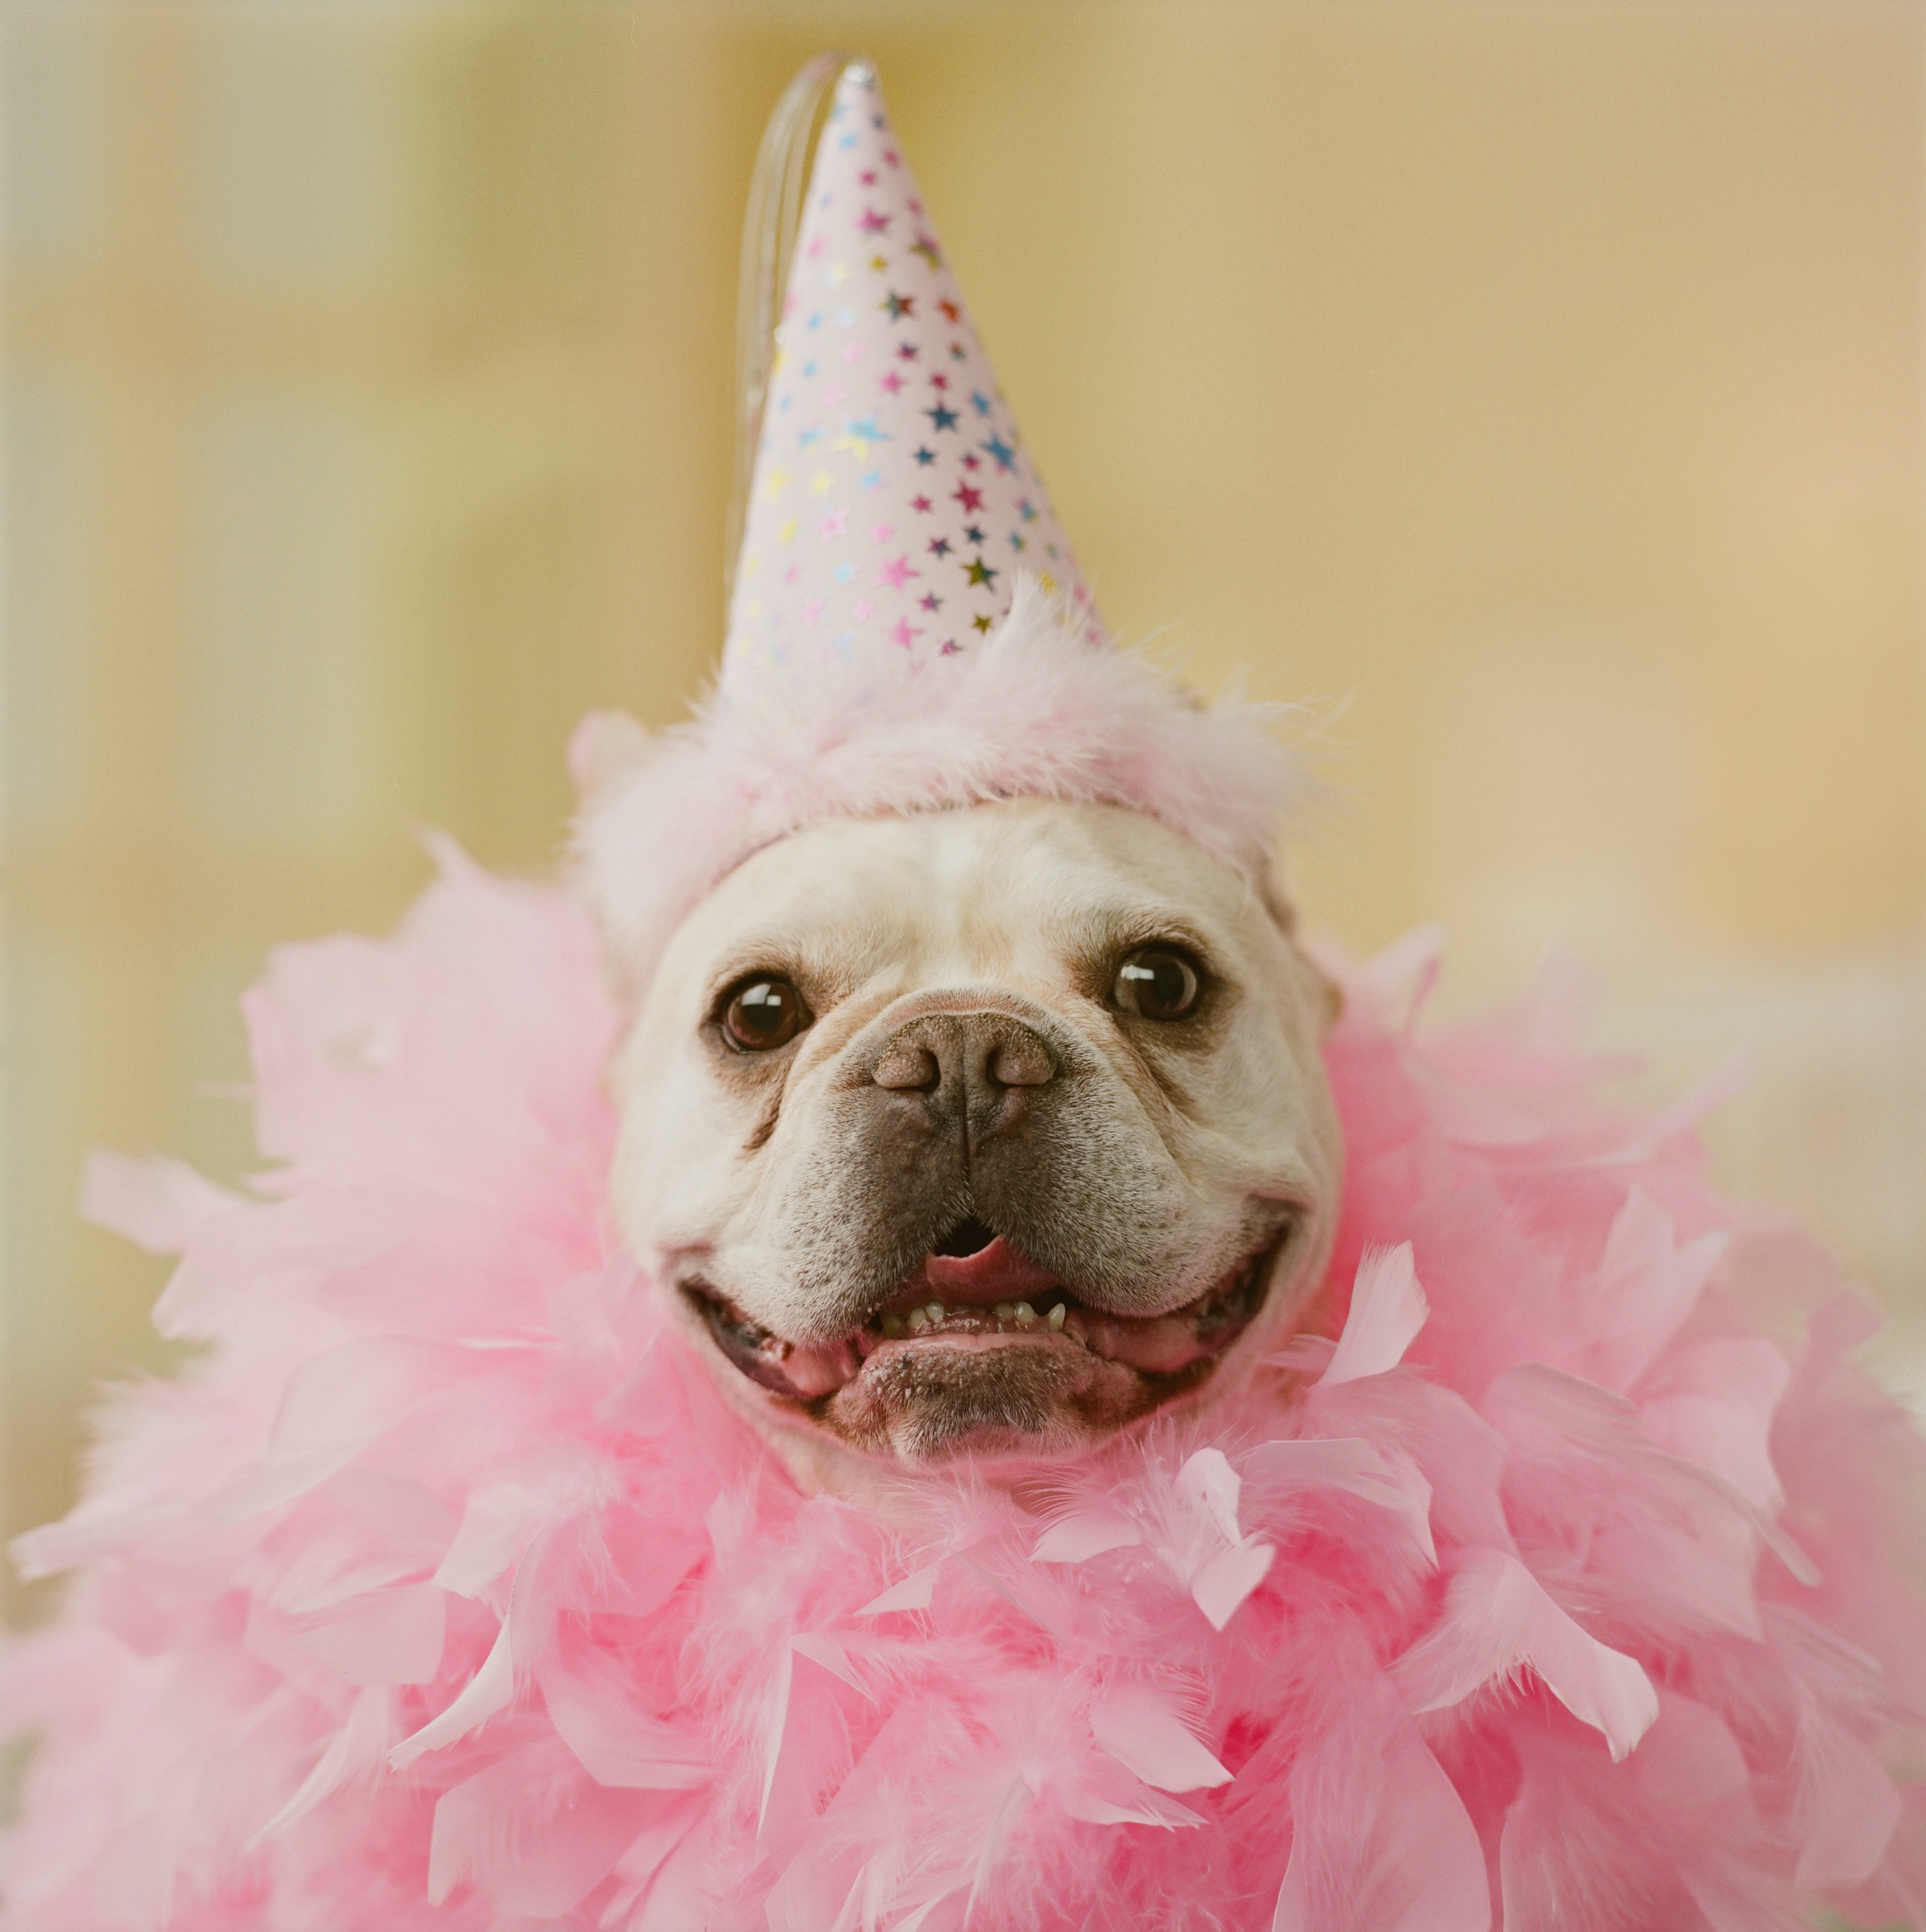
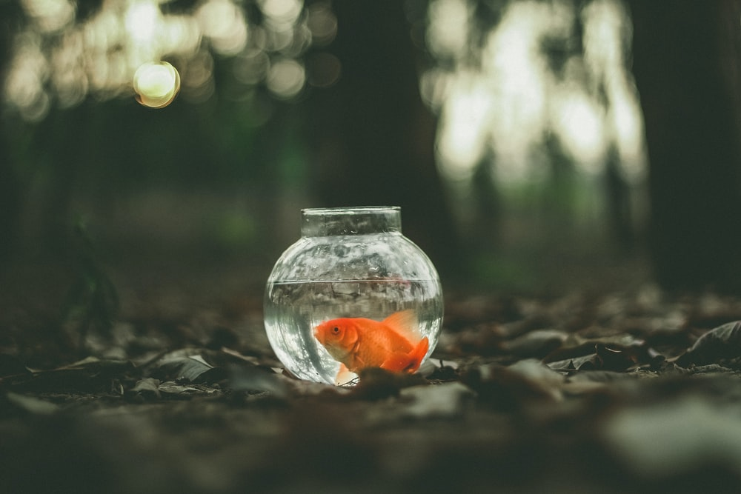
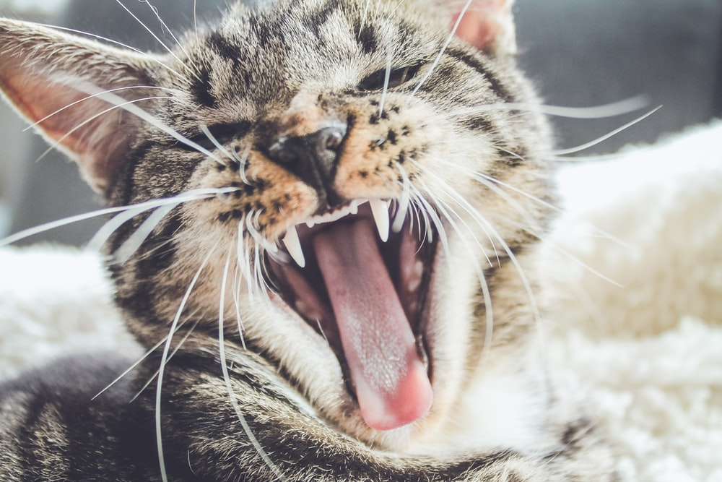
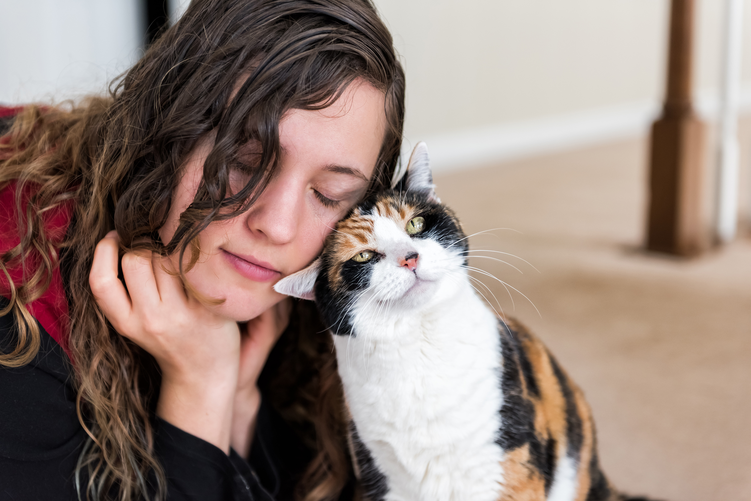
Lesson review
.
Which image or images persuade you to agree with the point of view: pets make us feel happy?
Source: Microsoft PP stock photo
Source: unsplash.com
Source: unsplash.com
Source: Microsoft PP stock photo
© Department for Education, the Government of South Australia, Learning at home, 2022

Slide 5
Lesson review
.
The two images shown on this slide are the ones that persuaded me the most to agree with the point of view:
pets make us feel happy.
The image of the cat and woman makes me feel that she is being comforted by the cat. She looks like she is feeling relaxed and enjoying the affectionate, cute cat making her happy. This makes me happy.
Source: Microsoft PP stock photo
Source: Microsoft PP stock photo
© Department for Education, the Government of South Australia, Learning at home, 2022

Slide 6
Lesson review
The image of the dog in a pink outfit makes me smile. It is humorous and this makes me feel very happy. The bright colours add to this feeling.
I didn’t respond as positively to the other images because I found the fish a bit dull and the other cat looked a bit fierce.
Source: Microsoft PP stock photo
© Department for Education, the Government of South Australia, Learning at home, 2022

Slide 7
Learning intention
.
To identify how types of texts vary in purpose and to understand degrees of formality.
© Department for Education, the Government of South Australia, Learning at home, 2022

Slide 8
Vocabulary
Term | Definition
Formal language | We use formal language in situations that are serious or that involve people we don’t know well. Formal language is more common when we write.
Types of texts | The three main types of texts are imaginative, informative and persuasive and their sub categories.
Informal language | Mainly used between people who know each other well, or in relaxed and unofficial situations. It is more common when we speak and when we write in more casual ways, for example, to entertain.
Purpose | The reason why an author writes in a specific way or about specific things.
© Department for Education, the Government of South Australia, Learning at home, 2022

Slide 9
Types of text – their purpose
Imaginative text | Informative text | Persuasive text
The primary purpose is to entertain, they represent feelings, ideas and mental pictures using words or visual images. | The primary purpose is to provide information and facts. | The primary purpose is to put forward a point of view to persuade the reader.
Types include: traditional tales, poetry, stories, plays | Types include: explanations and descriptions, recounts of events, instructions and directions, rules and laws and news articles. | Types include: advertising, debates, arguments, discussions, influential essays and feature articles.
© Department for Education, the Government of South Australia, Learning at home, 2022

Slide 10
Formal language
Formal language uses correct grammar and more complex vocabulary.
For example: My preferred season is summer. I can spend much of my leisure time swimming.
© Department for Education, the Government of South Australia, Learning at home, 2022

Slide 11
Formal language
Informative texts and persuasive texts use more formal language.
The main purpose of informative texts is to provide information. They are important as a store of knowledge of everyday life.
Informative texts can be broken into sub categories of recount, procedure, report and explanation and include, recounts of events, instructions and directions, rules and laws and news articles.
© Department for Education, the Government of South Australia, Learning at home, 2022

Slide 12
Formal language
The main purpose of a persuasive text is to put forward a point of view and persuade a reader, viewer or listener.
Persuasive texts can be broken into the sub categories of exposition and discussion texts and include advertising, debates, documentaries, arguments, discussions, and feature articles.
© Department for Education, the Government of South Australia, Learning at home, 2022

Slide 13
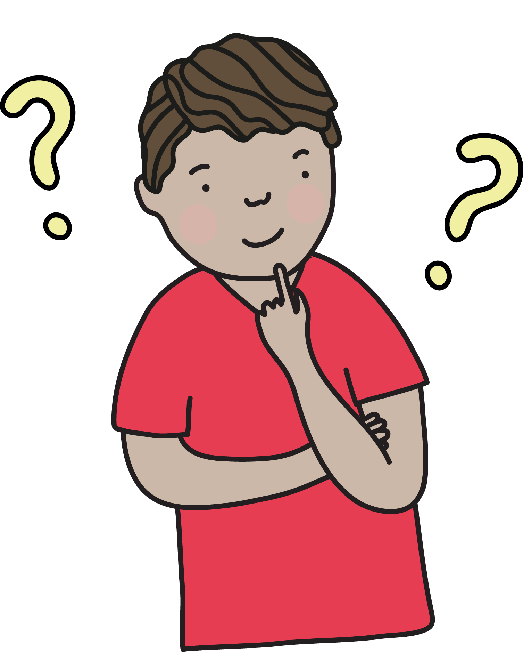
Quiz question
Which uses more formal language?
A fairy tale
Incorrect. A fairy tale is creative and uses informal language.
Correct. A news article uses formal language including current grammar
A news article
Click on the card with your answer. Were you correct?
Source: Department for Education, the Government of South Australia
© Department for Education, the Government of South Australia, Learning at home, 2022

Slide 14
Informal language
Informal language is more relaxed.
For example: I reckon summer is number one! I can muck around in the pool all day!
© Department for Education, the Government of South Australia, Learning at home, 2022

Slide 15
Informal language
Imaginative texts are more likely to have informal language.
Their primary purpose is to entertain through their imaginative use of language and structure. The language used can be creative and can break away from the rules that formal types of texts need to use.
Imaginative texts can be broken into the subcategories of narrative, poetry and drama texts. These include novels, traditional tales, poetry, stories, plays, fiction for young adults and children including picture books and multimodal texts such as film.
© Department for Education, the Government of South Australia, Learning at home, 2022

Slide 16
Quiz question
Which uses more informal language?
Correct. A fantasy story can be creative and not follow formal rules.
A fantasy story
Incorrect. A scientific report is written in a formal and specific way.
A scientific report
Click on the card with your answer. Were you correct?
Source: Department for Education, the Government of South Australia
© Department for Education, the Government of South Australia, Learning at home, 2022

Slide 17
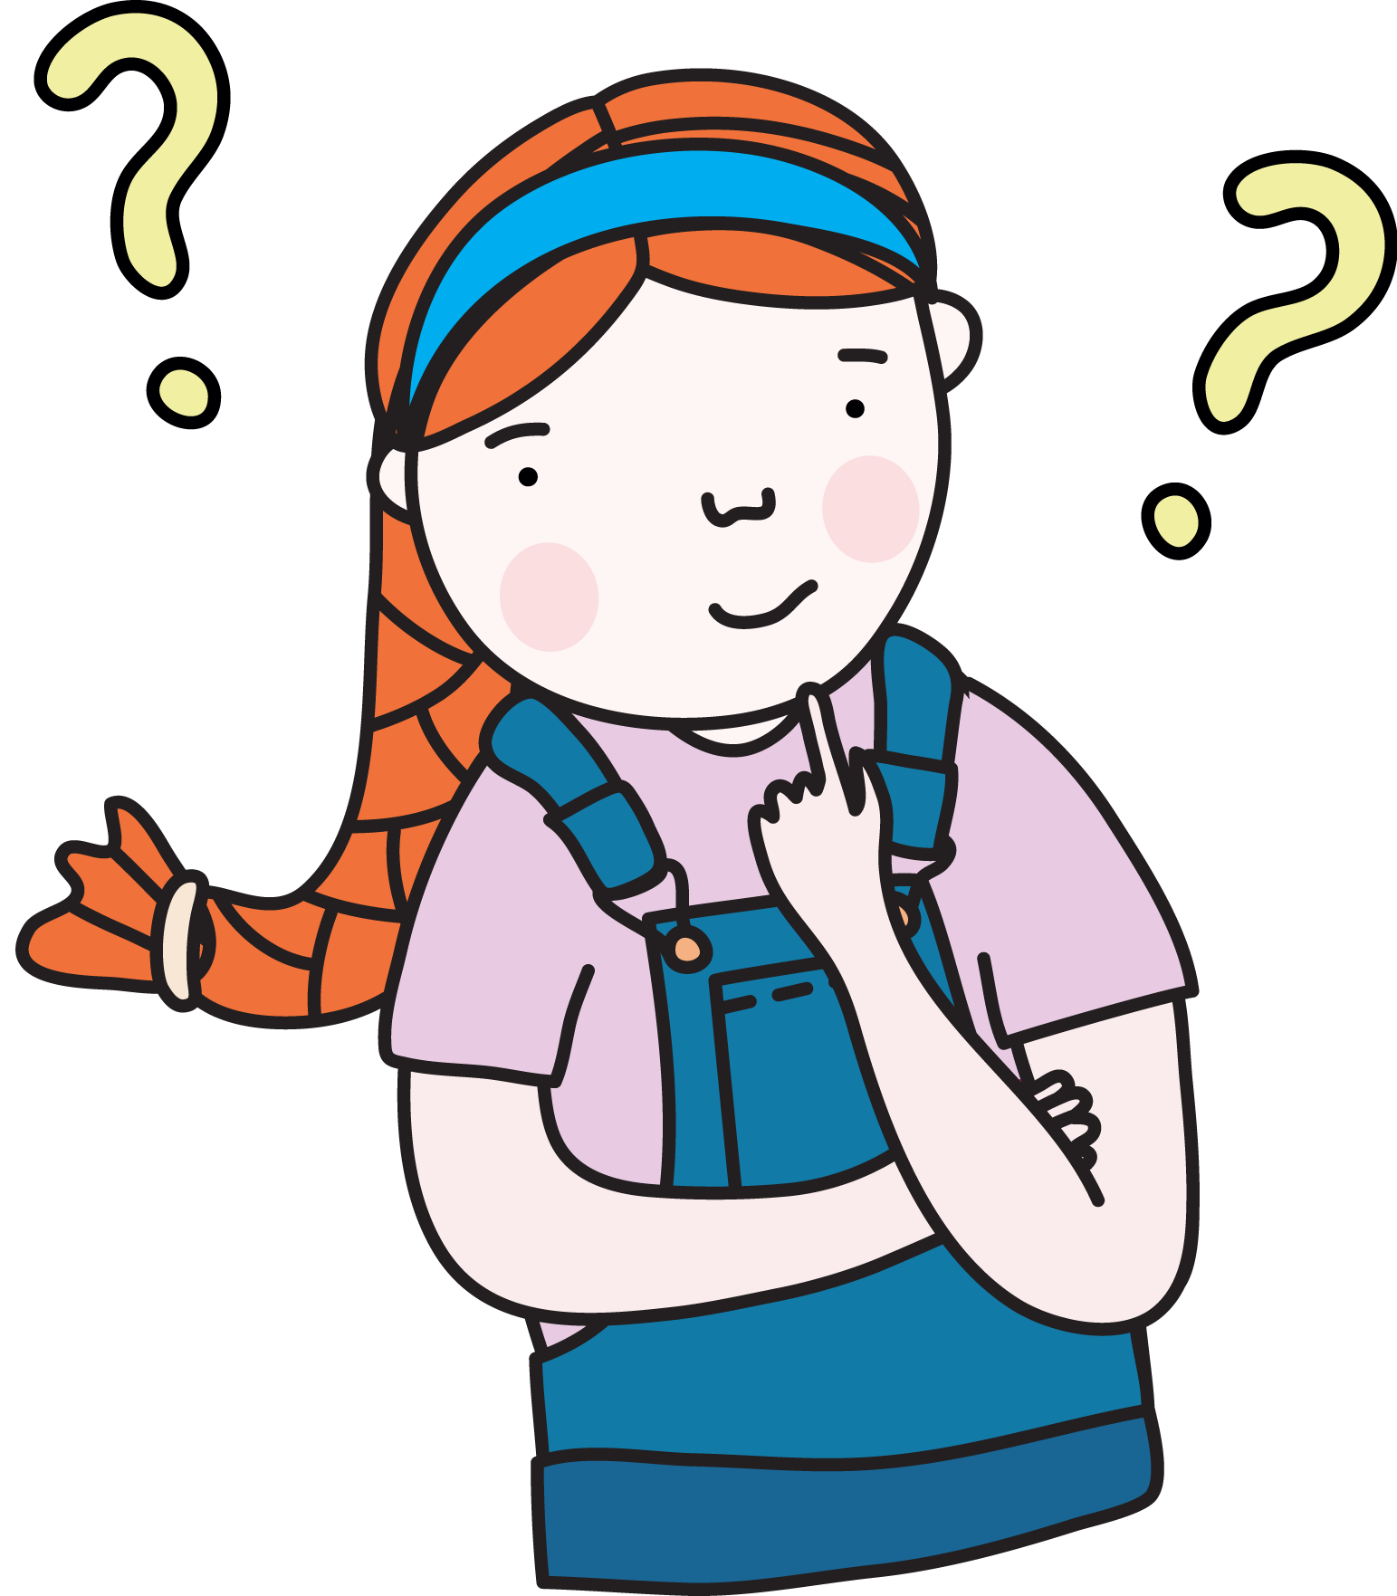
Review
Would you use formal or informal language when writing a letter to the principal of your school?
Formal language
Informal language
Correct. Language between a student and a principal is usually formal.
Incorrect. Language between a student and principal is usually formal.
Click on the card with your answer. Were you correct?
Source: Department for Education, the Government of South Australia
© Department for Education, the Government of South Australia, Learning at home, 2022

Slide 18
Review
Would you use formal or informal language when writing a text message or an email to a friend?
Formal language
Informal language
Incorrect. Language between friends is usually informal.
Correct. Informal language is common between friends.
Click on the card with your answer. Were you correct?
Source: Department for Education, the Government of South Australia
© Department for Education, the Government of South Australia, Learning at home, 2022

Slide 19
Degrees of formality
.
What do you think 'degrees of formality' could mean?
On paper or a device, record your thinking.
© Department for Education, the Government of South Australia, Learning at home, 2022

Slide 20
Degrees of formality
.
Degrees of formality refers to how informal or formal language is.
When language is written in a more ‘spoken-like’, casual way, it can be described as informal. When language is written in a more non ‘spoken-like’ way it can be described as formal.
How informal or formal the language is depends on the audience and purpose for the writing. This determines the degree of formality.
© Department for Education, the Government of South Australia, Learning at home, 2022

Slide 21
Degrees of formality review
To review – The 'degrees of formality' is guided by who the text is created for, the audience, and the author’s purpose, for example, to either entertain, inform or persuade.
When writing (and speaking) it’s important to choose words which suit your audience and purpose.
Language choices such as grammar and vocabulary are affected by how formal or informal the relationship is between the author or performer and the audience.
© Department for Education, the Government of South Australia, Learning at home, 2022

Slide 22
Independent task
Reflect and update the answer you gave for the earlier question:
What do you think 'degrees of formality' could mean?
On paper or a device, record your new thinking.

Slide 23

Daily reading routine
.
Choose something to read.​
Find a quiet, comfortable space to read.​
Read for 15 to 20 minutes.​
Have a chat about what you read with someone else.
© Department for Education, the Government of South Australia, Learning at home, 2022

Slide 24
.

