Slide 1
Year 5 English
.
Examining media texts
Lesson 5 – deepening understanding of degrees of formality

Slide 3
Get ready
.
You will need:
pen or pencil
paper or a notebook
or a digital device
notes from lesson 4.
© Department for Education, the Government of South Australia, Learning at home, 2022

Slide 4
Review
To review – The 'degrees of formality' is guided by who the text is created for, the audience, and the author’s purpose, for example, to either entertain, inform or persuade.
When writing (and speaking) it’s important to choose words which suit your audience and purpose.
Language choices such as grammar and vocabulary are affected by how formal or informal the relationship is between the author or performer and the audience.
© Department for Education, the Government of South Australia, Learning at home, 2022

Slide 5
Review
How did you go?
I think degrees of formality means the difference or amount of relaxed or more academic language used when writing. This can also relate to how we speak or perform but I’m focussing on writing. Depending on who you are writing to or for (the audience) and why (the purpose), changes how relaxed or formal your choice of language is. For example, if I was writing to my school principal I would use language such as, ‘Thank you for your time to help me last week with my concern’. If I was writing to a friend I would write more informally such as, ‘Thanks heaps for helping me the other day’.

Slide 6
Learning intention
.
To deepen understanding of degrees of formality.
© Department for Education, the Government of South Australia, Learning at home, 2022

Slide 7
Vocabulary
Term | Definition
Degrees of formality | ‘Degrees of formality’ is how formal or informal language is. The degree is guided by who the text is written or spoken for and it’s purpose.
Formal language | We use formal language in situations that are serious or that involve people we don’t know well. Formal language is more common when we write.
Informal language | Mainly used between people who know each other well, or in relaxed and unofficial situations. It’s more common when we speak and when we write in more casual ways, for example, to entertain.
© Department for Education, the Government of South Australia, Learning at home, 2022

Slide 8
Vocabulary
Term | Definition
Media texts | Media texts studied in English are found in newspapers, magazines and on television, film, radio, computer software and the internet.
Purpose | The reason why an author writes in a specific way or about specific things.
Types of texts | The three main types of texts are imaginative, informative and persuasive and their sub categories.
© Department for Education, the Government of South Australia, Learning at home, 2022

Slide 9
Informal language and formal language
.
The below continuum, shows where language fits according to how informal or formal it is.
The movement from informal written language, ‘spoken-like’ or relaxed to formal written language, more ‘non-familiar’ or academic can be plotted from informal to formal to show degrees of formality.
make
build
construct
Informal
Formal
© Department for Education, the Government of South Australia, Learning at home, 2022

Slide 10
Degrees of formality
Plot the terms along the continuum (line)
guts, tummy, stomach, gastrointestinal system
Informal
Formal
© Department for Education, the Government of South Australia, Learning at home, 2022

Slide 11
Degrees of formality
How did you go? Compare your placement of terms along the continuum with the example below.
guts tummy stomach
gastrointestinal system
Informal
Formal
© Department for Education, the Government of South Australia, Learning at home, 2022

Slide 12
Degrees of formality
.
Why are
media texts usually written using formal language?
On paper or a device, record your answer.
Source: Microsoft PP stock image
© Department for Education, the Government of South Australia, Learning at home, 2022

Slide 13
Degrees of formality
.
How did you go?
Media texts are usually written using formal language because their purpose is to inform with clear and concise language such as giving details including facts.
Using formal language best matches the importance of most media texts’ information. However, feature articles can use a combination of formal and informal language.
© Department for Education, the Government of South Australia, Learning at home, 2022

Slide 14
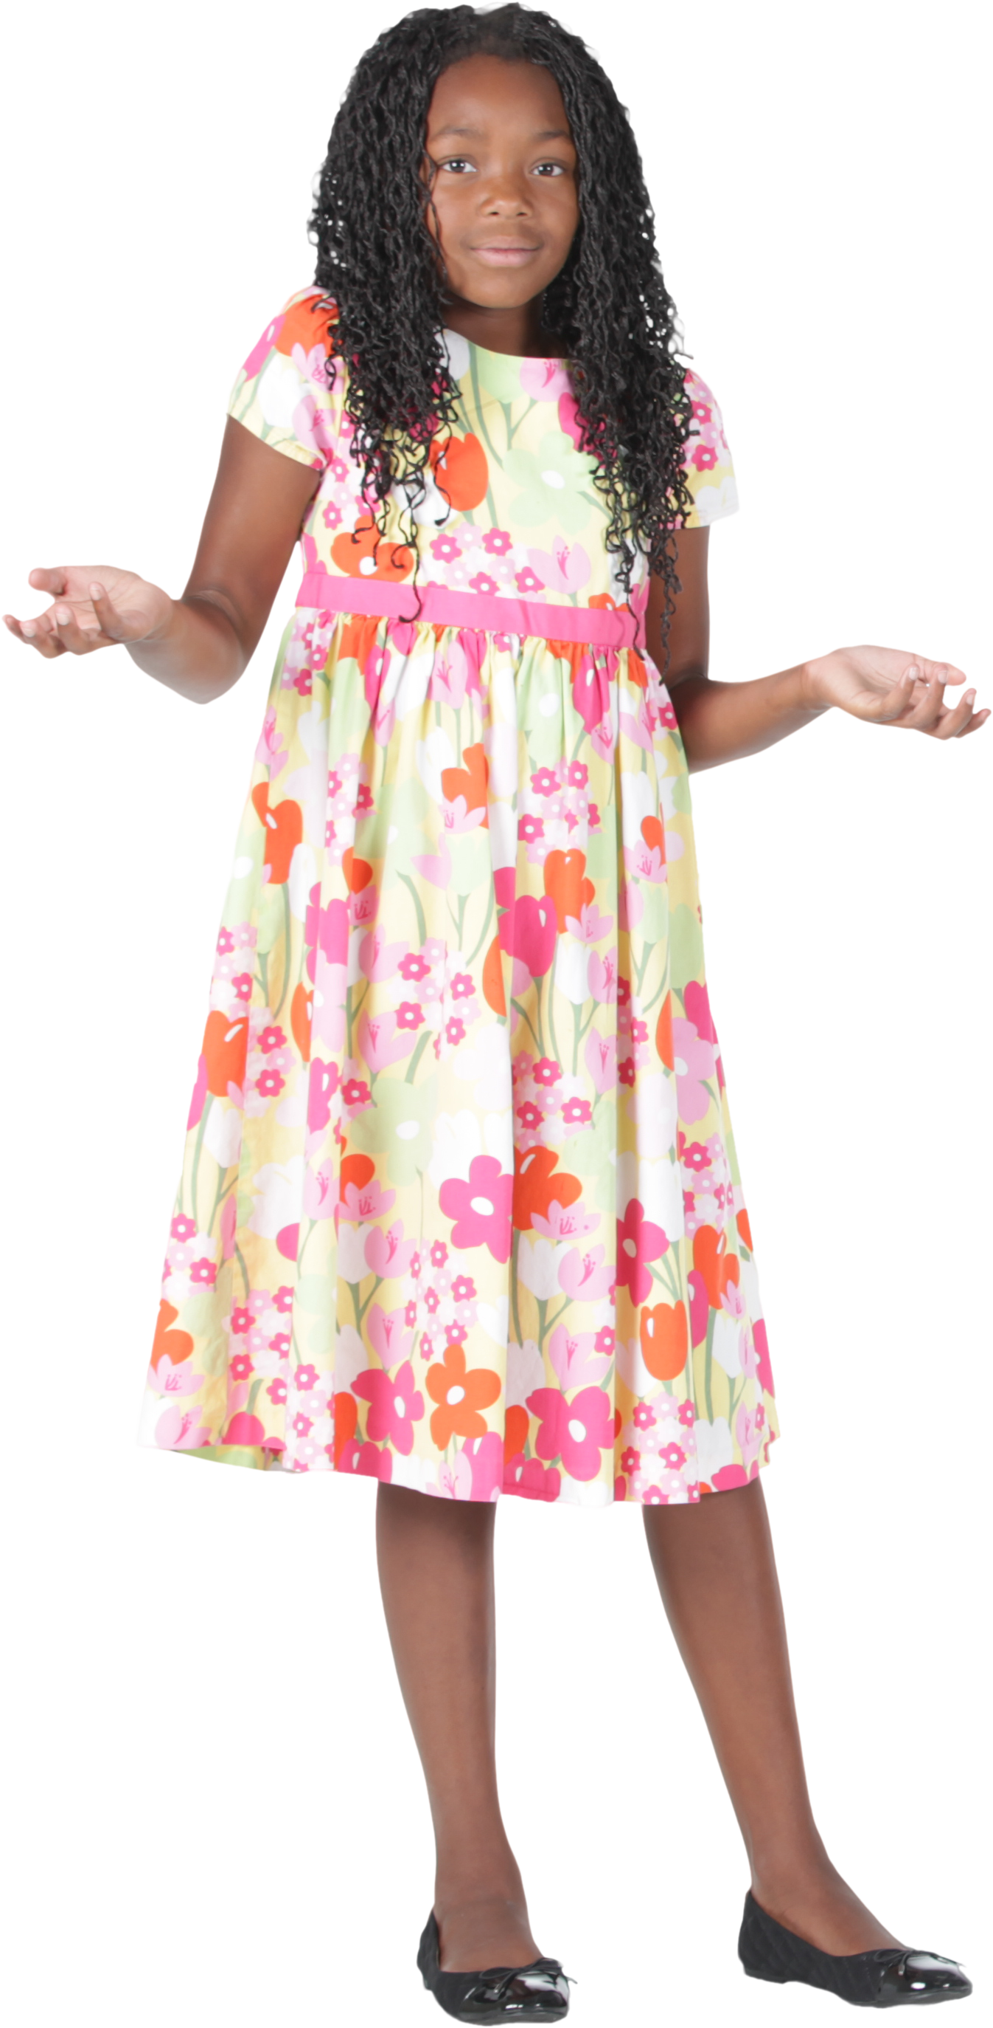
Degrees of formality
.
Why are
news articles usually written using formal language?
On paper or a device, record your answer.
Source: Microsoft PP stock image
© Department for Education, the Government of South Australia, Learning at home, 2022

Slide 15
Degrees of formality
The purpose of a news article is to inform with clear and direct language and everyday language is avoided. Using formal language helps to clearly communicate the author’s messages.
© Department for Education, the Government of South Australia, Learning at home, 2022

Slide 16
A news article Excerpt from, Fears about sea snail super packs
Mayor Amy Black released a statement saying the Port Elizabeth Council is satisfied the beach is safe and will not install warning signs or restrict beach access.
Port Elizabeth Museum's Curator of Molluscs, Dr Astrid Hope, said it was impossible for a sea snail super-pack to attack humans.
Source: https://games.abc.net.au
© Department for Education, the Government of South Australia, Learning at home, 2022

Slide 17
Degrees of formality
.
Feature articles are a type of media text so why do they often use informal
language?
On paper or a device, record your answer.
Source: Microsoft PP stock image
© Department for Education, the Government of South Australia, Learning at home, 2022

Slide 18
Degrees of formality
Feature articles are a type of media text. They can be a combination of formal language such as facts and informal language such as the explanations of those facts.
Feature articles explain the details more than news articles and give the author’s point of view. This leads an author to use more informal, creative language, including emotive language to persuade and communicate their point of view.
© Department for Education, the Government of South Australia, Learning at home, 2022

Slide 19
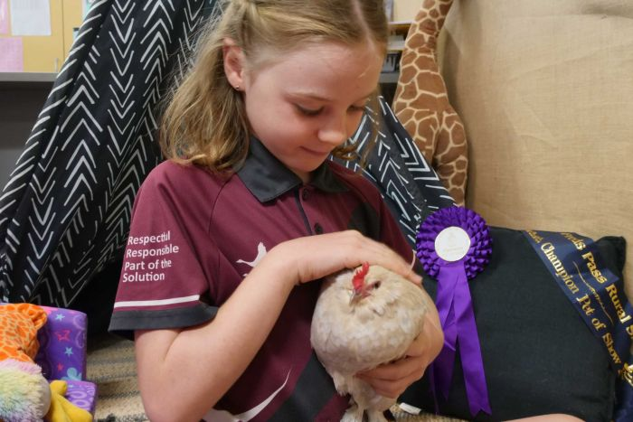
A feature article Excerpt from, Should every classroom have a pet?
Source: https://www.abc.net.au
An award-winning Porcelain Bantam hen named Ice Cream has a very important job.
The speckled grey hen is part of a special needs classroom giving some clucky encouragement to the students.
Source: https://www.abc.net.au
© Department for Education, the Government of South Australia, Learning at home, 2022

Slide 20
Lesson review
Plot the terms along the continuum (line)
news article, feature article
Informal
Formal
© Department for Education, the Government of South Australia, Learning at home, 2022

Slide 21
Lesson review
How did you go? Compare your placement of the terms news article and feature article along the continuum with the example below.
feature article
news article
Informal
Formal
© Department for Education, the Government of South Australia, Learning at home, 2022

Slide 22
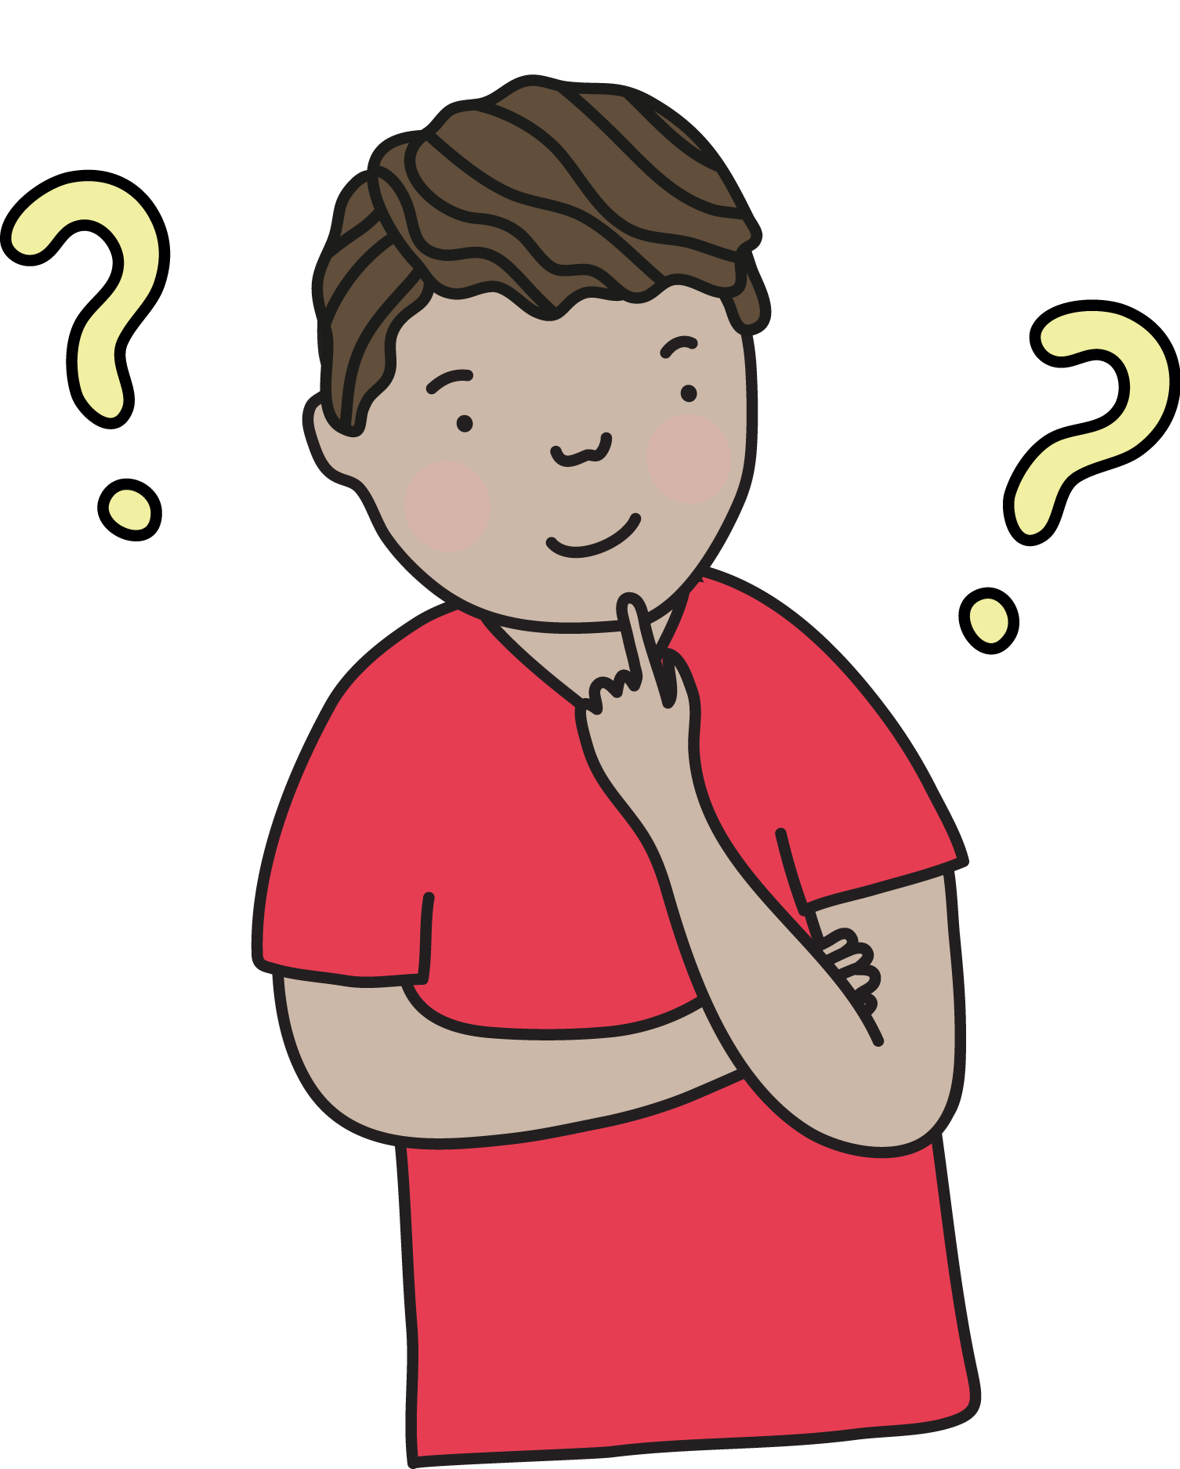
Lesson review
Would you use formal or informal language
when writing an English assessment task about text structures?
Correct. Language in an English assessment is usually formal.
Formal language
Incorrect. Language in an English assessment is usually formal not informal.
Informal language
Click on the card with your answer. Were you correct?
Source: Department for Education, the Government of South Australia
© Department for Education, the Government of South Australia, Learning at home, 2022

Slide 23
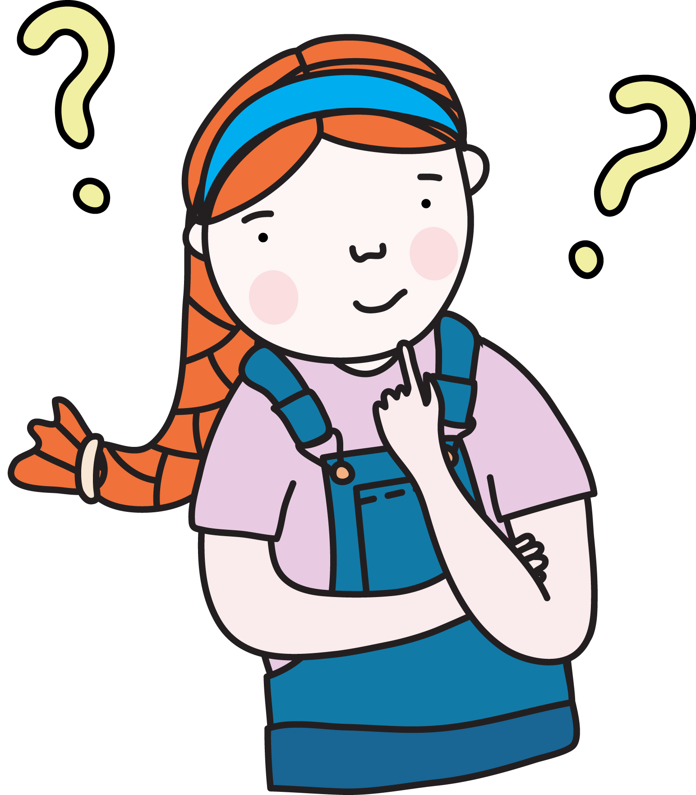
Lesson review
Would you use formal or informal language when writing a letter to the council?
Incorrect. Language between a resident and the council is usually formal.
Informal language
Correct. Language between a resident and the council is usually formal.
Formal language
Click on the card with your answer. Were you correct?
Source: Department for Education, the Government of South Australia
© Department for Education, the Government of South Australia, Learning at home, 2022

Slide 24
Lesson review
Would you use formal or informal language when sending an invitation to a casual barbecue at your place?
Incorrect. Language between friends and for a casual invitation is usually informal.
Formal language
Correct. Language between friends and for a casual invitation is usually informal.
Informal language
Click on the card with your answer. Were you correct?
Source: Department for Education, the Government of South Australia
© Department for Education, the Government of South Australia, Learning at home, 2022

Slide 25
Independent task
For your independent take-away task, on paper or on a device, complete one of options below:
1. Write a paragraph telling a friend what you did at the park.
Or
2. Write a paragraph that is an introduction to a speech about stopping littering in the school yard.

Slide 26
Daily reading routine
.
Choose something to read.​
Find a quiet, comfortable space to read.​
Read for 15 to 20 minutes.​
Have a chat about what you read with someone else.
© Department for Education, the Government of South Australia, Learning at home, 2022

Slide 27
.

