Slide 1
Year 5 English
.
Examining media texts
Lesson 6 – manipulating point of view

Slide 3
Get ready
.
You will need:
pen or pencil
paper or a notebook
a digital device
notes from lesson 5.
© Department for Education, the Government of South Australia, Learning at home, 2022

Slide 4
Review
1. Write a paragraph telling a friend what you did at the park.
Or
2. Write a paragraph that is an introduction to a speech about stopping littering in the school yard.
© Department for Education, the Government of South Australia, Learning at home, 2022

Slide 5
Review
.
How did you go?
Hey mate, you'll never believe what happened at the park yesterday. Mark told me to check out the new jumps that the council crew made. They're awesome and I flew heaps high.
Good afternoon. I am here today to raise awareness of a growing problem in our community. The increasing amount of litter in the school yard is both unsightly and poses a threat to our neighbouring, precious wetland ecosystem.
© Department for Education, the Government of South Australia, Learning at home, 2022

Slide 6
Learning intention
.
To examine and build understanding of how authors use language to manipulate a point of view.
© Department for Education, the Government of South Australia, Learning at home, 2022

Slide 7
Vocabulary
.
Terms | Definition
Bias | Favouring one side in an argument or discussion.
Evidence | Details used to support a point of view such as an expert’s comments or facts.
Language features | Features of language that support meaning such as expanded noun groups and emotive language.
Manipulate | To influence a reader’s point of view by including language and structural features and evidence to persuade.
Point of view | An opinion or an attitude.
© Department for Education, the Government of South Australia, Learning at home, 2022

Slide 8
Manipulating point of view
Authors can manipulate the way we think or feel about a topic.
They can do this through using:
evidence such as an expert’s comments or facts
language features such as emotive language, noun groups and verb groups
structural features including headings and images.
© Department for Education, the Government of South Australia, Learning at home, 2022

Slide 9
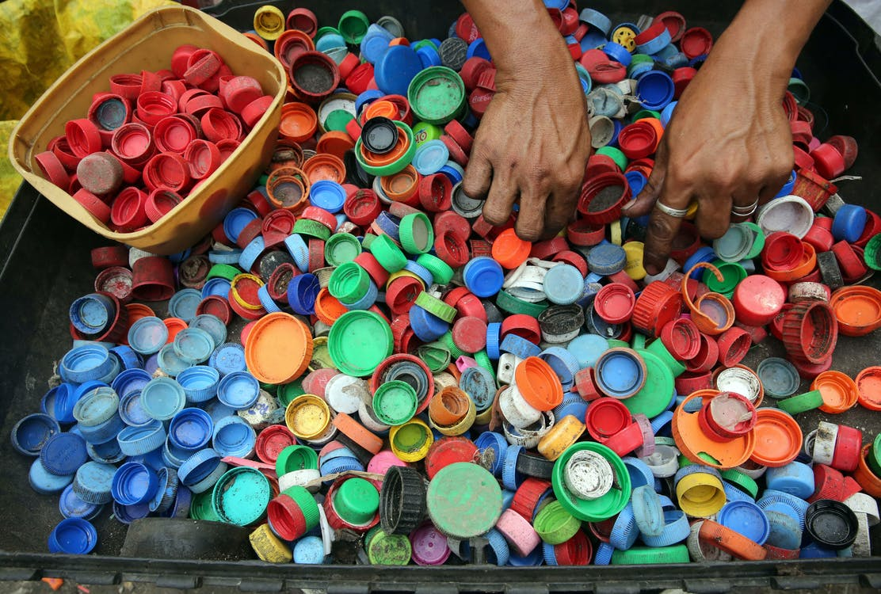
Lesson task
New recycling technology
By Dr Heather Smudge, Company Director
Until recently, 96% of plastic bottle lids has ended-up in
landfill. If left to rot in dumps, the lids break down to microplastics that enter food chains and the water system causing untold damage to precious ecosystems and our health.
Thankfully, this is soon to change.
Mark and Fiona Johnson are leading the way with their new and innovative recycling factory in South Australia.
Source: Pexels
© Department for Education, the Government of South Australia, Learning at home, 2022

Slide 10
Lesson task
The process they use quickly and safely converts plastic bottle lids into usable pellets just waiting to be turned into everything from garden sleepers to packaging. It has been such a success that they are already planning to expand to include other types of plastics.
‘This new technology is a game changer. It’s a win-win for all’, said the company’s chief environmental scientist, Professor Ollie Cooper.
With new, exciting technology and business owners who care about the environment, our planet is in safe hands.
© Department for Education, the Government of South Australia, Learning at home, 2022

Slide 11
Objective and subjective language
Language features can be used to manipulate a point of view.
Subjective language
Factual, unbiased, and evidence-based facts can persuade an audience to believe a point of view.​
Emotive language, which creates an emotional response in the reader, can be used to persuade an audience to believe a point of view.
Objective language
Click on each card to reveal the definition.
© Department for Education, the Government of South Australia, Learning at home, 2022

Slide 12
Noun groups and verb groups
Language features can be used to manipulate a point of view
Verb groups
Information around a noun. This can direct to a particular point of view. Negative or positive descriptions influence the reader to view a topic negatively or positively.​
Information around verbs that give more details. The choice of verbs can influence how the audience views a topic.
Expanded noun groups
Click on each card to reveal the definition.
© Department for Education, the Government of South Australia, Learning at home, 2022

Slide 13
Lesson task
Examine the feature article excerpt on the next slide. Then, identify one example of:
objective language
subjective language
an expanded noun group
a verb group.
On paper or a device, record your examples.
© Department for Education, the Government of South Australia, Learning at home, 2022

Slide 14
Lesson task
New recycling technology
By Dr Heather Smudge, Company Director
Source: Pexels
Until recently, 96% of plastic bottle lids has ended-up in
landfill. If left to rot in dumps, the lids breakdown to microplastics that enter food chains and the water system causing untold damage to precious ecosystems and our health.
Thankfully, this is soon to change.
Mark and Fiona Johnson are leading the way with their new and innovative recycling factory in South Australia.
© Department for Education, the Government of South Australia, Learning at home, 2022

Slide 15
Lesson review The article, New recycling technology, uses subjective language such as:
False
True
Try again
precious
causing untold damage.
Click on a card to show the answer. Were you correct?
© Department for Education, the Government of South Australia, Learning at home, 2022

Slide 16
Lesson review
Language features used to manipulate a point of view can include:
subjective language such as emotive language
False
True
Try again
objective language such as facts
expanded noun groups to
strengthen a point of view
Click on a card to show the answer. Were you correct?
verb groups to influence.
© Department for Education, the Government of South Australia, Learning at home, 2022

Slide 17
Independent task
Choose one of the following feature article headings:
The future of cars – is it electric?
or
Skate parks in the community.
On paper or a device, write a short article based on your chosen heading. Include language features to persuade your audience to your point of view.
© Department for Education, the Government of South Australia, Learning at home, 2022

Slide 18
Daily reading routine
.
Choose something to read.​
Find a quiet, comfortable space to read.​
Read for 15 to 20 minutes.​
Have a chat about what you read with someone else.
© Department for Education, the Government of South Australia, Learning at home, 2022

Slide 19
.
© Department for Education, the Government of South Australia, Learning at home, 2022

Slide 20
© Department for Education, the Government of South Australia, Learning at home, 2022

