Slide 1
Year 5 English
.
Examining media texts
Lesson 7 – identify and evaluate evidence

Slide 3
Get ready
.
You will need:
pen or pencil
paper or a notebook
a digital device
notes from lesson 6.
© Department for Education, the Government of South Australia, Learning at home, 2022

Slide 4
Review
Choose one of the feature article headings:
The future of cars – is it electric?
or
Skate parks in the community.
Write a short article using language features to persuade your audience of your point of view.
© Department for Education, the Government of South Australia, Learning at home, 2022

Slide 5
Review
.
The future of cars – is it electric?
Our city streets have become choked with cars. If this isn’t bad enough, the toxic gases spewing from a thousand exhaust pipes creates a dangerous mix.
Electric cars emit zero fumes, leaving our air pure and breathable.
‘We hope to replace at least 80% of petrol cars with electric ones by 2030. If we can achieve this, we can all breathe a sigh of relief’, said scientist, Dr Stan Green.
Skate parks in the community
The benefits of constructing a skate park in our local community are enormous. It provides the opportunity for young people to develop skills, fitness and a sense of belonging.
‘We don’t know what we would do without this skate park’, said local teenagers, Jack and Cooper. So, next time you hear the sound of wheels against concrete and happy voices, take a minute
to reflect on the importance of our skate park.
© Department for Education, the Government of South Australia, Learning at home, 2022

Slide 6
Learning intention
.
To be able to identify and evaluate the reliability of evidence in feature articles.
© Department for Education, the Government of South Australia, Learning at home, 2022

Slide 7
Vocabulary
.
Terms | Definition
Assertion | A statement that someone strongly believes is true and not necessarily based on fact.
Bias | Favouring one side in an argument or discussion.
Evaluate | To consider something and make an assessment or judgement about its quality or worth.
© Department for Education, the Government of South Australia, Learning at home, 2022

Slide 8
Vocabulary
.
Terms | Definition
Evidence | Details with-in or from a source used to support a point of view.
Reliable | Something or a person likely to be correct such as a qualified expert.
Source | A person or document that provides information.
© Department for Education, the Government of South Australia, Learning at home, 2022

Slide 9
The SAFE test
.
The SAFE test is a series of tips and checks for authors and readers. An author can use the SAFE test to ensure their feature article is persuasive. The SAFE test also guides readers to determine how and if they are being manipulated.
The acronym, SAFE: S = source
A = attitude
F = facts
E = emotions
Source: https://www.pexels.com
© Department for Education, the Government of South Australia, Learning at home, 2022

Slide 10
Questions to ask about:
Source - Does the evidence come from a reliable source, such as a referenced image, quality article, expert person?​
Source
Attitude
Attitude - Does this evidence express a positive attitude or a negative attitude? How can I tell?
Click on each word as you hear them to reveal what to consider for each of these checks.
Facts
Facts - Does this evidence provide facts or make assertions?​
Emotions - Does this evidence express any strong feelings? If so, what are they?
Emotions
© Department for Education, the Government of South Australia, Learning at home, 2022

Slide 11
Evaluating evidence​ General features of The SAFE test – selecting evidence
.
General features​ | Writer’s tips​ and reader’s checks
Source​ | Does the evidence come from a reliable source, such as a referenced image, quality article, expert person?​
Attitude​ | Does this evidence express a positive attitude or a negative attitude? How can I tell?​
Facts​ | Does this evidence provide facts or make assertions?​
Emotions​ | Does this evidence express any strong feelings? If so, what are they?​
© Department for Education, the Government of South Australia, Learning at home, 2022

Slide 12
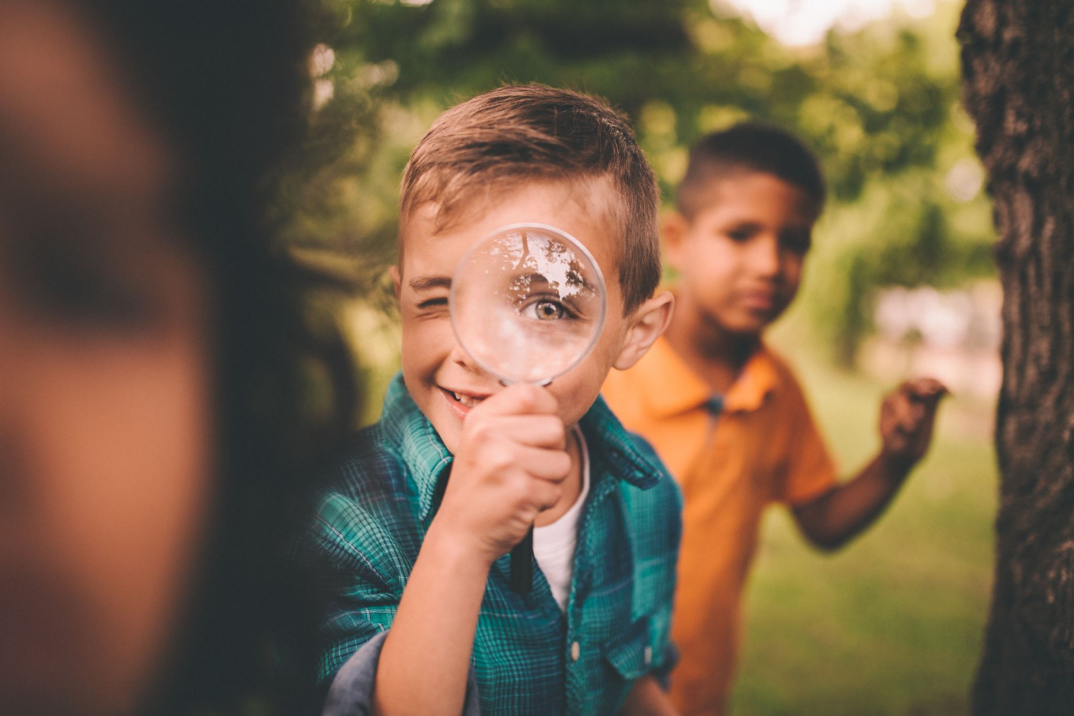
Apply the SAFE test
.
Apply the SAFE test to evaluate the evidence in the feature article on the following slides.
This will require you to be a detective. You will need to identify evidence in the article that answers the questions that are given for each of the 4 SAFE checks or steps of the test.
© Department for Education, the Government of South Australia, Learning at home, 2022
Source: Microsoft PP stock image

Slide 13
Lesson task
Source – Does the evidence come from a reliable source, such as a referenced image, quality article or expert person?​
Attitude – Does this evidence express a positive attitude or a negative attitude? How can I tell?​
Fact – Does this evidence provide facts or make assertions?​
Emotions – Does this evidence express any strong feelings? If so, what are they?​
© Department for Education, the Government of South Australia, Learning at home, 2022

Slide 14
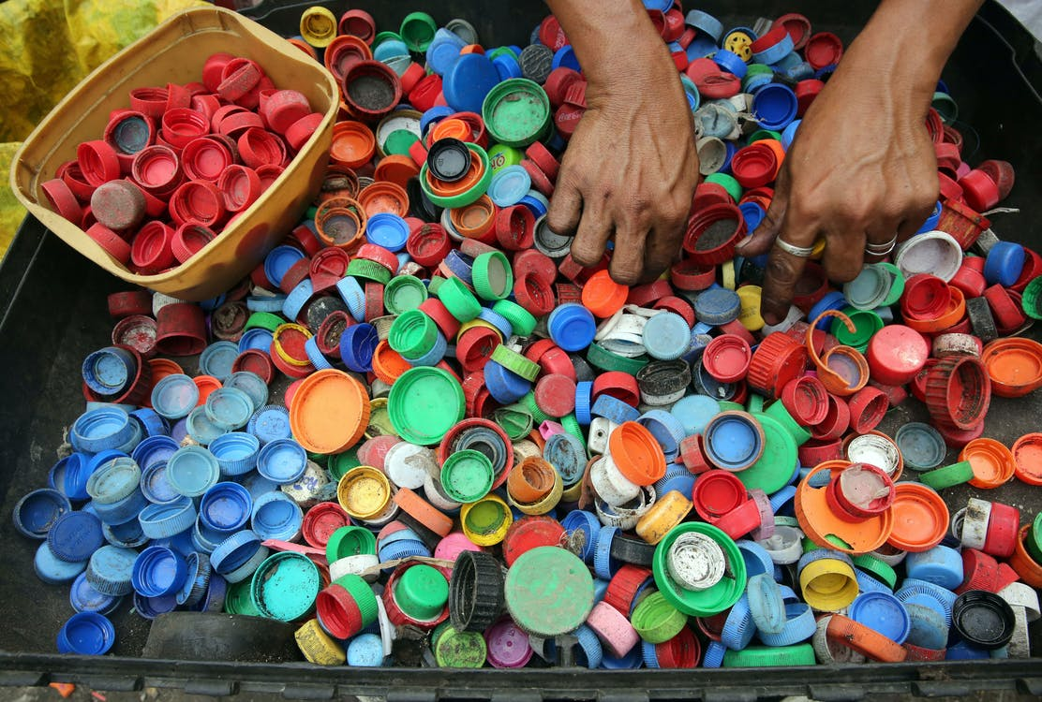
Lesson task
New recycling technology
By Dr Heather Smudge, Company Director
Source: Pexels
Until recently, 96% of plastic bottle lids has ended-up in
landfill. If left to rot in dumps, the lids break down to microplastics that enter food chains and the water system causing untold damage to precious ecosystems and our health.
Thankfully, this is soon to change.
Mark and Fiona Johnson are leading the way with their new and innovative recycling factory in South Australia.
© Department for Education, the Government of South Australia, Learning at home, 2022

Slide 15
Lesson task continued
The process they use quickly and safely converts plastic bottle lids into usable pellets just waiting to be turned into everything from garden sleepers to packaging. It has been such a success that they are already planning to expand to include other types of plastics.
‘This new technology is a game changer. It’s a win-win for all’, said the company’s chief environmental scientist, Professor Ollie Cooper.
With new, exciting technology and business owners who care about the environment, our planet is in safe hands.
© Department for Education, the Government of South Australia, Learning at home, 2022

Slide 16
Lesson task
New recycling technology
By Dr Heather Smudge, Company Director
Until recently, 96% of plastic bottle lids has ended-up in
landfill. If left to rot in dumps, the lids break down to microplastics that enter food chains and the water system causing untold damage to precious ecosystems and our health.
Thankfully, this is soon to change.
Mark and Fiona Johnson are leading the way with their new and innovative recycling factory in South Australia.
Source: Pexels
© Department for Education, the Government of South Australia, Learning at home, 2022

Slide 17
Lesson task continued
The process they use quickly and safely converts plastic bottle lids into usable pellets just waiting to be turned into everything from garden sleepers to packaging. It has been such a success that they are already planning to expand to include other types of plastics.
‘This new technology is a game changer. It’s a win-win for all’, said the company’s chief environmental scientist, Professor Ollie Cooper.
With new, exciting technology and business owners who care about the environment, our planet is in safe hands.
© Department for Education, the Government of South Australia, Learning at home, 2022

Slide 18
Lesson review
.
General features​ | ​Writer’s tips​ and reader’s checks
Source​ | Does the evidence come from a reliable source, such as a referenced image, quality article, expert person?​
Attitude​ | Does this evidence express a positive attitude or a negative attitude? How can I tell?​
Facts​ | Does this evidence provide facts or make assertions?​
Emotions​ | Does this evidence express any strong feelings? If so, what are they?​
© Department for Education, the Government of South Australia, Learning at home, 2022

Slide 19
Independent task
.
Complete the following 2 sentences.
When reading a feature article, it’s important to use the SAFE test to………..
When writing a feature article the SAFE test is useful because………
On paper or a device, record your response.
© Department for Education, the Government of South Australia, Learning at home, 2022

Slide 20
Daily reading routine
.
Choose something to read.​
Find a quiet, comfortable space to read.​
Read for 15 to 20 minutes.​
Have a chat about what you read with someone else.
© Department for Education, the Government of South Australia, Learning at home, 2022

Slide 21
.

Slide 22
© Department for Education, the Government of South Australia, Learning at home, 2022

