Slide 1
Year 5 English
.
Examining media texts
Lesson 8 – evidence to support a point of view

Slide 3
Get ready
.
You will need:
pen or pencil
paper or a notebook
a digital device
notes from lesson 7.
© Department for Education, the Government of South Australia, Learning at home, 2022

Slide 4
Review
.
Complete the following 2 sentences.
When reading a feature article, it’s important to use the SAFE test to………..
When writing a feature article the SAFE test is useful because………
© Department for Education, the Government of South Australia, Learning at home, 2022

Slide 5
Review
.
When reading a feature article, it’s important to use the SAFE test to check if and how the author might be trying to manipulate you to agree with their point of view.
When writing a feature article the SAFE test is useful because it gives you tips on what language to include if you are trying to manipulate or persuade the audience to your point of view.
© Department for Education, the Government of South Australia, Learning at home, 2022

Slide 6
Learning intention
.
To know how authors use evidence to support a point of view.
© Department for Education, the Government of South Australia, Learning at home, 2022

Slide 7
The role of evidence
Reliability
Reliability – Authors build reliability by using objective, factual or evidence-based information. For example, facts from a scientist or someone in authority.​
Click on each word or term as you hear them to reveal how authors build these features to persuade an audience to agree with their point of view.
Create emotion – Authors create emotion by using precise vocabulary, subjective (emotive) language and images which create strong feelings in an audience.
Create emotion
© Department for Education, the Government of South Australia, Learning at home, 2022

Slide 8
Role of evidence and writer’s tips
.
General features​ | Writer’s tips​
Reliability​ | Authors build reliability by using objective, factual or evidence-based information. For example, facts from a scientist or someone in authority.​
Create emotion​ | Authors create emotion by using precise vocabulary, subjective (emotive) language and images which create strong feelings in an audience.​
© Department for Education, the Government of South Australia, Learning at home, 2022

Slide 9
Lesson task
The role of evidence
First, read and listen to the feature article which appears across the next 2 slides.
© Department for Education, the Government of South Australia, Learning at home, 2022

Slide 10
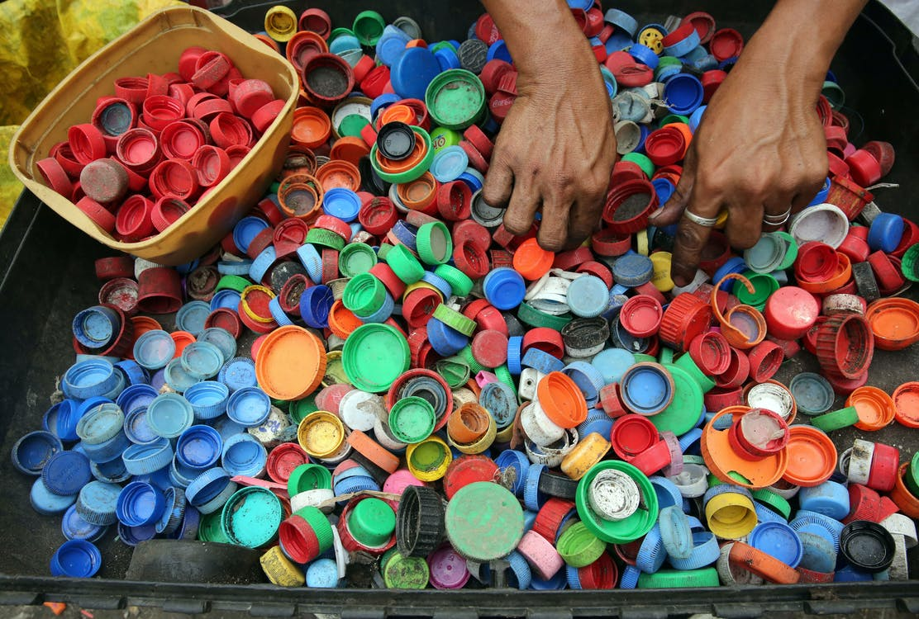
Feature article
New recycling technology
By Dr Heather Smudge, Company Director
Source: Pexels
Until recently, 96% of plastic bottle lids has ended-up in
landfill. If left to rot in dumps, the lids break down to toxic microplastics that enter food chains and the water system causing untold damage to precious ecosystems and our health.
Thankfully, this is soon to change.
Mark and Fiona Johnson are leading the way with their new and innovative recycling factory in South Australia.
© Department for Education, the Government of South Australia, Learning at home, 2022

Slide 11
Feature article
The process they use quickly and safely converts plastic bottle lids into usable pellets just waiting to be turned into everything from garden sleepers to packaging. It has been such a success that they are already planning to expand to include other types of plastics.
‘This new technology is a game changer. It’s a win-win for all’, said the company’s chief environmental scientist, Professor Ollie Cooper.
With new, exciting technology and business owners who care about the environment, our planet is in safe hands.
© Department for Education, the Government of South Australia, Learning at home, 2022

Slide 12
Lesson task
.
Evidence to support a point of view
Complete the following statements based on the feature article, New recycling technology.
1a. The topic is:
b. The author’s point of view is:
On paper or a device, record your answer.
© Department for Education, the Government of South Australia, Learning at home, 2022

Slide 13
.
Lesson task
How did you go?
1a. The topic is recycling and specifically about recycling plastic bottle lids.
b. The author’s point of view is that recycling and this particular new technology is a good thing.
© Department for Education, the Government of South Australia, Learning at home, 2022

Slide 14
Lesson task
.
2. Select evidence that the author uses to support their point of view.
List the evidence you selected from the feature article.
On paper or a device, record your answer.
© Department for Education, the Government of South Australia, Learning at home, 2022

Slide 15
Lesson task
.
How did you go?
2. Evidence that the author uses to support their point of view.
A quote – ‘This new technology is a game changer. It’s a win-win for all’, said the company’s chief environmental scientist, Professor Ollie Cooper.
This is given by an expert so it’s very reliable.
A fact – Until recently, 96% of plastic bottle lids has ended-up in
landfill.
This shows the need for recycling and that they have reduced it from a huge 96%.
© Department for Education, the Government of South Australia, Learning at home, 2022

Slide 16
.
Lesson task
3. List 2 words or terms the author uses to create emotion that increases the chance of an audience agreeing with their point of view about recycling.
On paper or a device, record your answer.
© Department for Education, the Government of South Australia, Learning at home, 2022

Slide 17
Lesson task
.
How did you go?
3. Words or terms the author uses to create emotion.
Toxic
Precious ecosystems
© Department for Education, the Government of South Australia, Learning at home, 2022

Slide 18
Lesson task
4. If you were the author, choose a word or term that could be included to make the message of the article even stronger.
On paper or a device, record your answer.
© Department for Education, the Government of South Australia, Learning at home, 2022

Slide 19
Lesson task
How did you go?
4. A word or term that could be included to make the message of the article even stronger.
…who care passionately about the environment…
© Department for Education, the Government of South Australia, Learning at home, 2022

Slide 20
Lesson review
Select the correct word or term to complete each sentence: create emotion, reliability.
Authors use facts including percentages to add ____________.
Words or terms such as passionately care and toxic are used to _____________.
On paper or a device, record your answers.
© Department for Education, the Government of South Australia, Learning at home, 2022

Slide 21
Lesson review
How did you go?
Authors use facts including percentages to add reliability.
Words or terms such as passionately care and toxic are used to create emotion.
© Department for Education, the Government of South Australia, Learning at home, 2022

Slide 22
Independent learning
.
Write a paragraph on a topic you are interested in. Include the writer’s tips to help you write persuasively.
Or
Write a paragraph based on the heading, Free fruit for all. Include the writer’s tips to help you write persuasively.
On paper or a device, record your response.
© Department for Education, the Government of South Australia, Learning at home, 2022

Slide 23
Daily reading routine
.
Choose something to read.​
Find a quiet, comfortable space to read.​
Read for 15 to 20 minutes.​
Have a chat about what you read with someone else.
© Department for Education, the Government of South Australia, Learning at home, 2022

Slide 24
.

Slide 25
© Department for Education, the Government of South Australia, Learning at home, 2022

