Slide 1
Year 5 English
.
Examining media texts
Lesson 9 – create emotion in writing

Slide 3
Get ready
.
You will need:
pen or pencil
paper or a notebook
a digital device
notes from lesson 8.
© Department for Education, the Government of South Australia, Learning at home, 2022

Slide 4
Review
.
Write a short response about a topic you are interested in and try to persuade the audience to support your point of view.
or
Write a short response based on the heading, Free fruit for all, and try to persuade the audience to support your point of view.
© Department for Education, the Government of South Australia, Learning at home, 2022

Slide 5
Review
.
Providing free fruit in every supermarket is an excellent idea. If this idea was started, it would become a vital way of keeping families healthier and would save so much money and stress by reducing illness.
“The cost to governments by providing money to supermarkets so fruit can be free would save the even bigger costs of sick days to communities,’’ said Dr David Gallagher.
© Department for Education, the Government of South Australia, Learning at home, 2022

Slide 6
Review
.
Providing free fruit in every supermarket would be a disaster. Even if free, many people still wouldn’t take it and this would cause enormous food wastage.
“Up to 60% could be wasted each week. It would also cause a lot of problems between fruit growers because not all types of fruit could be free,’’ said supermarket owner, Ismail Woods.
Imagine going into a shop with rotting fruit that no one wants. This would smell horrific and turn people away. So, no way to free fruit.
© Department for Education, the Government of South Australia, Learning at home, 2022

Slide 7
Learning intention
.
To understand how authors create emotion in writing.
© Department for Education, the Government of South Australia, Learning at home, 2022

Slide 8
How and why authors create emotion in writing Authors create emotion to make an audience care about their topic or point of view. They use it to develop characters, to entertain, to build empathy and humour and to persuade in support of their point of view. To achieve this, they use particular features such as structural features that include images and headings, and subjective or emotive language which includes language of effect and language of judgement.
.
© Department for Education, the Government of South Australia, Learning at home, 2022

Slide 9
Use of images to create emotion
What emotions do the images below create for you? On paper or a device, record your response.
1. 2.
Source: Microsoft 365 Image Library
Source: Microsoft 365 Image Library
© Department for Education, the Government of South Australia, Learning at home, 2022

Slide 10
Use of images to create emotion
How did you go?
1. Happy 2. Stressed
Source: Microsoft 365 Image Library
Source: Microsoft 365 Image Library
© Department for Education, the Government of South Australia, Learning at home, 2022

Slide 11
Use of language to create emotion The language of affect Language of affect is language which works to express feelings. This language helps encourage readers to experience distinct emotional reactions to characters, places, behaviour or things. Words that express attitudes can be positive or negative. On the next slide are the categories of affect and some examples.
© Department for Education, the Government of South Australia, Learning at home, 2022

Slide 12
Language of affect
.
Positive | Negative
Happiness | Unhappy
elated, glad, happy, joyful, thrilled | sad, upset, miserable, gloomy
Security | Insecurity
comfortable, safe, trusting, calm | uneasy, anxious, frightened, shocked
Satisfaction | Dissatisfaction
pleased, content, delighted, success | frustrated, irritated, annoyed, failure
© Department for Education, the Government of South Australia, Learning at home, 2022

Slide 13
Language of affect table
Below are words that express either security (safety) or insecurity (danger or unsafe). On paper or a device, sort them into 2 groups under the headings of security and insecurity.
uneasy | safe
comfortable | trusting
trembling | shocked
© Department for Education, the Government of South Australia, Learning at home, 2022

Slide 14
Language of affect
On paper or a device, create the table below. Place the words from the previous slide under the correct headings on the table, depending on whether they create feelings of security (safety) or insecurity (danger).
Language of affect
Security | Insecurity
comfortable | uneasy
© Department for Education, the Government of South Australia, Learning at home, 2022

Slide 15
Language of affect table How did you go?
Language of affect
Security | Insecurity
comfortable safe trusting | uneasy trembling shocked
© Department for Education, the Government of South Australia, Learning at home, 2022

Slide 16
Choosing language to create a particular emotion
Authors choose specific words when creating a particular emotion.
Where authors want to create a feeling of security they choose to use positive language of affect.
Where authors want to create a feeling of insecurity they choose to use negative language of affect.
Think of a situation where an author would use more positive words and a situation where an author would use more negative words?
On paper or a device, record your thinking.
© Department for Education, the Government of South Australia, Learning at home, 2022

Slide 17
Choosing language to create a particular emotion
How did you go?
Where authors might want to create a feeling of security they choose to use positive language of affect.
For example, when writing about volunteers helping elderly people in the community authors are likely to use positive language such as supportive and safe.
Where authors might want to create a feeling of insecurity they choose to use negative language of affect.
For example, when writing about plastic in our oceans authors are likely to use negative language such as shocked and uneasy.
© Department for Education, the Government of South Australia, Learning at home, 2022

Slide 18
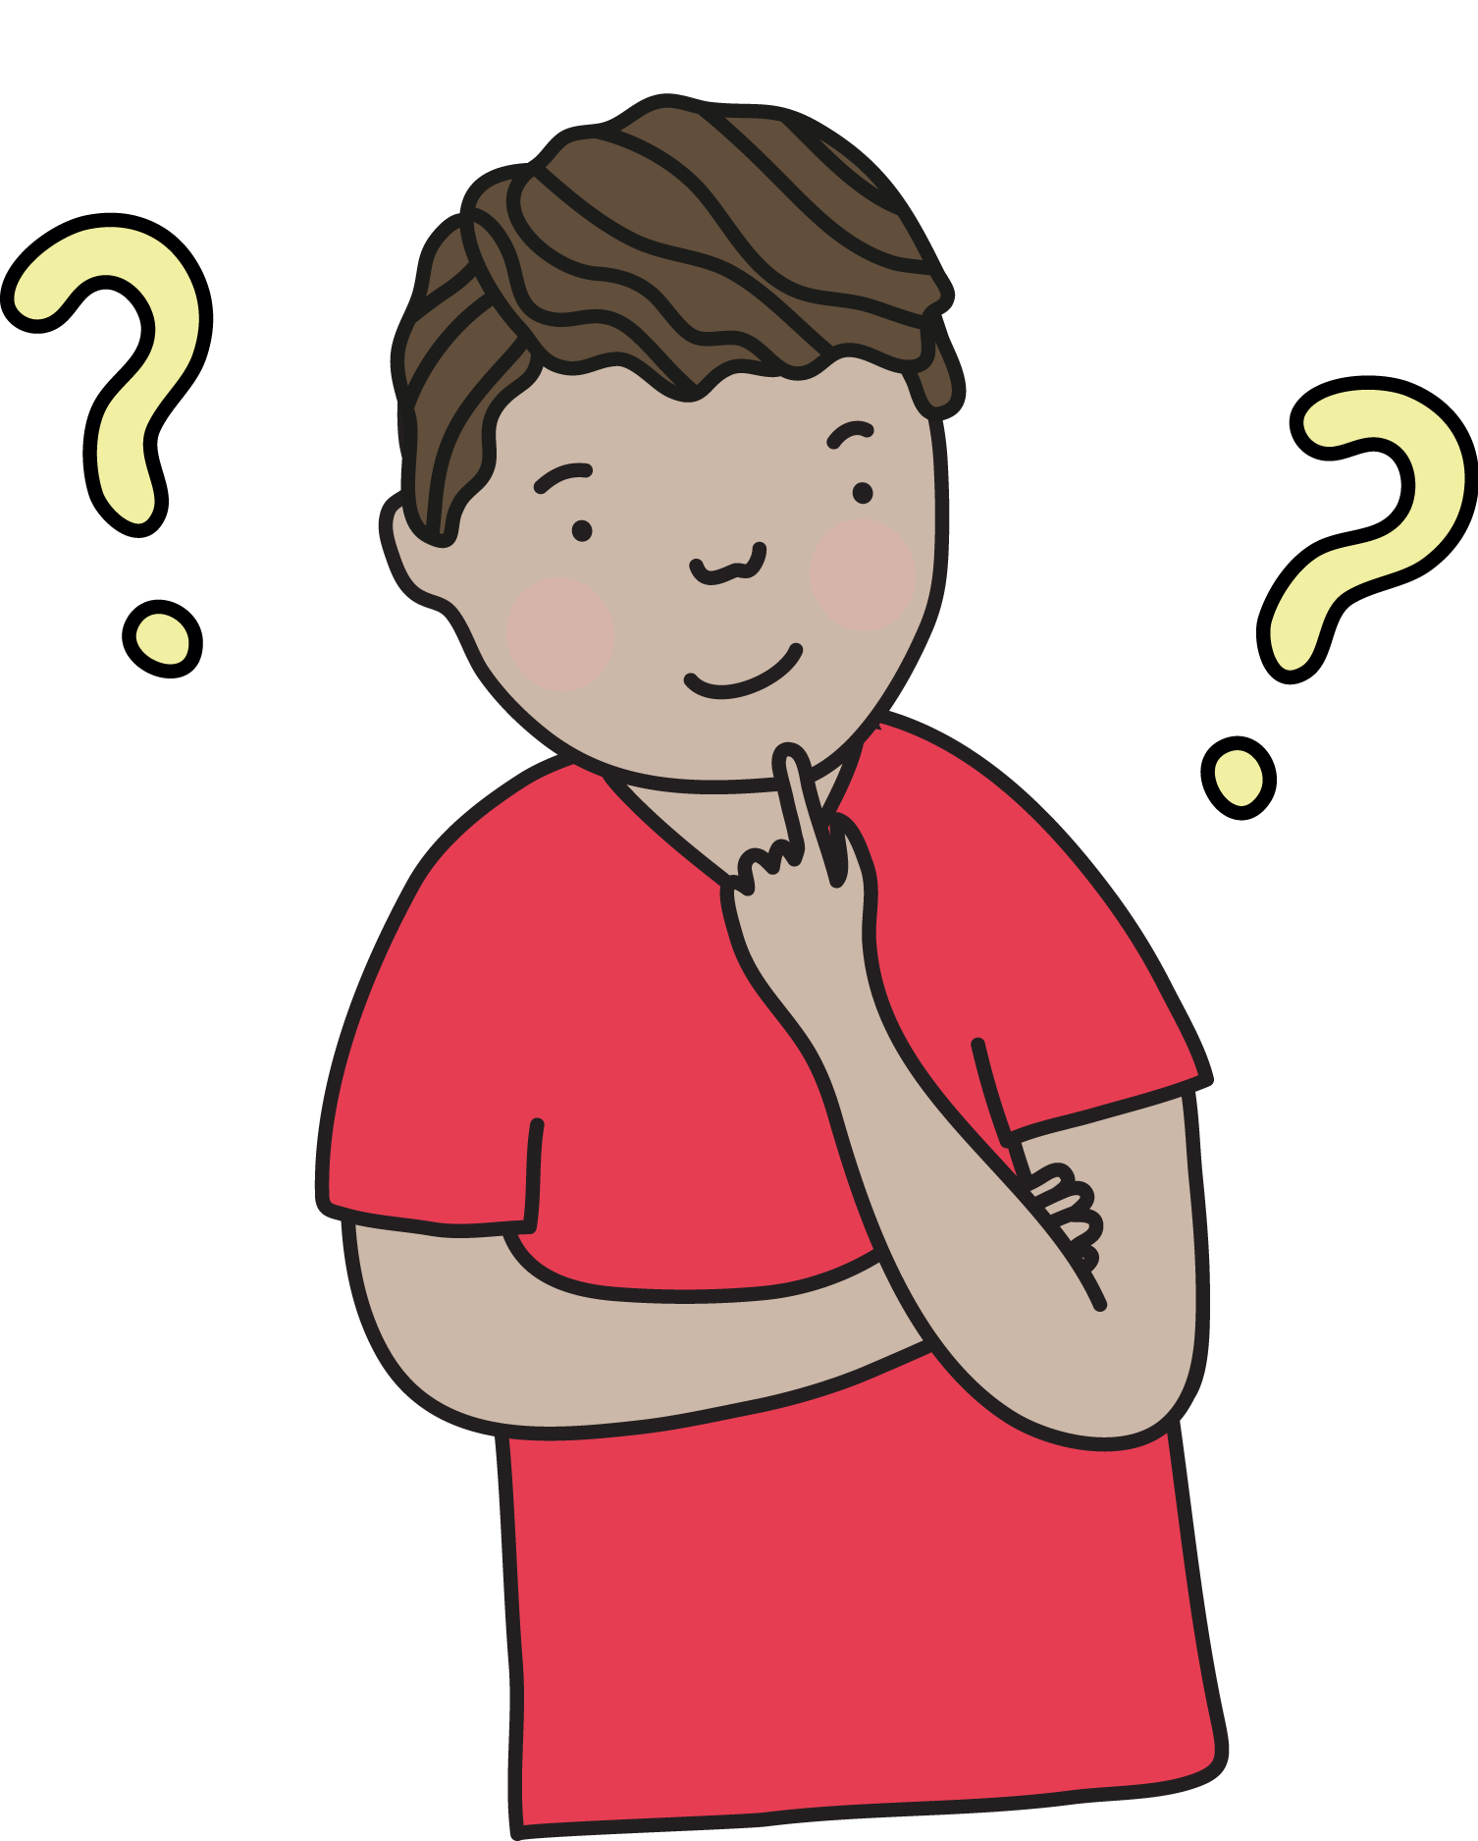
Lesson review
Which word is an example of a positive word to express happiness?
Click on the card with your answer. Were you correct?
elated
Correct. Elated expresses a high degree of happiness.
miserable
Try again
Source: Department for Education, the Government of South Australia
© Department for Education, the Government of South Australia, Learning at home, 2022

Slide 19
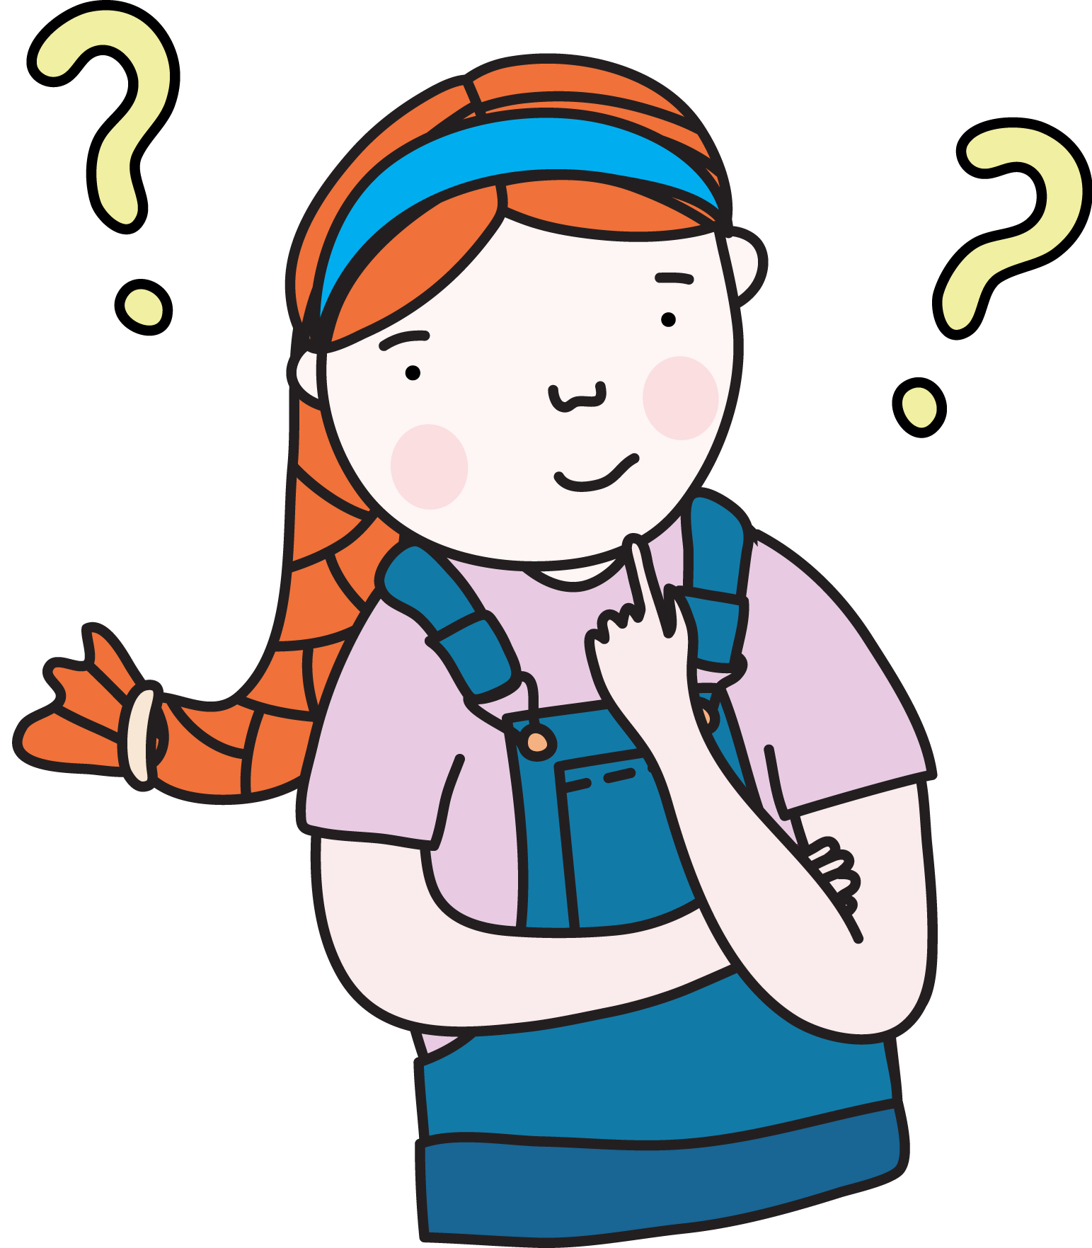
Lesson review
Which word would you use to express annoyance?
Click on the card with your answer. Were you correct?
frustrated
Correct.
Frustrated is a feeling connected to annoyance - when something isn’t going to plan.
content
Try again.
Source: Department for Education, the Government of South Australia
© Department for Education, the Government of South Australia, Learning at home, 2022

Slide 20
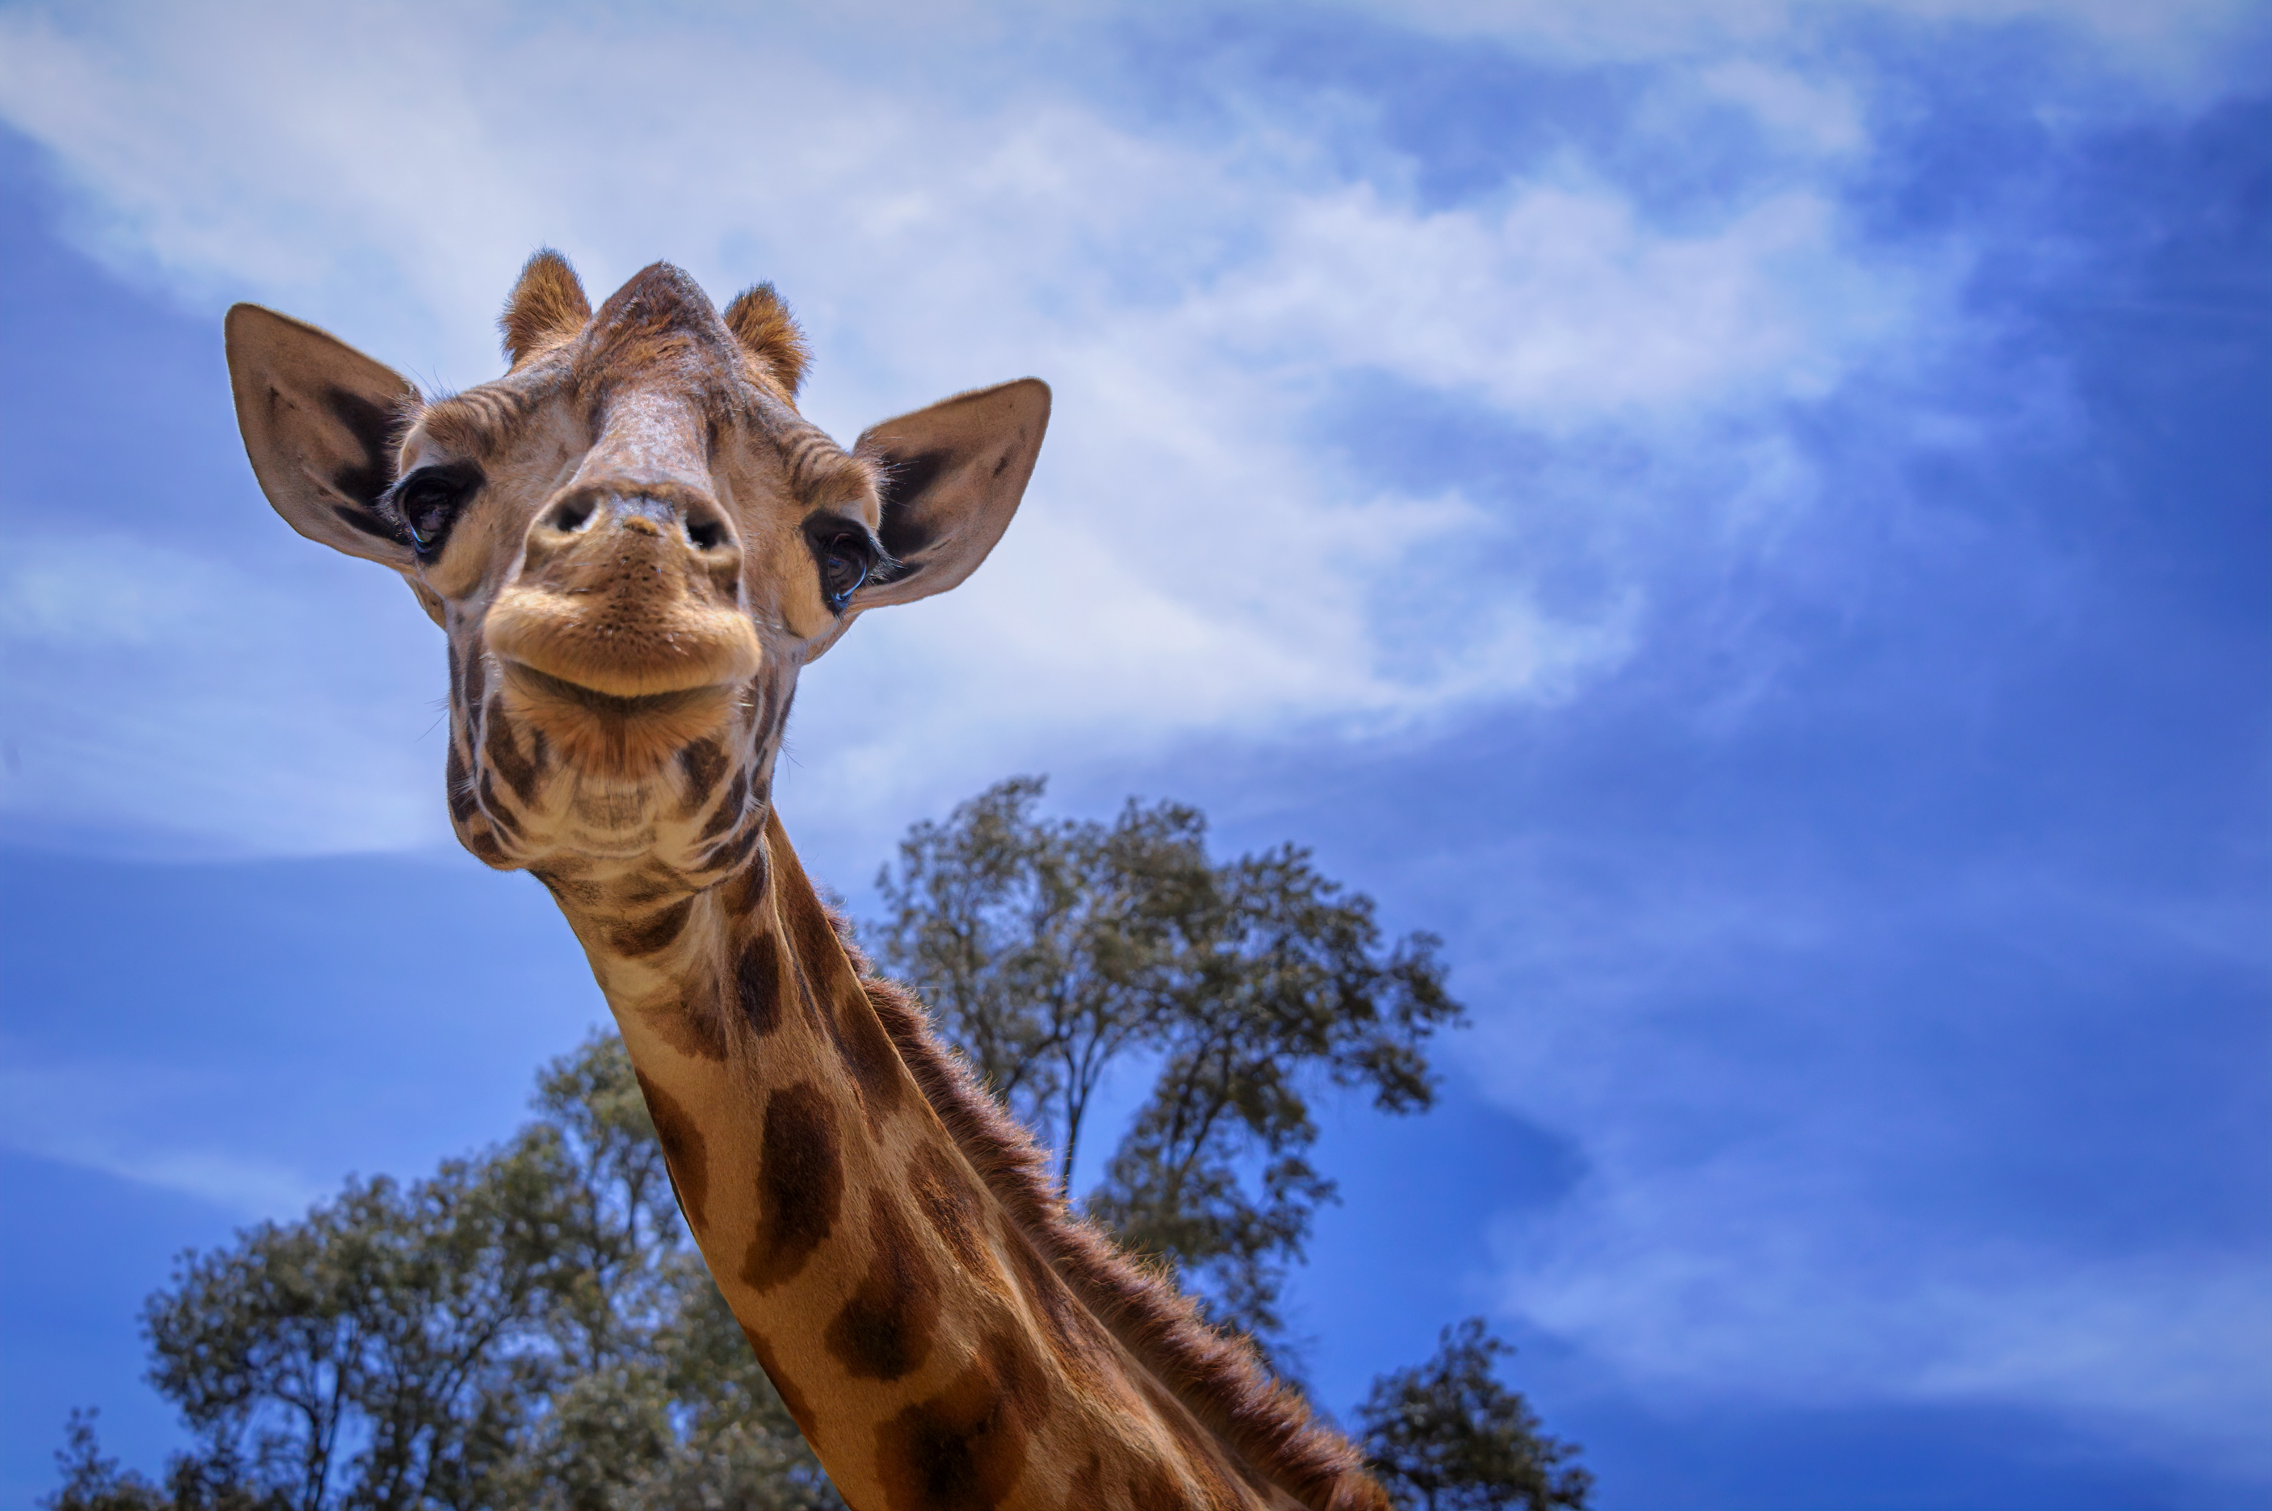
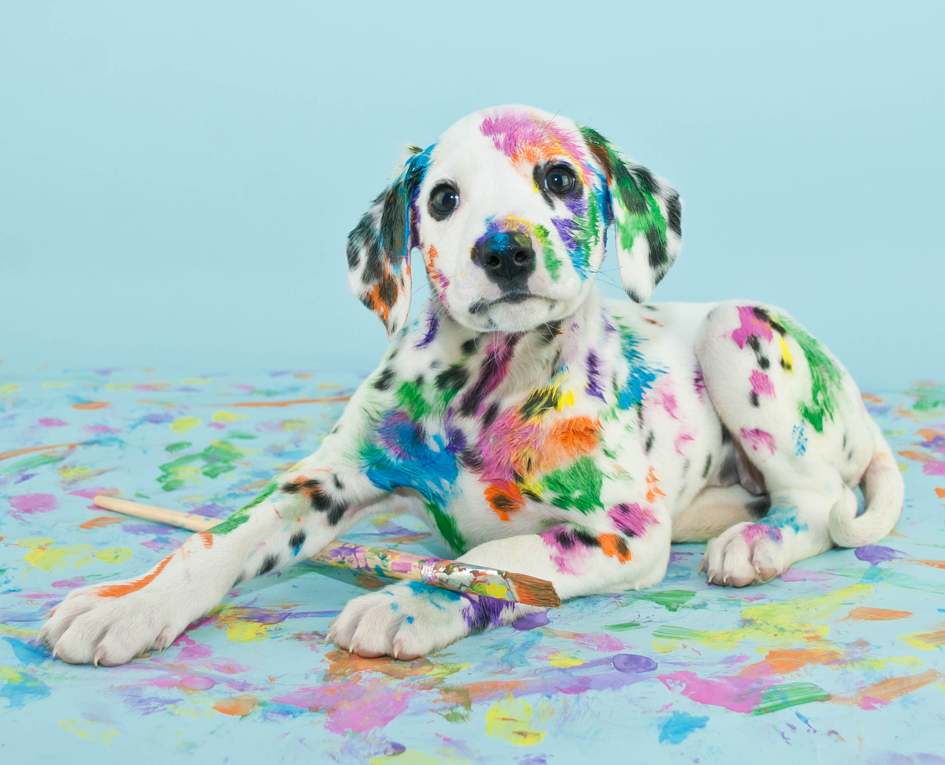
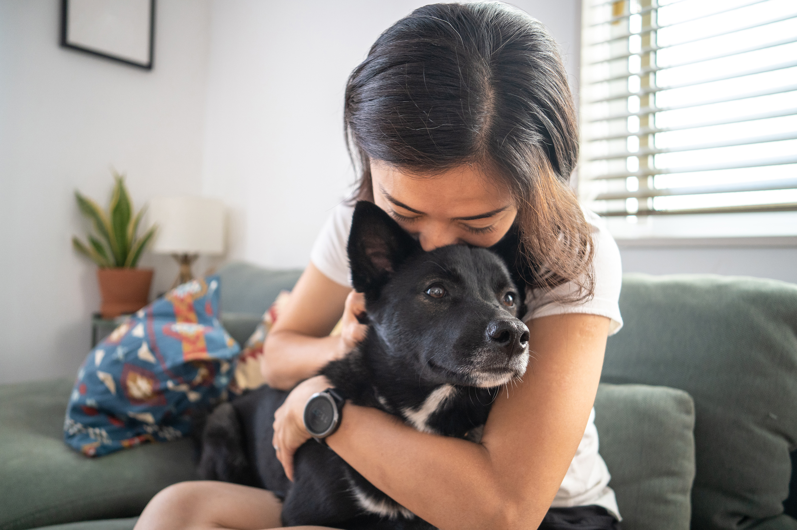
Independent learning
.
Which image or images would you select to support the point of view that all classrooms should have a pet? Provide reasons.
1. 2. 3. 4.
Source: Microsoft 365 Image Library
On paper or a device, record your response.
© Department for Education, the Government of South Australia, Learning at home, 2022

Slide 21
Daily reading routine
.
Choose something to read.​
Find a quiet, comfortable space to read.​
Read for 15 to 20 minutes.​
Have a chat about what you read with someone else.
© Department for Education, the Government of South Australia, Learning at home, 2022

Slide 22
.

Slide 23
© Department for Education, the Government of South Australia, Learning at home, 2022

