Slide 1
Year 5 English
.
Examining media texts
Lesson 10 – opposing point of view

Slide 3
Get ready
.
You will need:
pen or pencil
paper or a notebook
a digital device
notes from lesson 9.
© Department for Education, the Government of South Australia, Learning at home, 2022

Slide 4
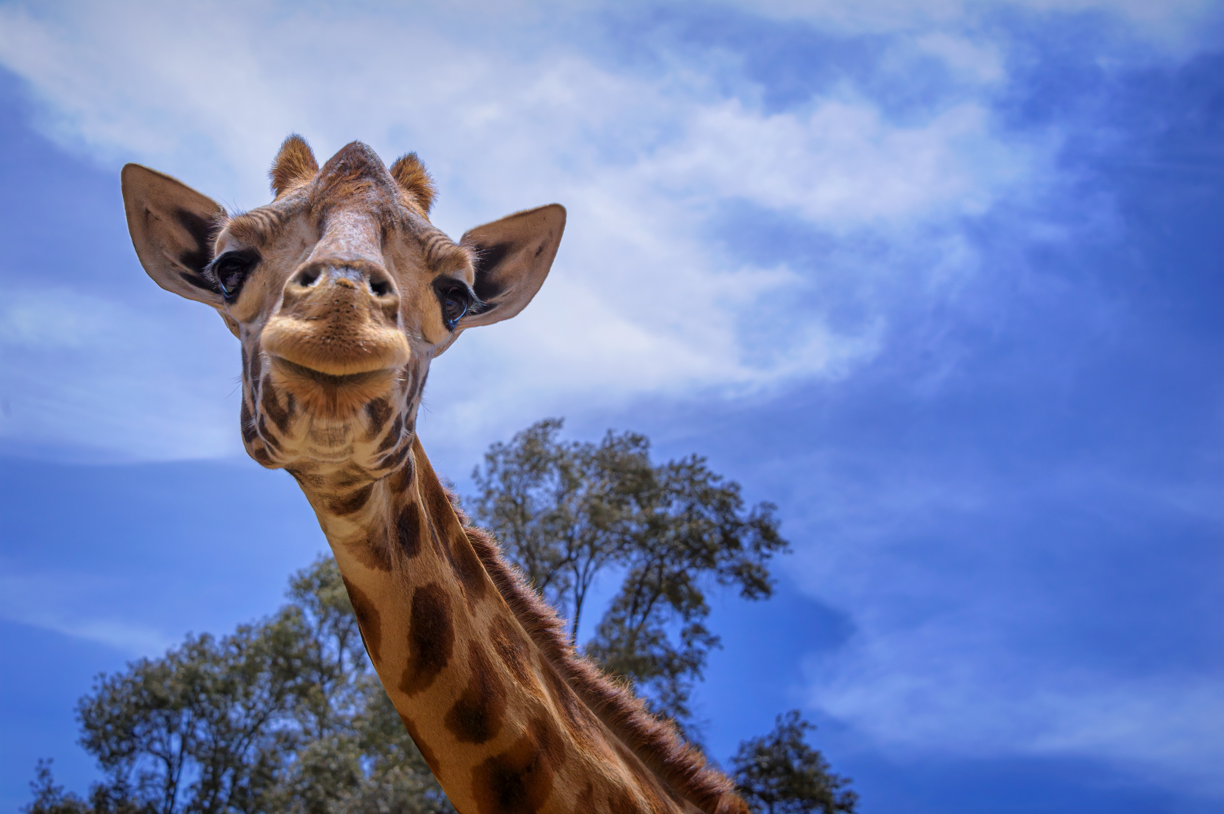
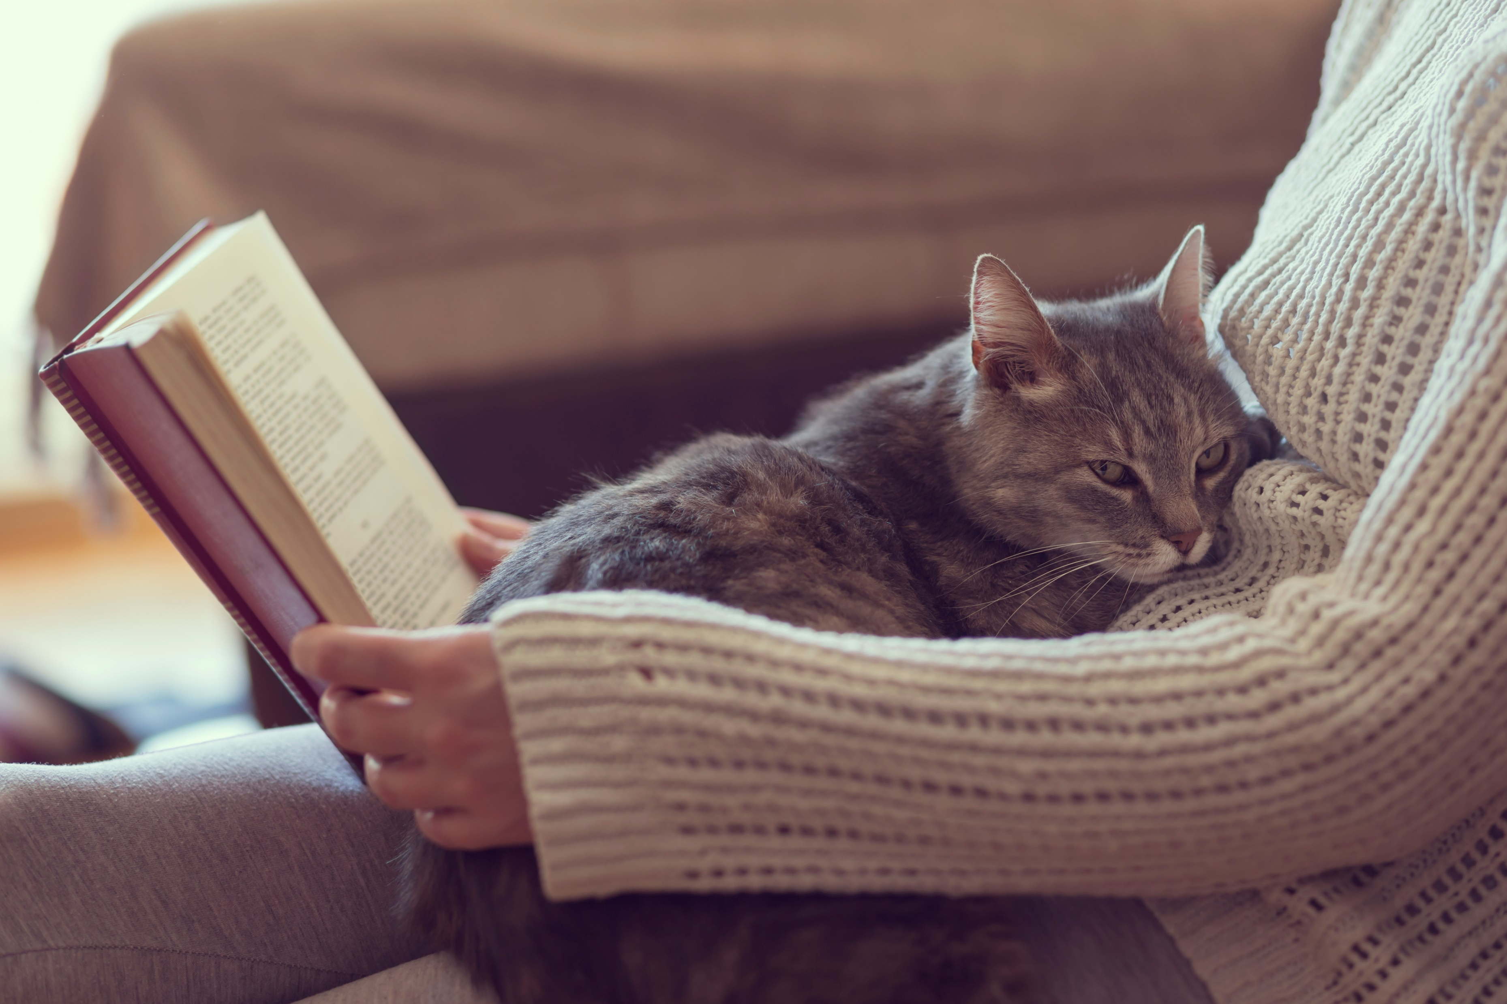
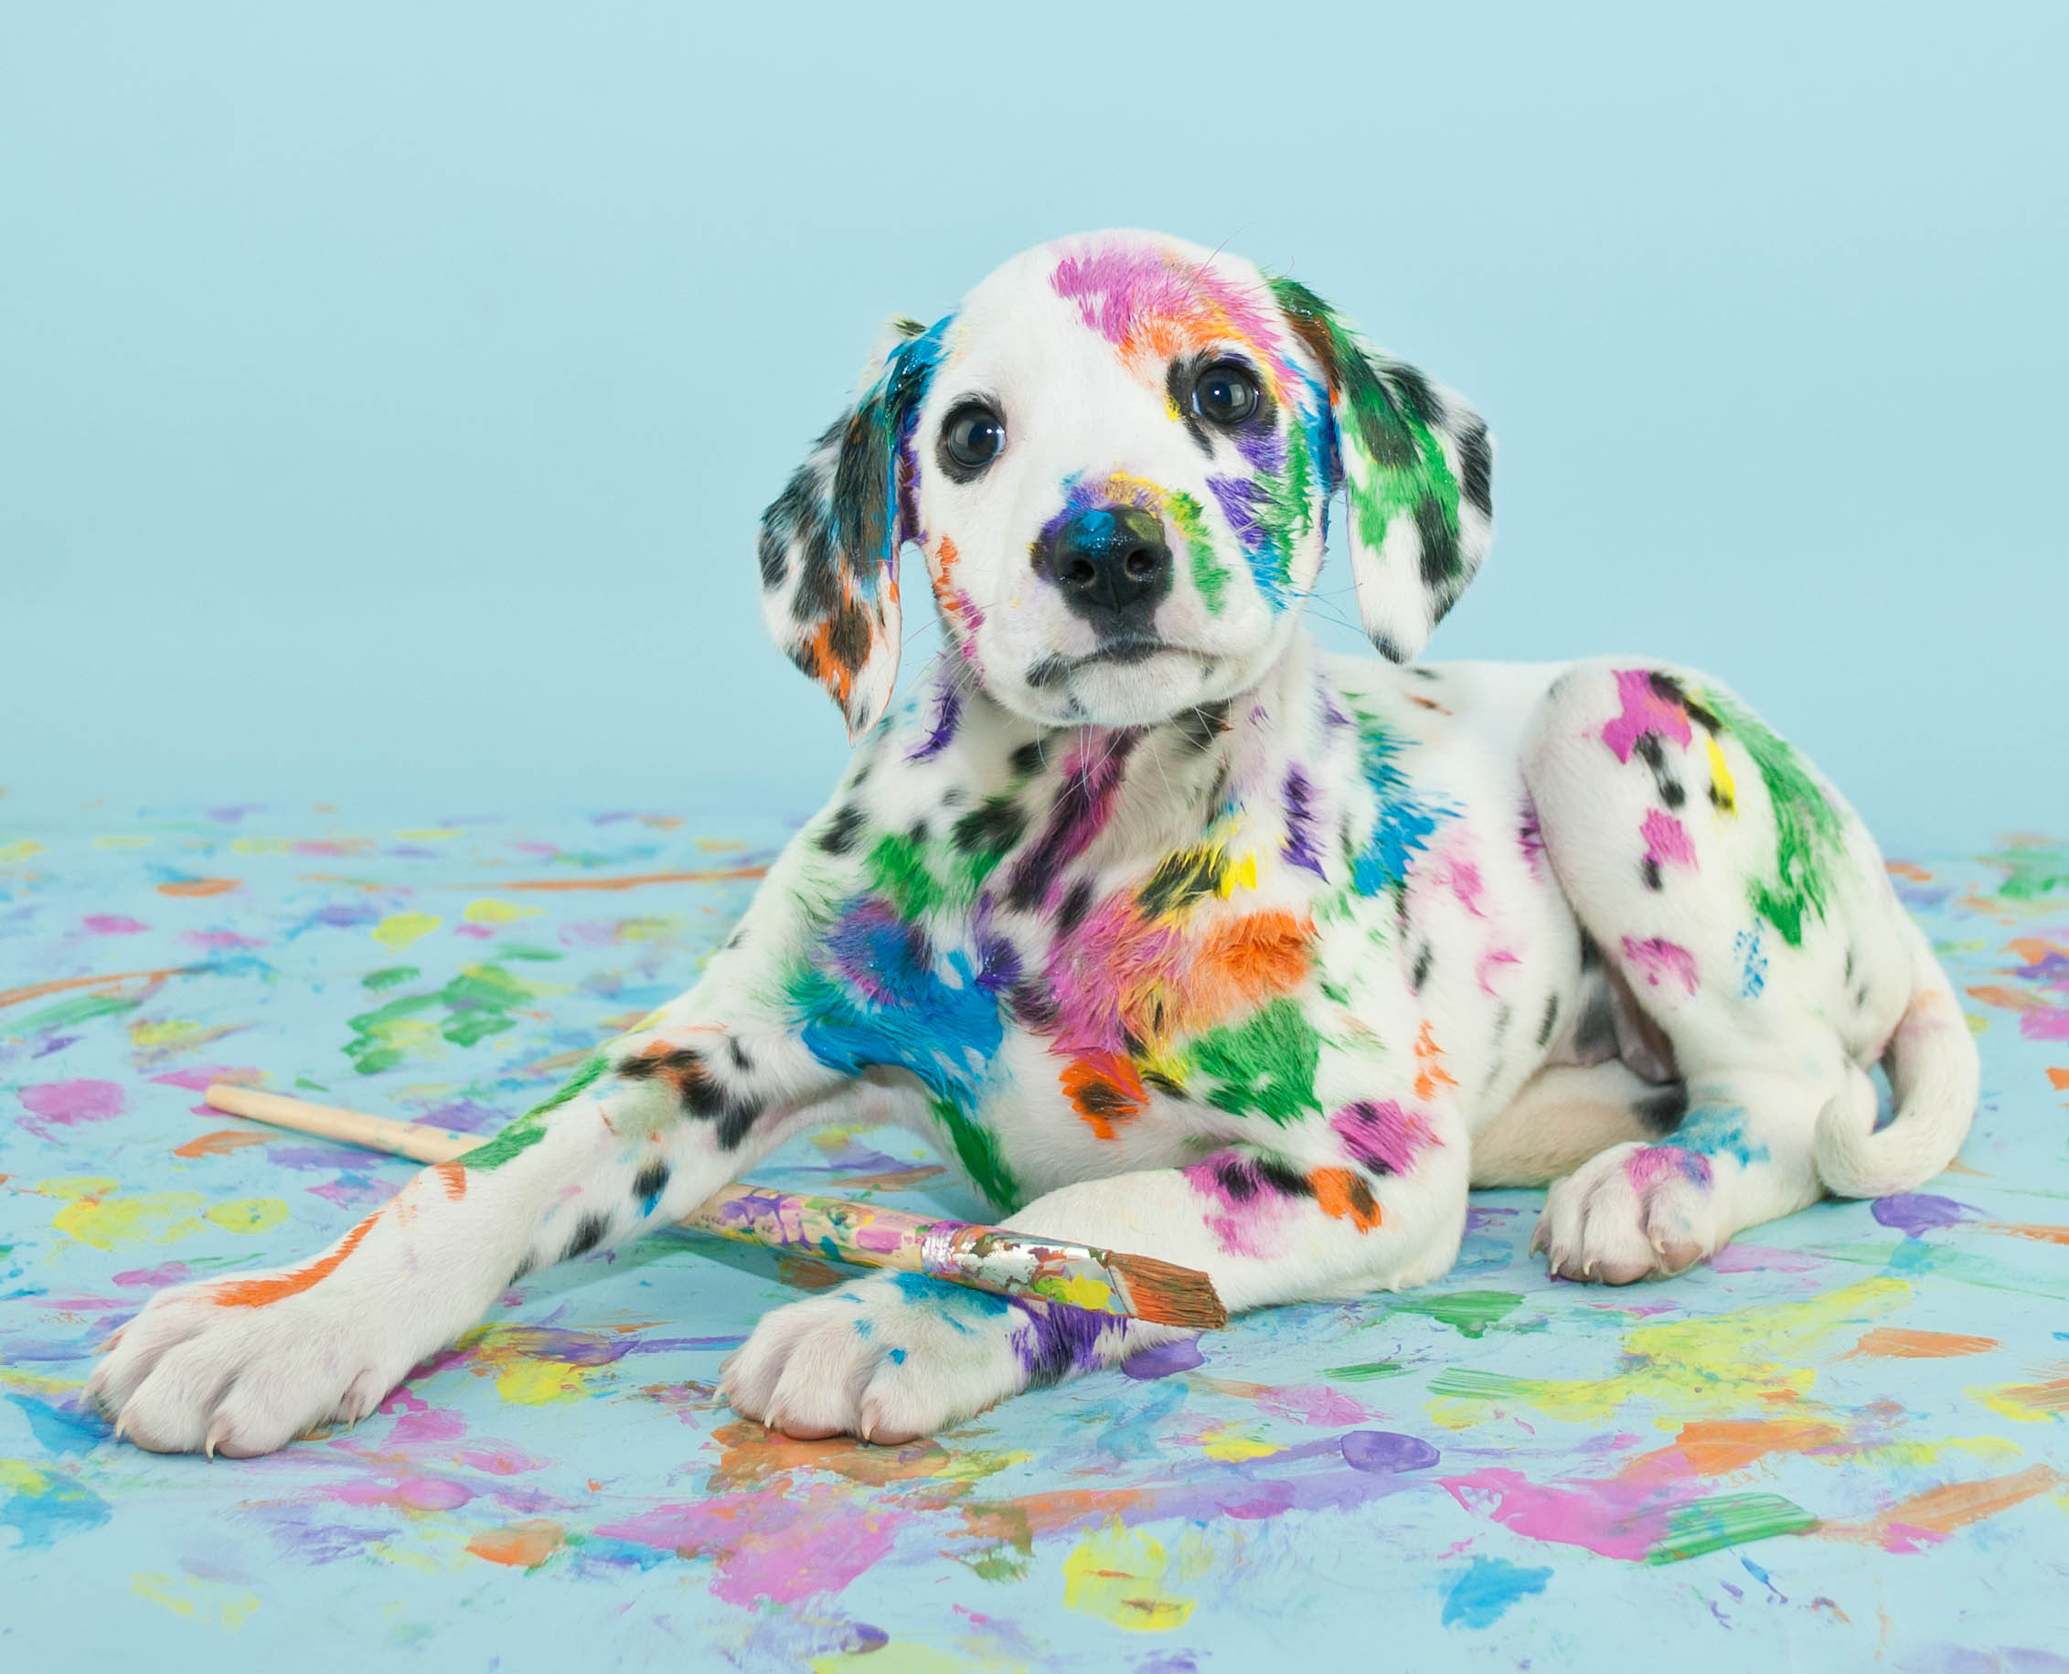
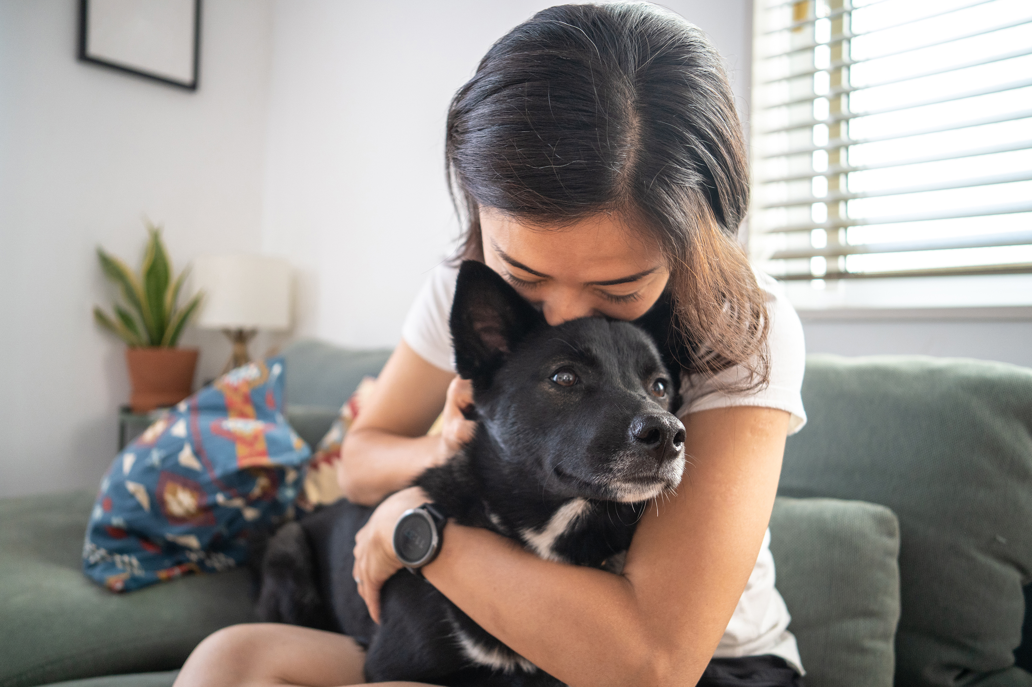
Independent learning Which image or images would you select to support the point of view that all classrooms should have a pet?
.
1. 2. 3. 4.
Images source: Microsoft 365 Image Library
© Department for Education, the Government of South Australia, Learning at home, 2022

Slide 5
Review How did you go? I think images 2 and 4 are the most likely to support the idea that all classrooms should have a pet because they express a calm, supportive atmosphere that is needed in a class. However, it depends on what you want to gain from having a class pet, calmness or laughter. I also love images 1 and 3 because if your classroom is upstairs you could feed the pet giraffe through the window and that would make me very happy to be at school. Image 3 makes me smile too. If I wanted a very funny and mischievous pet to make everyone laugh, this puppy would be the perfect class pet. In conclusion, from my point of view, they all support having a class pet depending on how you want to feel everyday.
.
1. 2. 3. 4.
© Department for Education, the Government of South Australia, Learning at home, 2022
Images source: Microsoft 365 Image Library

Slide 6
Learning intention
.
To know how to identify and select evidence that supports an opposing point of view.
© Department for Education, the Government of South Australia, Learning at home, 2022

Slide 7
Vocabulary
Term | Definition
Evaluate | Positive or negative language that judges the worth of something.
Evidence | Facts or information to support a point of view.
Opposing | To be opposite in point of view.
Point of view | An opinion or an attitude.
© Department for Education, the Government of South Australia, Learning at home, 2022

Slide 8
Points of view
On paper or a device, create a table as shown below. Then, plot the following words under the correct heading according to which point of view, positive or negative, the words relate to. The topic is, all classrooms should have a pet.
relaxing, dangerous, calming, distracting, supportive, messy, smelly, important, fun, fragile, needy, laugh, happy, unhealthy
All classrooms should have a pet
Positive | Negative
relaxing | distracting
© Department for Education, the Government of South Australia, Learning at home, 2022

Slide 9
Points of view How did you go?
All classrooms have a pet
Positive | Negative
relaxing calming supportive fun important laugh happy | distracting dangerous unhealthy messy smelly fragile needy
© Department for Education, the Government of South Australia, Learning at home, 2022

Slide 10
Opposing point of view
Having an opposing point of view is having an opposite point of view or opinion about a topic, place, person or item.
For example, if an author states that giraffes make great pets, an opposing point of view is, giraffes don’t make great pets.
© Department for Education, the Government of South Australia, Learning at home, 2022

Slide 11
Opposing point of view
Consider an opposing point of view.
From the text, shown across the following three slides, identify and select examples of language that supports the point of view that, ‘pets should not be allowed in classrooms’.
On paper or a device, record your examples.
© Department for Education, the Government of South Australia, Learning at home, 2022

Slide 12
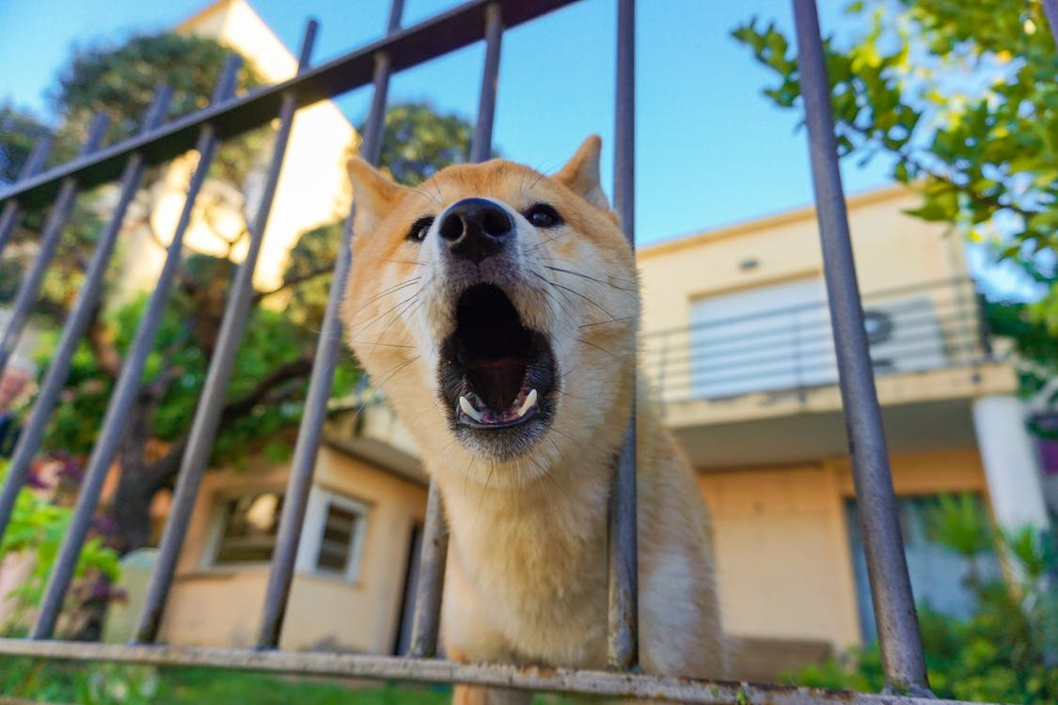
Pets should not be allowed in classrooms by Zena Davis
.
The wellbeing benefits of mixing students with animals are clearly stated in articles such as, Should every classroom have a pet? However, are these articles telling us the true story?
For example, a recent study by animal expert, Dr Tina Brown, proved that there were more problems associated with having pets in classrooms than benefits.
Source: Pexels
© Department for Education, the Government of South Australia, Learning at home, 2022

Slide 13
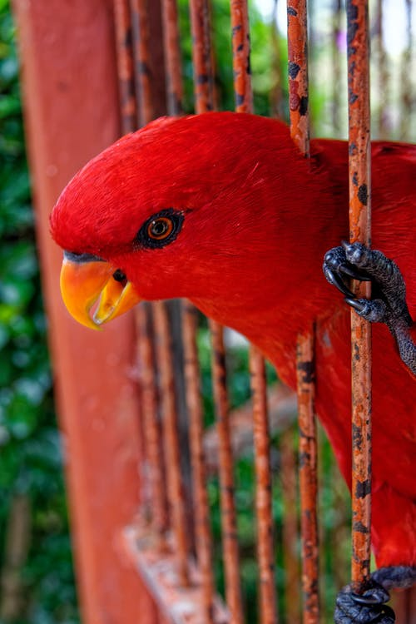
Pets should not be allowed in classrooms by Zena Davis
.
At one local school, the parents and staff have returned all class pets to their owners. They have caused terrible problems such as distraction from learning and dangerous health issues.
According to teacher, Ms Sally Smith, the problems pets have caused in her class have been disastrous.
‘Our pet bird was messy, chirped all day and distracted the students’, she said.
Source: Pexels
© Department for Education, the Government of South Australia, Learning at home, 2022

Slide 14
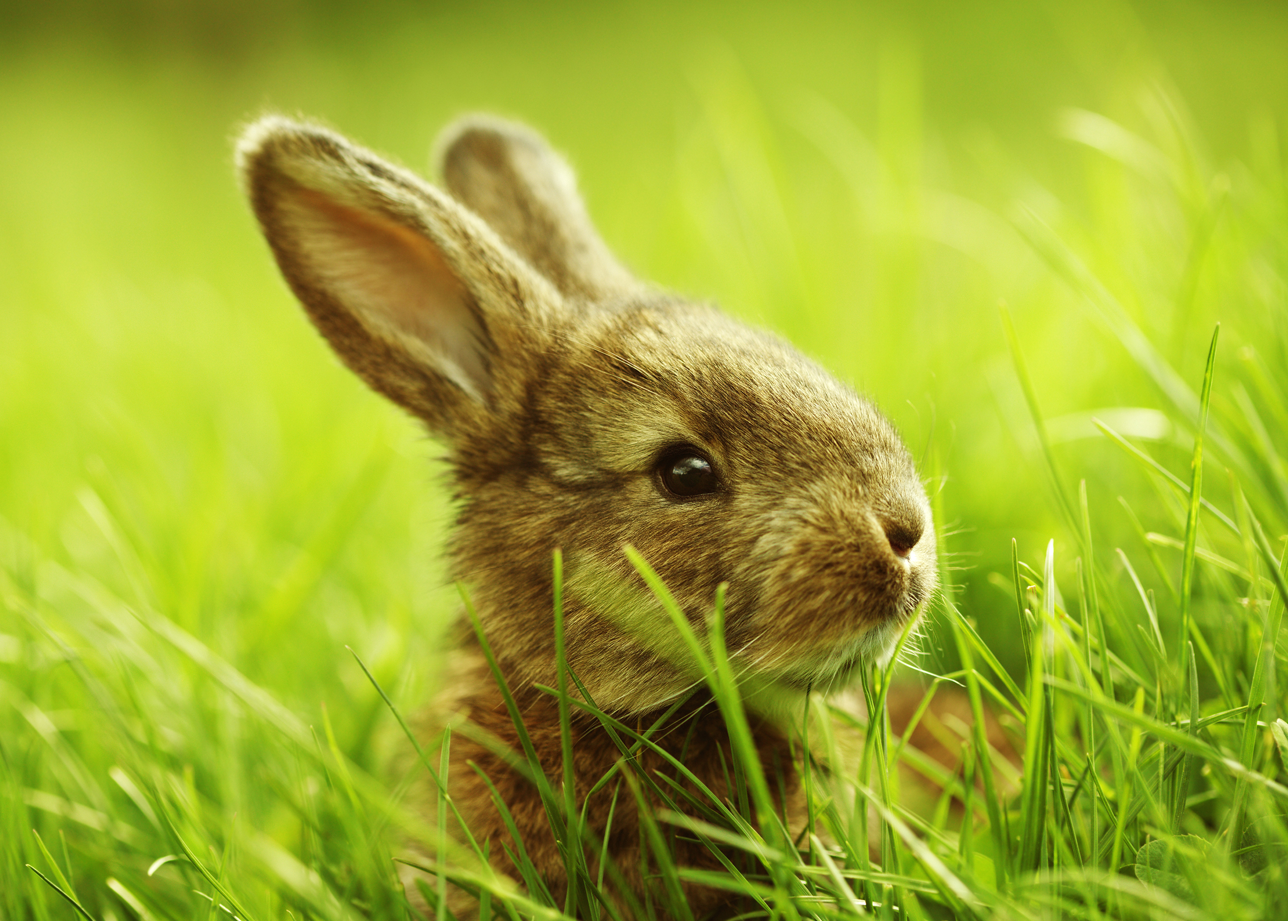
Pets should not be allowed in classrooms
.
by Zena Davis
Parent, Mr Tom Murray, complained that the class pet caused complex health issues.
‘I’ve made multiple complaints about Rex the rabbit. It’s caused
my child to be exhausted from sneezing all day’, he said.
A recent survey at a local primary school showed that 55% of students now say that a pet’s place is in the home and definitely not in the classroom.
Source: Microsoft 365 Image Library
© Department for Education, the Government of South Australia, Learning at home, 2022

Slide 15
Pets should not be allowed in classrooms by Zena Davis How did you go?
.
The wellbeing benefits of mixing students with animals are clearly stated in articles such as, Should every classroom have a pet? However, are these articles telling us the true story?
For example, a recent study by animal expert, Dr Tina Brown, proved that there were more problems associated with having pets in classrooms than benefits.
Source: Pexels
© Department for Education, the Government of South Australia, Learning at home, 2022

Slide 16
Pets should not be allowed in classrooms by Zena Davis
.
At one local school, the parents and staff have returned all class pets to their owners. They have caused terrible problems such as distraction from learning and dangerous health issues.
According to teacher, Ms Sally Smith, the problems pets have caused in her class have been disastrous.
‘Our pet bird was messy, chirped all day and distracted the students’, she said.
Source: Pexels
© Department for Education, the Government of South Australia, Learning at home, 2022

Slide 17
Pets should not be allowed in classrooms
.
by Zena Davis
Parent, Mr Tom Murray, complained that the class pet caused complex health issues.
‘I’ve made multiple complaints about Rex the rabbit. It’s caused
my child to be exhausted from sneezing all day’, he said.
A recent survey at a local primary school showed that 55% of students now say that a pet’s place is in the home and definitely not in the classroom.
Source: Microsoft 365 Image Library
© Department for Education, the Government of South Australia, Learning at home, 2022

Slide 18
Lesson review
.
Click on the box that correctly completes the statement.
An opposing point of view is…
an agreement
Try again
a procedure
Try again
a point of view that is opposite to the previously stated point of view
Correct!
a story
Try again
© Department for Education, the Government of South Australia, Learning at home, 2022

Slide 19
Lesson review
.
Click on the box that correctly completes the statement.
The feature article, Pets should not be allowed in classrooms, uses examples of …
diagrams
an opposing point of view
Try again
Correct!
instructions
music
Try again
Try again
© Department for Education, the Government of South Australia, Learning at home, 2022

Slide 20
Independent learning
Creamy cakes are great!
On paper or a device record a reason or reasons that give an opposing point of view to the heading, Creamy cakes are great!
Source: Microsoft 365 Image Library
© Department for Education, the Government of South Australia, Learning at home, 2022

Slide 21
Independent learning
To get you started, here’s one example of an opposing point of view for Creamy cakes are great!
Creamy cakes can be very messy to eat.
2.
3.
© Department for Education, the Government of South Australia, Learning at home, 2022

Slide 22
Daily reading routine
.
Choose something to read.​
Find a quiet, comfortable space to read.​
Read for 15 to 20 minutes.​
Have a chat about what you read with someone else.
© Department for Education, the Government of South Australia, Learning at home, 2022

Slide 23
.
© Department for Education, the Government of South Australia, Learning at home, 2022

Slide 24
© Department for Education, the Government of South Australia, Learning at home, 2022

