Slide 1

Year 8
English
Lesson 1 – representations in news media

Slide 3
You will need
A pen or pencil , paper or workbook.
A digital device.

Slide 4
Learning intention
To develop knowledge and understanding of what news is, its purpose and how it is reported.

Slide 5
Reflect on your knowledge and understanding
What is news?
What people, events or issues are newsworthy?
What is the purpose of news?
Why do people follow the news?
Record your reflections on these questions in your workbook or digital journal.

Slide 6
What is news?
It may be new or new information about something old.
It may be unusual.
It may be interesting.
It may be significant.
It may be about people.
It may be about an event or issue that will impact people.

Slide 7
What is the purpose of the news?
The primary purpose of news is to inform, however it may also educate or entertain the audience.

Slide 8
Why do we follow the news?
Knowing the news helps us meet some basic human needs:
    Safety – we need to know about basic resources such as food, water, and shelter for ourselves and for our families.
    Security – we need to make plans for the future, knowing that there will be peace, education, transport, employment and opportunities to go about our business.
    Community, connection and belonging – we need to know our community and how to get along with them.
    Creativity and entertainment – we need to share stories, laughter, sorrow and hope.

Slide 9
Student activity: news record
Begin to keep a record of news items that you come across.
Draw a simple table with 4 columns in your workbook or digital journal.
If you use a workbook use a double page so that you can add additional columns later.

Slide 10
Student activity: news record
The news item | Why this person, event or issue is news | Where I heard, viewed or read the news report | Who else might be interested?

Slide 11
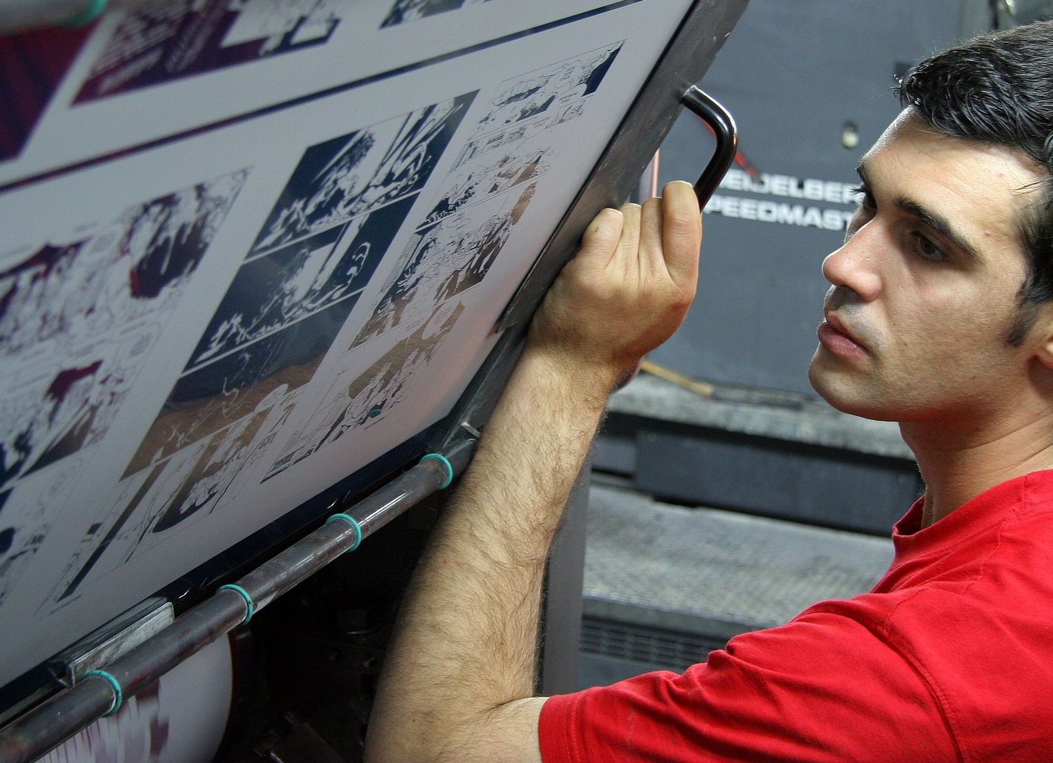
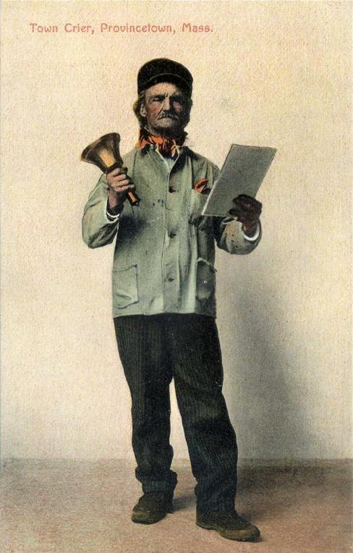

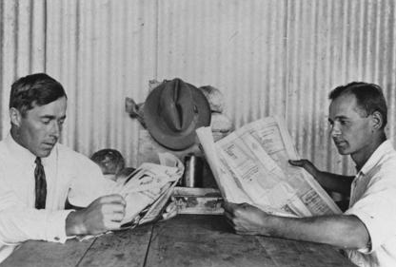
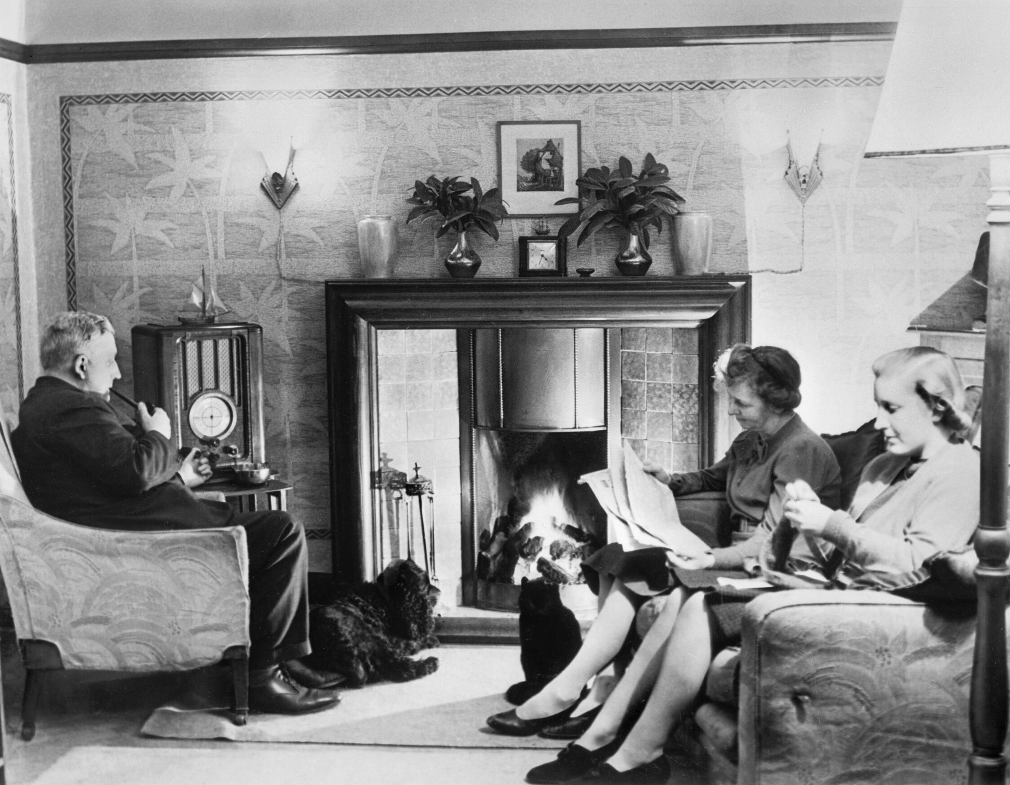
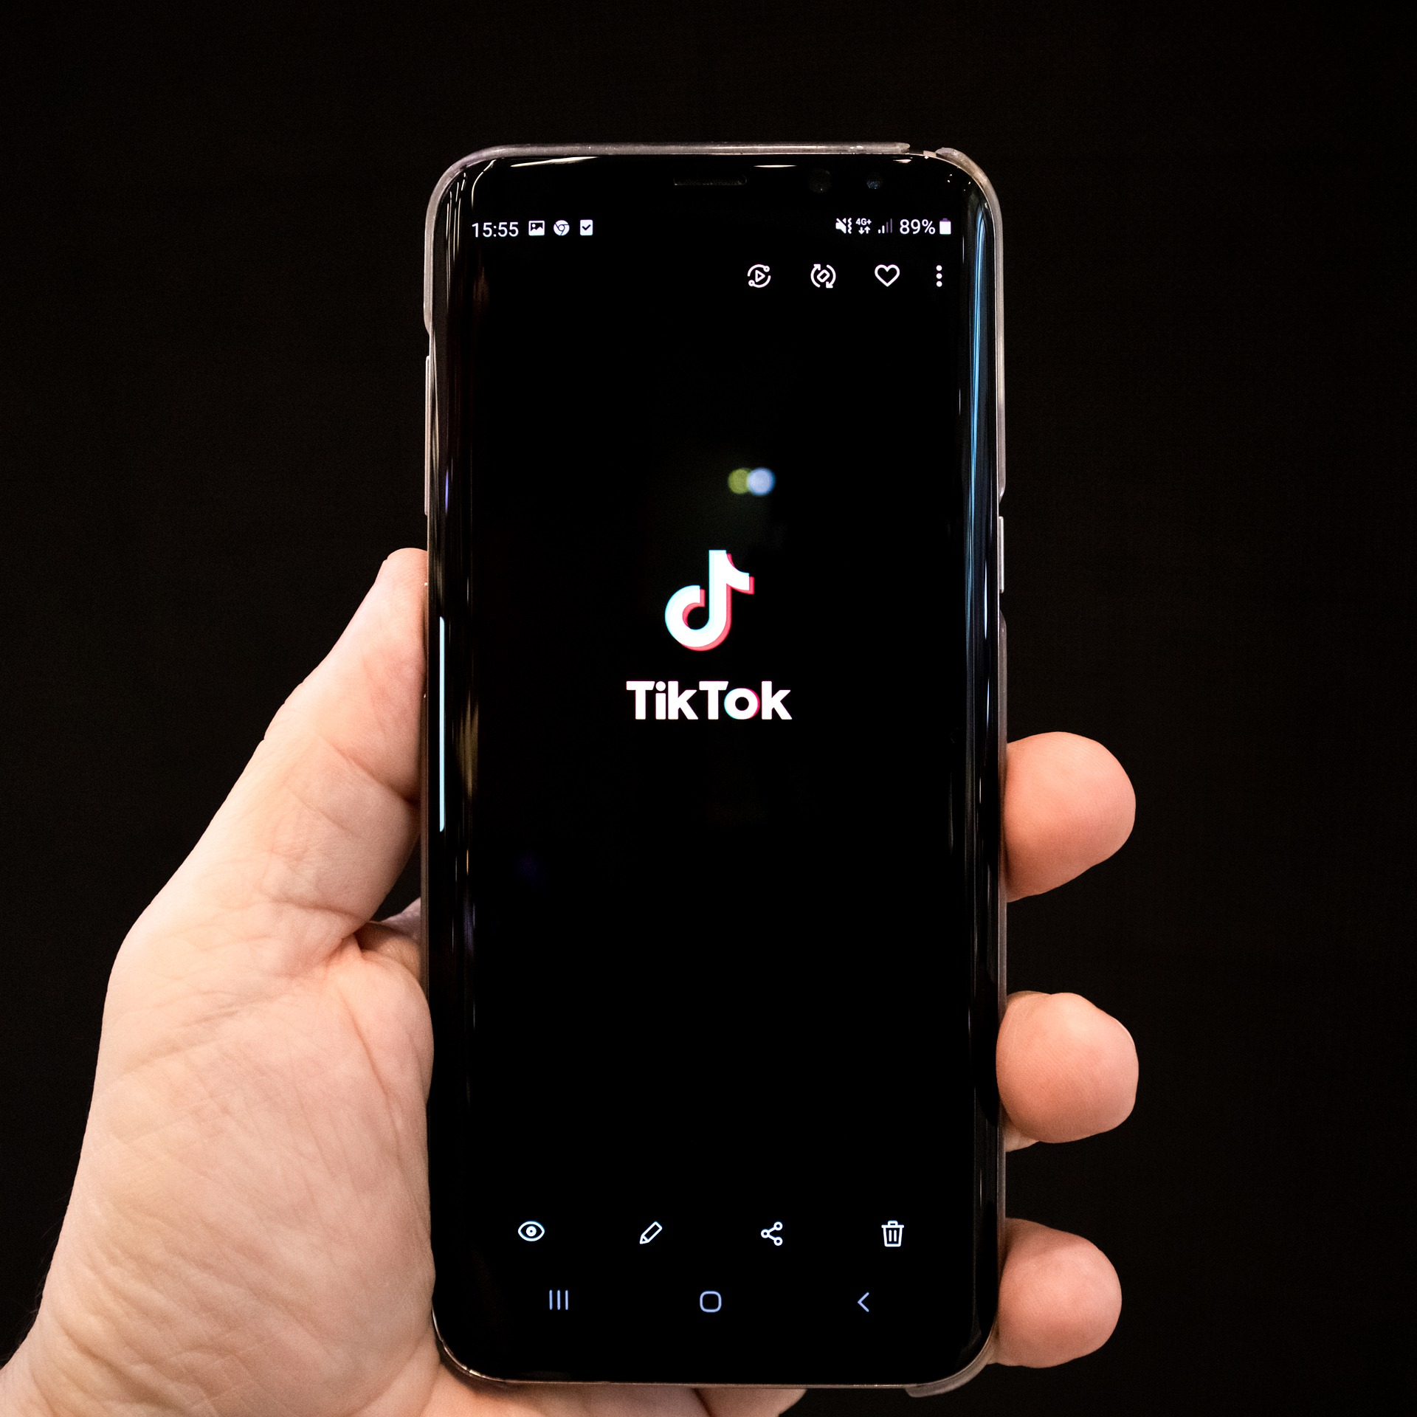

Old versus new
Source: Pixabay
Source: Pixabay
Source: State Library of Queensland [Public Domain]
Source: Wikimedia [Public Domain]
Source: Wikimedia [Public Domain]
Source: Pixabay
Source: Pixabay

Slide 12
Mind map
Television news
News Media
Phone news app

Slide 13
Lesson recap
In this lesson you developed your knowledge and understanding of what news is, its purpose and how it is reported.
Keep/save your news record and mind map in a safe place – you’ll need these in later lessons!

Slide 14
Daily reading routine
Choose something to read.
Read for at least 20 to 30 minutes.
After and perhaps during reading, make notes about what you’ve read (2 or more paragraphs).
If possible, have a chat about what you read with someone else.

