Slide 1
Year 8
English
Lesson 10 – is it real or is it fake?

Slide 3
You will need
A pen , paper or workbook.
A digital device.

Slide 4
What have we learnt?
How news has changed over time.
Structural elements of online news sites.
Conventions of infographics and data visualisations.
Assessing the credibility of a news source.

Slide 5
Learning intention
To define fake news and disinformation and understand the importance of being able to identify them.
Image: Pixabay

Slide 6
What is fake news?
Answer the following as you watch:
What is fake news?
List some of the ways in which you can verify if news is real or fake.
Source : How to spot fake news – BTN Media Literacy on YouTube (Behind the news, 2018). For your safety: watch this video in the slideshow without accessing YouTube

Slide 7
What is fake news and disinformation?
Fake news is:
false information which is presented as news
false information which is distributed deliberately
false information with no verifiable facts, sources or quotes
false information which is distributed for political or commercial purposes.

Slide 8
List some of the steps we can take to make sure our news is real and not fake
Step 1 Ask yourself some questions – can this be real? Is it a bit suspicious? Is it too crazy to be true?
Step 2 Read beyond the headline – headlines can be misleading or can act as clickbait (a headline which tries to manipulate you into following the link – usually makes you curious enough to click on it), read further to verify the facts.
Step 3 Dig deeper – who is the author? Where does the story come from? What is the source and is it trustworthy? Are there errors in the story, does it look professional? What is the story’s purpose? Is it actually news? Why was it written? Crosscheck the facts – use the web or other sources of information.

Slide 9
Headlines – fake or real?
Label the headlines as fake or real:
NASA is installing internet on the moon
A university banned the use of capital letters to avoid scaring students
Couple in California name baby with emoji
Eight-year old girl pulls medieval sword from lake
German street covered in chocolate after leak from chocolate factory

Slide 10
Headlines – fake or real?
Label the headlines as fake or real:
NASA is installing internet on the moon – real
A university banned the use of capital letters to avoid scaring students – fake
Couple in California name baby with emoji – fake
Eight-year old girl pulls medieval sword from lake – real
German street covered in chocolate after leak from chocolate factory – real

Slide 11
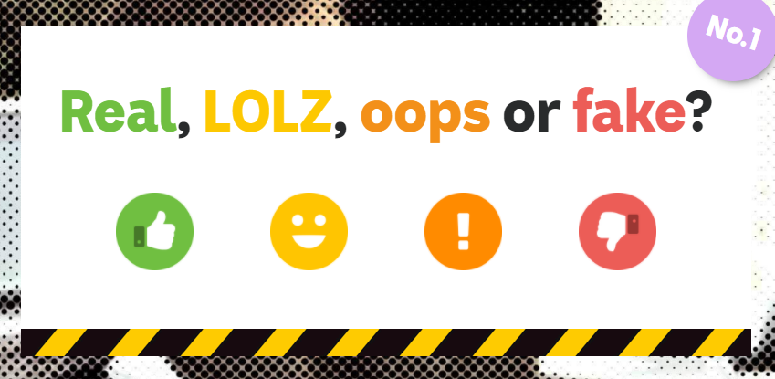
Student activity 1 – can you spot a fake?
Access the interactive here:
Source : ABC Education

Slide 12
Student activity 2 – design your own clickbait
As a creative writing activity:
find three interesting articles online
copy the lead paragraphs of the articles into your workspace
write clickbait headlines for each of your lead paragraphs.

Slide 13
Recap
Fake news – a definition.
How to be literate and critical consumers of the news.

Slide 14
Daily reading routine
Choose something to read.
Read for at least 20 to 30 minutes.
After reading, make notes about what you’ve read (2 or more paragraphs).
If possible, have a chat about what you read with someone else.

