Slide 1

Year 8
English
Lesson 5 – the metalanguage of news media

Slide 3
Learning intention
To develop knowledge and understanding of some of the vocabulary which is specific to news media.

Slide 4
You will need
A pen, paper or workbook.
A digital device.
Your news record table (created in lesson1 ).
The news item ​ | Why this person, event or issue is news​ | Where I heard, viewed or read the news report​ | Who else might be interested?​ ​ | Is it local, state/national or international news?
 | ​
​ | ​ | ​ | ​
​ | ​ | ​ | ​

Slide 5
Introduction
In previous lessons, you began to explore some of the vocabulary which is very specific to the features of news media, that is, the metalanguage.
You looked at some definitions and examples of terms such as headlines and lead. The next couple of slides have been included to remind you of what they are.
In this lesson, we will begin to look at examples of some of the other metalanguage that is used in the world of print news media.

Slide 6
Metalanguage
Headline This is the topic of the news report. The headline attracts attention through the size and style of the font. It is usually a short, punchy sentence fragment which makes use of a variety of techniques to attract attention, such as emotive language, alliteration, puns, metaphors, rhetorical questions and more.
Lead In a news story, the lead is usually the first paragraph of the report. The lead summarises the 5W questions.

Slide 7
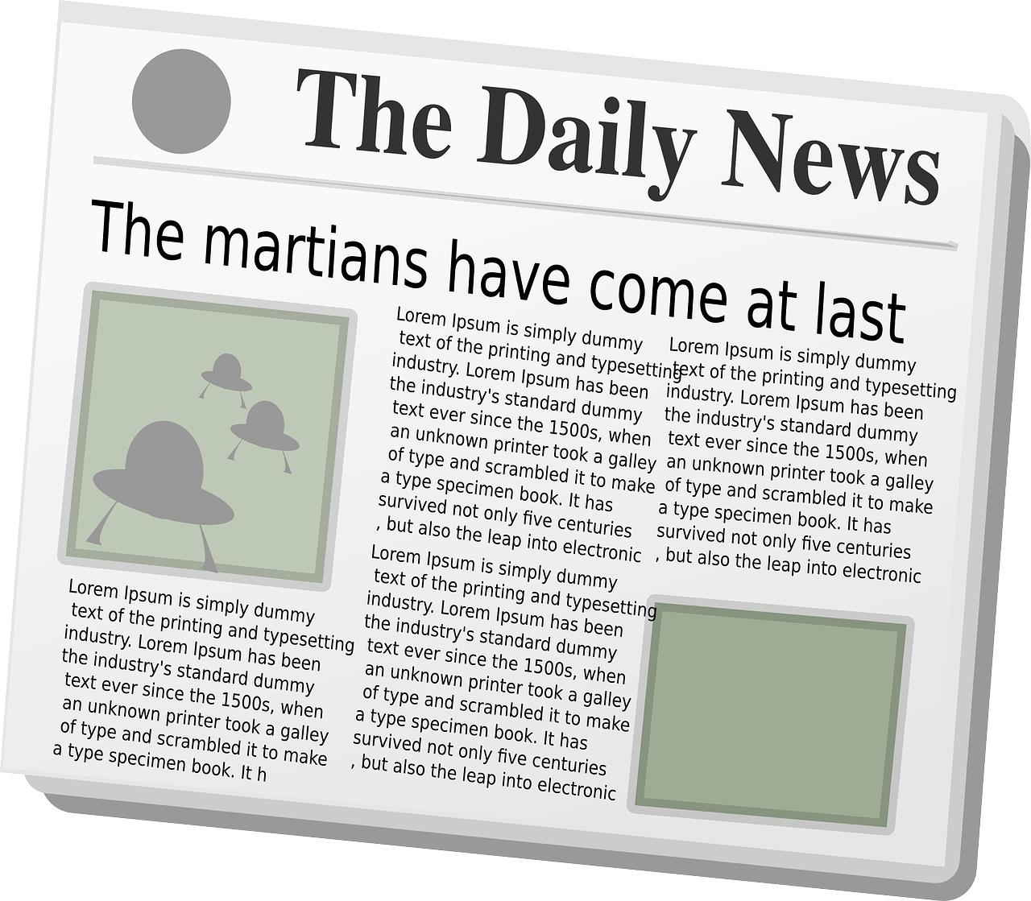
Headline
The headline provides the topic of the news report and acts as the ‘hook’.
It attracts the readers’ attention using a variety of structural elements, language features and literary devices:
size, colour and style of font
short, punchy sentence fragments
emotive language, command verbs
word play (puns)
alliteration
metaphor
intertextual references
rhetorical questions and more.
Source: Pixabay

Slide 8
Lead
In a news story, the lead is usually the first paragraph of the report. The lead summarises the 5W questions.
5Ws: Who, What, Where, When, Why
other important information
less important details
least important
details
Source: Pixabay

Slide 9
Metalanguage
Masthead Is the newspaper’s name displayed in a top prominent position. It is a brand logo and is meant to advertise the publication’s character.
Skyline The skyline is the panel that usually appears above the masthead. Each skyline has a headline, an image, a page turn, and often has a category. Skylines are not intended to inform the reader, rather they advertise the publication.

Slide 10
Metalanguage
Banner The banner is the group of panels which form a strip across the top of the page and might include the masthead and skyline. Sometimes the banner might also include a banner headline. It is valuable space which reveals the publication’s priorities.

Slide 11
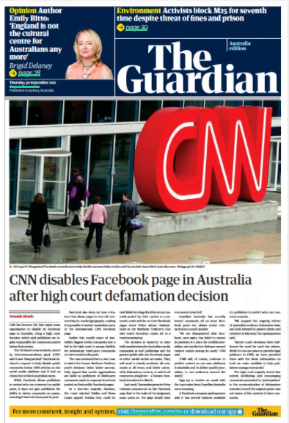
Masthead, skyline, banner
Banner
Skyline
Masthead
Let’s have a look at an example of the features that we have explored so far:
Source: The Guardian Australia, 30 September 2021
https://www.theguardian.com/media/2021/sep/29/cnn-disables-australian-facebook-page-after-high-court-defamation-decision

Slide 12
Metalanguage
Tagline The tagline is a slogan that builds the readers’ recognition and brand loyalty. Taglines appear in the banner in a prominent position. Essentially, they are another advertising technique and like the skyline use catchy, engaging language features.
Date and edition
The date helps demonstrate that a newspaper is a credible and trustworthy record of events; it means that historical accuracy can be cross-checked.
Some printed newspapers may publish more than one edition during the course of a day. They might have a morning, evening or international edition.

Slide 13
Tagline
Some examples of taglines include:
The Mirror – ‘The Heart of Britain’
Fox News – ‘Fair and Balanced’
The Edmondson News – ‘It covers Dixie Like The Dew’
The Aspen Daily News – ‘If You Don’t Want It Printed, Don’t Let It Happen’
Have a look at your news record table and see if you can identify any taglines from the examples of publications you have recorded.

Slide 14
Metalanguage
Page turn A page turn tells the reader where to find an article or where to continue reading the rest of the article. Page turns commonly appear in three places; in the skyline, near a news report, or at the end of a report that has been cut-off midway.
Cut, cutline and image credits
The cut is the collected photographs, illustrations and other visual materials on the page. Cutlines are captions that accompany these and provide brief descriptions so that readers can make sense of the image. Image credits show the source of the image.

Slide 15
Page turn, cut, cutline
Have another look at the page from
The Guardian newspaper that we have been studying.
In this example, are you able to identify a page turn, a cut and a cutline?
Source: The Guardian Australia, 30 September 2021
https://www.theguardian.com/media/2021/sep/29/cnn-disables-australian-facebook-page-after-high-court-defamation-decision

Slide 16
Page turn, cut, cutline
Page turn
Cut
Cutline
Source: The Guardian Australia, 30 September 2021
https://www.theguardian.com/media/2021/sep/29/cnn-disables-australian-facebook-page-after-high-court-defamation-decision

Slide 17
Metalanguage
This matter is important to our community. These parklands are part of our history and our cultural identity, and we need to preserve them for future generations.
Pull quote
A pull quote is a phrase, quotation, or excerpt taken directly from an article. It is presented as larger, boxed or in a different font and is intended to capture the readers’ attention and entice them to read the article.

Slide 18
Student activity
In this activity you will need to:
Look closely at the 2 news media front pages on the next slide.
Identify any of the features of news media that we have explored in lesson 3 and 4 that you can find.
Record in your workbook or digital journal the feature and the example you have found from each of the front pages.
To begin, go to the next slide where you will find a front page from the Washington Post, 14 November 2021 and The Mail, 13 June 2021.

Slide 19
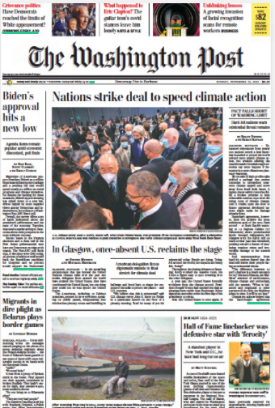
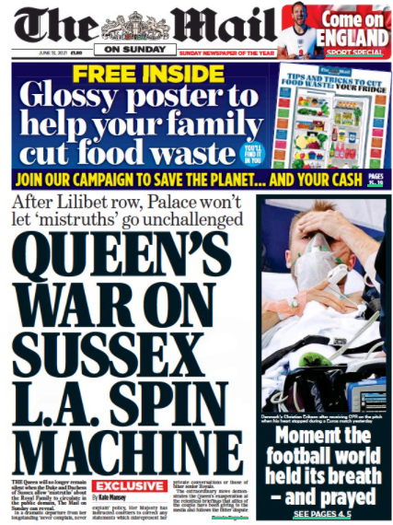
Source: Washington Post, 14 November 2021, https://thewashingtonpost.pressreader.com/the-washington-post/
Source: The Mail, 13 June 2021
https://www.thepaperboy.com/uk/the-mail-on-sunday/front-pages-today.cfm?frontpage=63583

Slide 20
Lesson recap
In this lesson, you continued to develop your knowledge and understanding of some of the vocabulary which is specific to news media.

Slide 21
Student activity
Think about a recent event or an issue that is important to you.
Come up with a headline.
In your workbook or digital journal, write a lead paragraph which provides the reader information about the 5Ws.

Slide 22
Daily reading routine
Choose something to read.
Read for at least 20 to 30 minutes.
After and perhaps during reading, make notes about what you’ve read (2 or more paragraphs).
If possible, have a chat about what you read with someone else.

