Slide 1
Year 8
English
Lesson 6 – let’s talk about brand and audience

Slide 3
What have we learnt?
News – a definition.
The purpose of news.
News in context: local, state or national, and international news.
Hard versus soft news.
5Ws – who, what, where, when and why.
Structural conventions of a front page.

Slide 4
Learning intention
To consolidate our understanding of the structure of a news media front page and understand how the reader is influenced by the structural elements of a front page.

Slide 5
You will need
A pen, paper or workbook.
A digital device.
Vocabulary – general definitions and structural elements of a front page.

Slide 6
Vocabulary – general definitions
Term | Definition
text structure | the way in which information is organised in different types of texts
literary devices | narrative, poetic and rhetorical devices authors use in their texts
language features | features of language that support meaning – they can be worded language features, visual or performative
hard news | breaking news, factual, a daily record of events with the most impact on the audience
soft news | human interest stories, background information to news of the day, opinion pieces, news in entertainment, fitness, travel and more
5Ws | who, what, where, when, why of a news report

Slide 7
Vocabulary – structural elements of a front page
Term | Definition
news package | group or ‘package’ of news items about one event
entry points | elements of front page to attract reader attention, such as section labels, photographs, headlines, captions, pull quotes
headline | topic of the news report
lead | first paragraph of a news report
standfirst | works with the headline as to hook the reader into the story – a sentence or phrase, usually in bold, but not as large as the headline
masthead | name of the newspaper
skyline | a panel above the masthead (usually) giving readers information about articles and sections inside the publication

Slide 8
Vocabulary – structural elements of a front page
Term | Definition
banner | panels across the top of the front page, includes the skyline and masthead
tagline | company or publication slogan (usually in the banner)
page turn | tells the reader where to find the article or continue reading
cut and cutline | photographs, illustrations and other visual materials on the page and their captions
pull quote | phrase, quotation or excerpt from the article which is larger or presented in a text box to attract reader attention
headline | topic of the news report
lead | first paragraph of a news report
standfirst | adds information to headline to hook the reader – larger size and font than body of news

Slide 9
Front page – what is the purpose?
Purpose:
to attract reader attention
to sell their brand and representation of the news to the reader.
Some essential questions to ask:
What type of audience is being persuaded to buy and read this publication?
How is the news presented to the target audience?
How are events, issues and individuals being represented?

Slide 10
Front page – a closer look at structure
Click on the image on this slide to access an online version of the front page of The New York Times.
Then answer the questions which follow in your workspace.
Source: The New York Times, 23 June 2018, www.nytimes.com/issue/todayspaper/2018/06/23/todays-new-york-times

Slide 11
Front page – The New York Times
Question 1: front page layout – entry points
How many items or stories appear on The New York Times front page? List the story headlines.

Slide 12
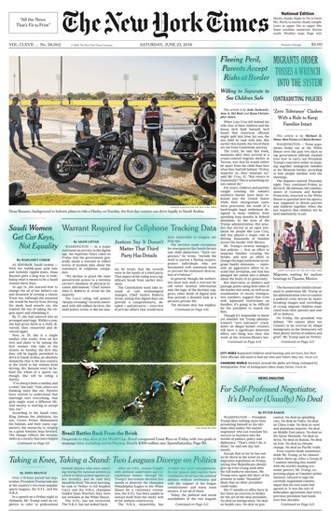
Question 1 – check your answer How many items or stories appear on the front page?
Eight news items have been included on this front page:
Saudi Women Get Car Keys, Not Equality
Warrant Required for Cellphone Tracking Data
Fleeing Peril, Parents Accept the Risks at Border
Migrants Order Tosses a Wrench Into the System
Brazil Battles Back From the Brink
For Self-Professed Negotiator, It’s Deal or (Usually) No Deal
Taking a Knee, Taking a Stand: Two Leagues Diverge on Politics
Source: The New York Times, 23 June 2018 www.nytimes.com/issue/todayspaper/2018/06/23/todays-new-york-times

Slide 13
Front page – The New York Times
Question 2 front page layout: cut – entry points
Roughly calculate how much of the front page is made up of cut (images or photographs) and how much of text.
Based on the ratio of cut to text, what does this reveal about how this publication is branding itself for potential readers?
Source: The New York Times, 23 June 2018 www.nytimes.com/issue/todayspaper/2018/06/23/todays-new-york-times

Slide 14
Question 2 – check your answer
Roughly calculate how much of the front page is made up of cut (images or photographs) and how much of text.
Roughly a 1/3 of the front page is made up of cut, and 2/3 is text.
Based on the ratio of cut to text, what does this reveal about how this publication is branding itself for potential readers?
This is a publication focussed on the news, on the content of the article as opposed to the visuals.

Slide 15
Front page – The New York Times
Question 3: structural elements – banner
Identify and list the structural elements included in the banner of this particular publication.
Source: The New York Times, 23 June 2018, www.nytimes.com/issue/todayspaper/2018/06/23/todays-new-york-times

Slide 16
Question 3 – check your answer Identify and list the structural elements included in the banner of this front page.
Structural elements in the banner are the:
tagline: “All the News That’s Fit to Print”
masthead: The New York Times
edition type: National Edition
weather forecast with page turn: Mostly cloudy…Weather map, Page A22.
edition number: VOL. CLXVII…No. 58,002 (translates to 2018…No. 58,002)
copyright information: © 2018 The New York Times Company
date of edition: Saturday, June 23, 2018
place of printing: Chicago
price: $3.00.

Slide 17
Front page – The New York Times
Question 4: tagline – literary device
Identify the literary device used in the tagline – “All the News That’s Fit to Print”.

Slide 18
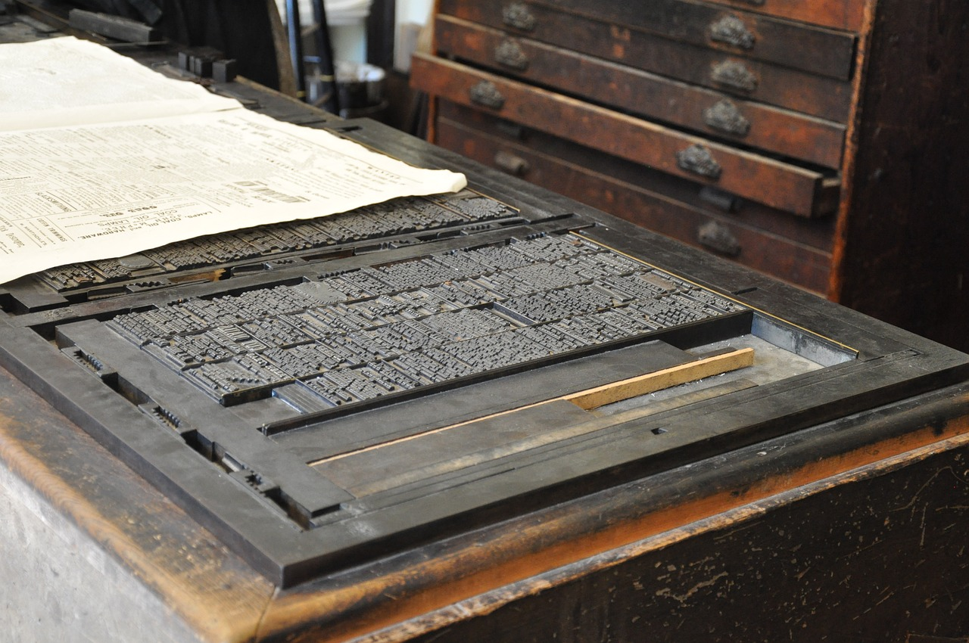
Question 4 – check your answer Identify the literary device used in the tagline.
A pun or wordplay is used in the tagline – “All the News That’s Fit to Print”.
Source: Pixabay

Slide 19
Front page – The New York Times
Source: The New York Times, 23 June 2018 www.nytimes.com/issue/todayspaper/2018/06/23/todays-new-york-times
Question 5: section labels - entry points
List the news categories and headlines in the section labels. What do the section labels reveal about how the publication brands itself for potential readers? And what type of reader is being targeted?

Slide 20
Question 5 – check your answer What do the section labels reveal about how the publication brands itself for potential readers?
Some of you may have considered the following:
breadth and balance of content – types of news articles and content listed include Business Day, International, Obituaries, Arts, New York, SportsSaturday, Editorial Op-Ed, Kids Section: National Parks
news which is relevant to an educated (probably university educated), mostly well-off readership, whose interests are varied and broad. The assumption too is that some of the readers have children (Kids Section), and are potentially older.

Slide 21
Recap
Brand and audience – a summary
How does the newspaper brand itself to potential readers?
What type of reader is the publication targeting?

Slide 22
Student activity
Repeat the process:
analyse the banner of the front page and consider the tagline
identify and analyse the entry points, with particular focus on the section labels, type and number of stories featured on the front page, the cut and cutlines
describe the brand of this particular publication, how it brands itself to potential readers
describe the audience targeted by this newspaper.
Source: The New York Post, 23 June 2018 nypost.com/cover/covers-for-june-23-2018/

Slide 23
Student activity: mind map
Television news
News Media
Phone news app

Slide 24
Daily reading routine
Choose something to read.
Read for at least 20 to 30 minutes.
After reading, make notes about what you’ve read ( 2 or more paragraphs).
If possible, have a chat about what you read with someone else.

