Slide 1
Year 8
English
Lesson 7 – how do people read the news?

Slide 3
You will need
A space to note down your answers.
Your mind map.

Slide 4
Learning intentions
To understand how news media has changed over time and how technology has changed the way we access our news.

Slide 5
Sources of news mind map
Social media:
Facebook
Instagram
Tik Tok
Twitter
YouTube
Snapchat
Reddit
Tumblr
Blogs, comment sections
The internet:
search engines
& websites
Phone news apps & widgets
Libraries, classrooms & waiting rooms
Radio news
Where does our News come from?
Television news
Community noticeboard
Newspapers & magazines
Posted community articles, council mail or reports
Family
Teachers or other adults
Friends

Slide 6
When a society’s storytelling – its news reporting – is not accurate, objective and fair, it leads to conflict, misinformation and a breakdown in trust. News should report the facts, the information we read should be credible and verifiable.

Slide 7
Vocabulary – useful adjectives
accurate correct in all details, exact (similar words: correct, precise, exact, right, errorless)
objective not influenced by personal feelings or opinions in considering and representing the facts (similar words: unbiased, impartial, unprejudiced)
fair without favouritism or discrimination (similar words: just, equitable)

Slide 8
Vocabulary – useful adjectives continued…
credible able to be believed, trustworthy, convincing (similar words: acceptable, reliable, dependable, plausible)
verifiable able to be checked or demonstrated to be true and accurate

Slide 9
Vocabulary activity
Complete each sentence using one of the words in the highlighted text box:
fair objective verifiable credible accurate
News reporting should be ………….., providing readers with the correct details and facts.
………… reporting is not influenced by opinion or personal feelings.
News reporting that treats people, events and ideas equally without favouritism or discrimination can be described as ………….
Before believing what you read in the news, you should make sure the source of your news is ………….. and trustworthy.
……………. facts and information can be checked, and proven to be true, accurate and justified.

Slide 10
Vocabulary activity – answers
fair objective verifiable credible accurate
News reporting should be accurate, providing readers with the correct details and facts.
Objective reporting is not influenced by opinion or personal feelings.
News reporting that treats people, events and ideas equally without favouritism or discrimination can be described as fair.
Before believing what you read in the news, you should make sure the source of your news is credible and trustworthy.
Verifiable facts and information can be checked, and proven to be true, accurate and justified.

Slide 11
Old news media and new news media
Source: Pixabay
Source: Pixabay

Slide 12
Old news media and new news media
Old media forms on new platforms:
the mastheads, headlines and advertising space of newspaper front pages are being transferred to online media homepages, apps and message alerts
the news anchors and roving reporters of broadcast television and radio now broadcast in YouTube news channels, or in podcasts.

Slide 13
Can I trust this source of news?
Is the source credible?
Who is the publisher or creator of this news platform or source?
Why should I trust this source?
What authority or credibility do they have?
What is the purpose of this news?
Source: Pixabay

Slide 14
Student activity – can I trust this source?
What gives this report credibility? Questions we need to ask:
Who are the Reuters Institute?
Who is the University of Oxford?
Why should anyone listen to what they have to say anyway?
What authority and credibility do they have?
What is the purpose of this report?

Slide 15
Student activity – I can trust this source
What gives this report credibility? Questions we need to ask:
Who are the Reuters Institute? University of Oxford’s research centre – studies issues affecting news media globally.
Who is the University of Oxford? One of the oldest universities in the English-speaking world, highly respected university in the small town of Oxford, United Kingdom. Ranked first in the world for many years and has over 25,000 students.
Why should anyone listen to what they have to say anyway?
What authority and credibility do they have?
What is the purpose of this report?

Slide 16
News – how do people read it?
Source: Reuters Institute Digital News Report 2021 on YouTube
For your safety, watch this video in the slideshow without accessing YouTube

Slide 17
Student activity 1 – the key points
According to the report, which age group has the weakest ties to traditional news media?
Where are most young people (60%) likely to find their news?
In which visual networks are young people increasingly sharing the news that matters to them?
The report highlights some important questions publishers will face in the near future – one of these questions is: How will news publishers engage the next generation of news consumers?
What are your ideas?
How do you think the publishers of news can interest you, as that generation, and keep you informed so that you can have your say?

Slide 18
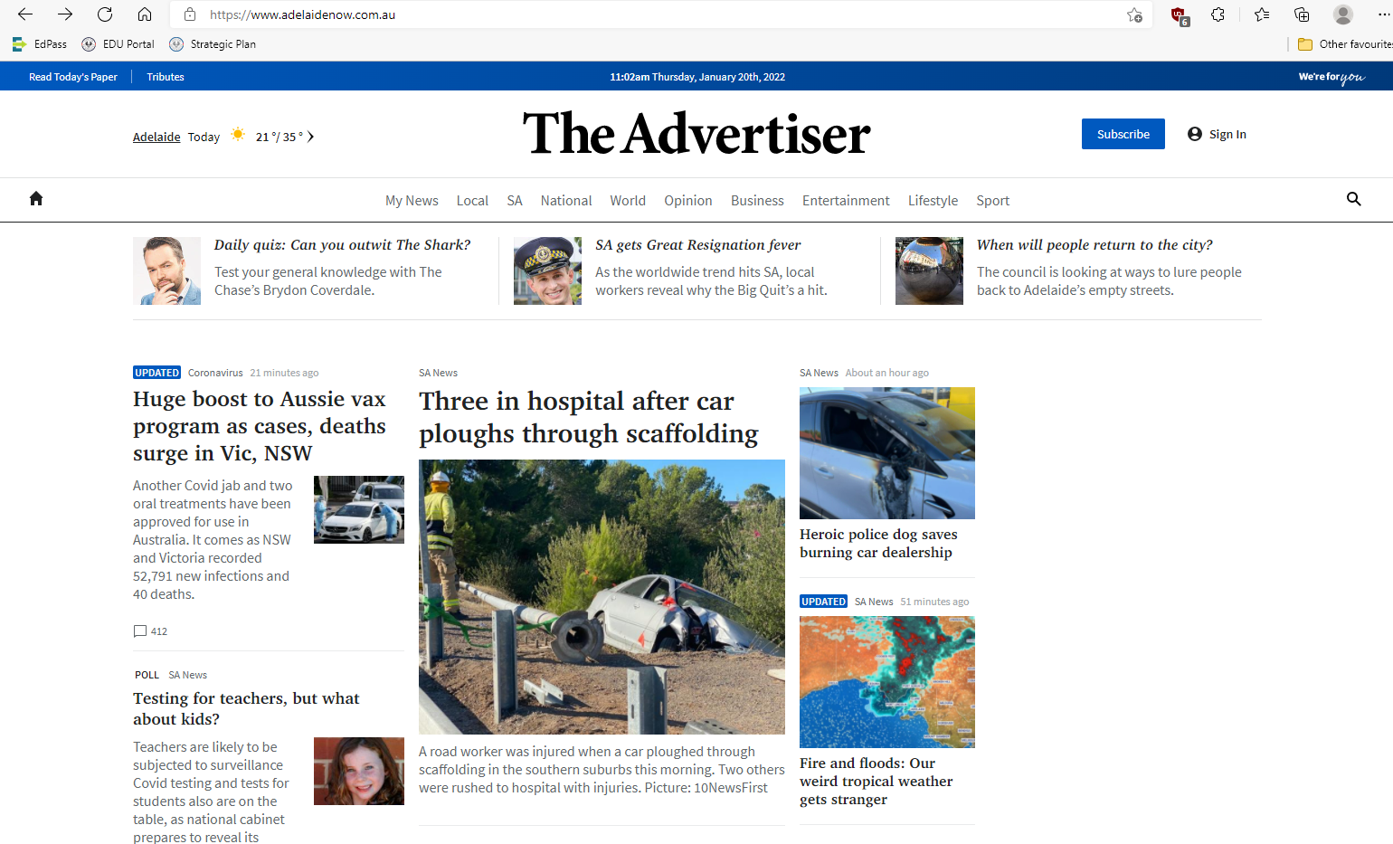
Student activity 2 – old news into new news
Source: The Advertiser, 20 January 2022, http://adelaidenow.com.au ,
Source: The Advertiser, 20 January 2022, www.adelaidenow.com.au

Slide 19
Recap
The way we access our news has changed.
How to verify the credibility of a news source.

Slide 20
Daily reading routine
Choose something to read.
Read for at least 20 to 30 minutes.
After reading, make notes about what you’ve read (2 or more paragraphs).
If possible, have a chat about what you read with someone else.

