Slide 1

Year 8
English
Lesson 8 – comparing the text structures of printed and online news media

Slide 3
You will need
A pen, paper or workbook.
A digital device.

Slide 4
Learning intention
To develop an understanding of the similarities and differences in text structure between printed and online news reports.

Slide 5
Introduction
As news media has gone online and digital, authors have used new forms and platforms to engage readers in ways that are more inclusive and interactive.
Despite these innovations in how news is presented today, there are a range of features that have been adapted from print news media and incorporated into digital forms to engage the reader.
Readers need to recognise how they are being engaged with by online news media.
Are they swept away by engaging, inclusive and interactive text structures but not really being informed by credible news?

Slide 6
Activity
Watch this episode of Behind The News which talks about the revolution occurring in how we get our news.
In your workbook or digital journal record your notes from the video and your response to the following question.
In the video it was suggested that in the future people may have to pay for their news. What are some of the possible implications of that for individuals or society?

Slide 7
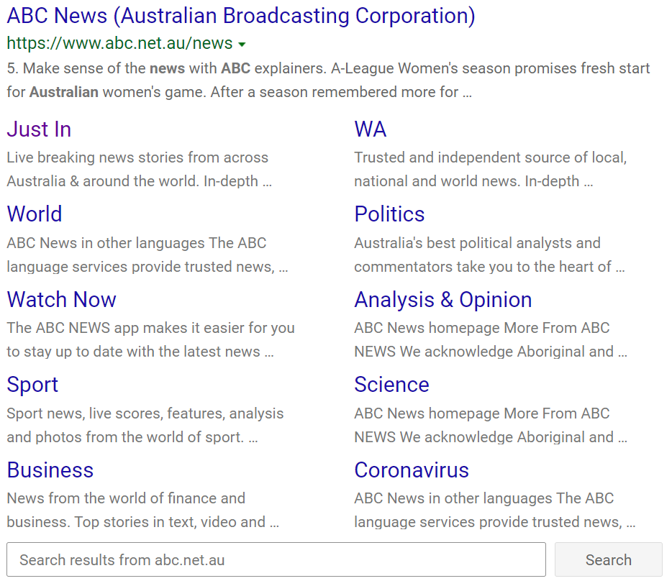
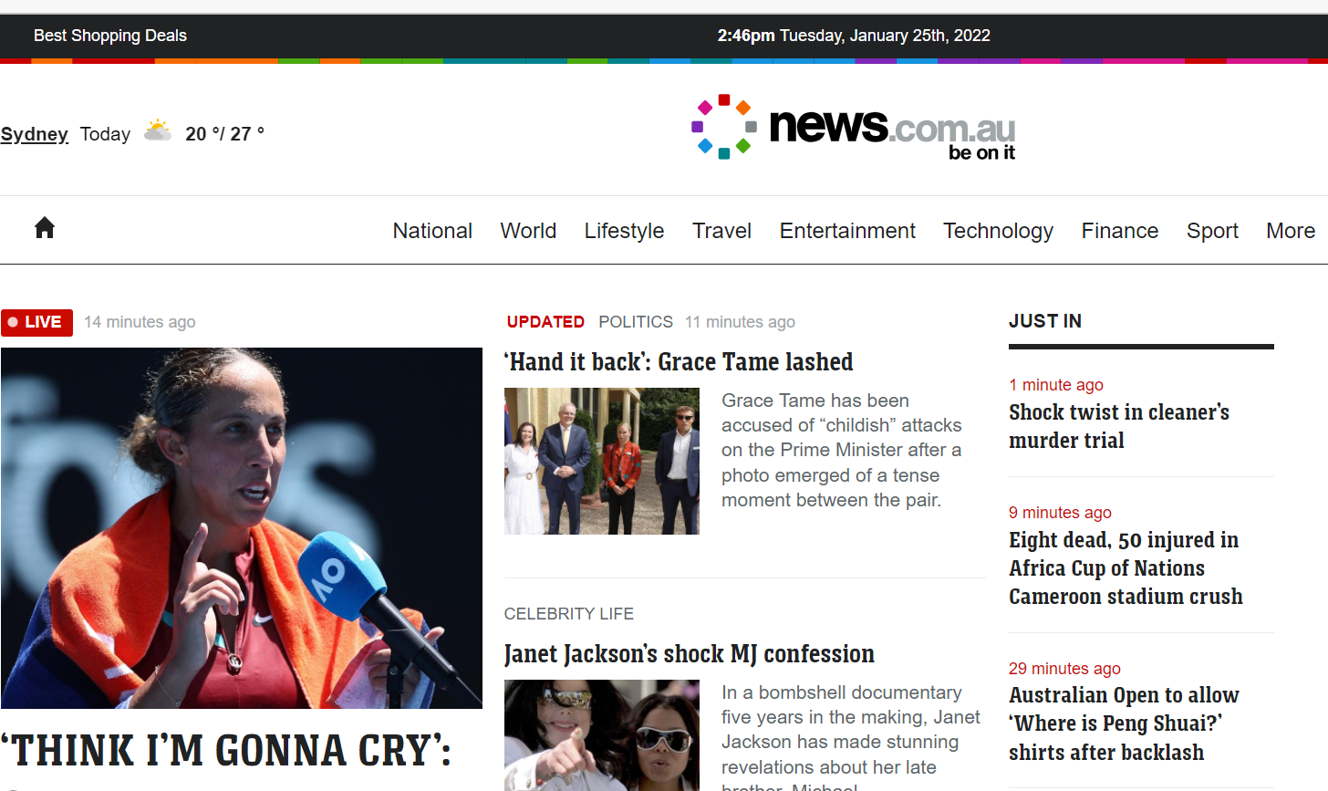
Entry points
Source: News.com.au, 25 January 2022, http://news.com.au
Source: ABC News, 25 January 2022 a Google search on January 25, 2022

Slide 8
Structural features
Date
Masthead
Banner
Tagline
Headline
Lead
Cut
Pull quote
Source: News.com.au, 25 January 2022, http://news.com.au
Page turn

Slide 9
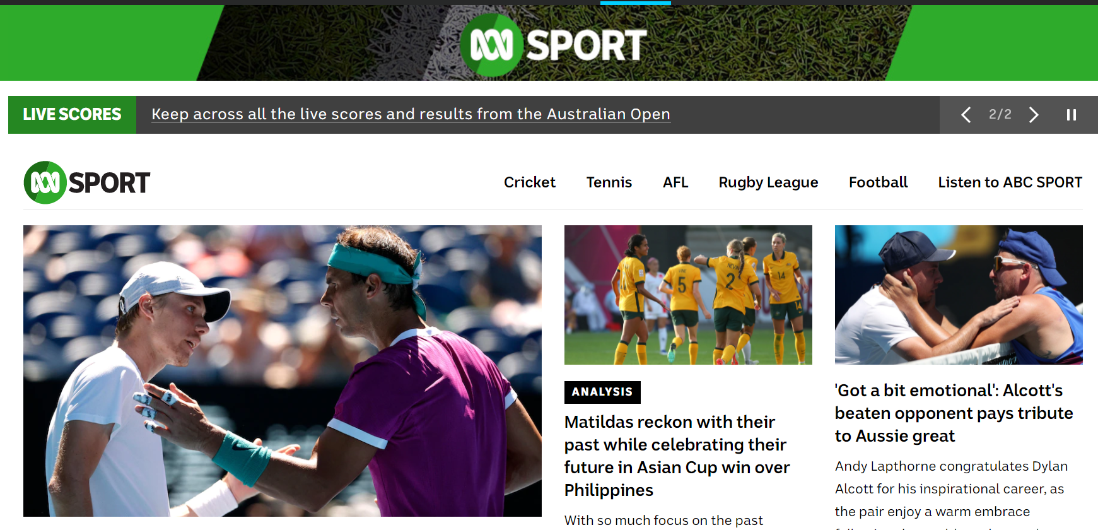
Cut
Source: ABC News Sport, 25 January 2022, http://www.abc.net.au/news/sport/

Slide 10
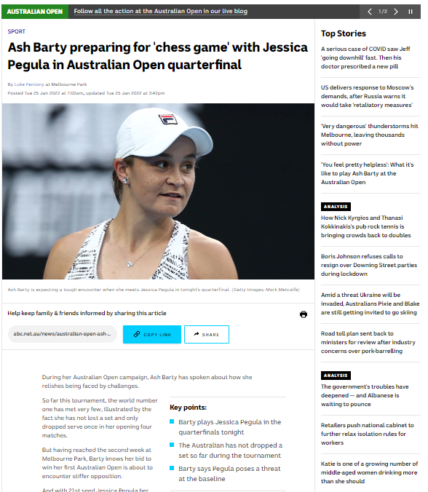
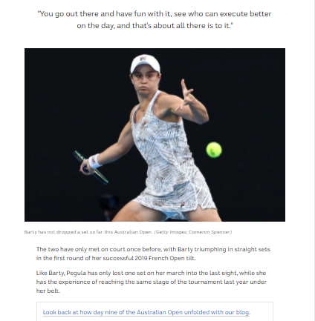
Structural features
Source: ABC News Sport, 25 January 2022, http://www.abc.net.au/news/2022-01-25/australian-open-ash-barty-jessica-pegula/100778998

Slide 11
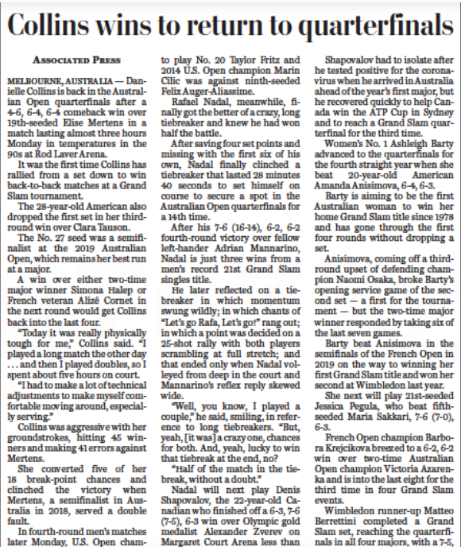
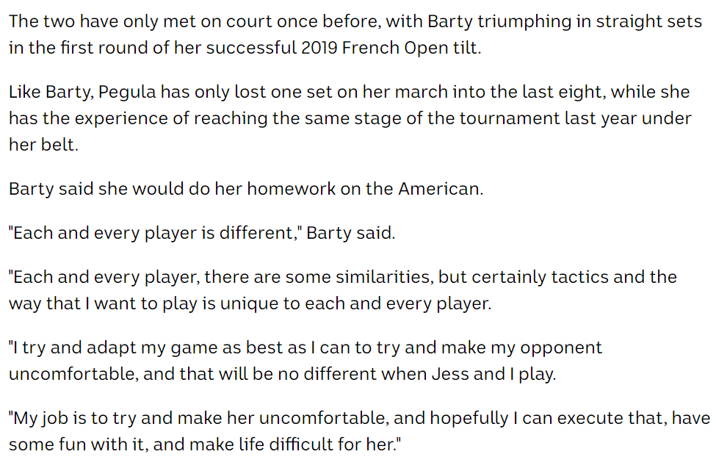
Source: ABC News 25 January 2022, www.abc.net.au/news/2022-01-25/australian-open-ash-barty-jessica-pegula/100778998
Source: The Washington Post, 24 January 2022, http://www.washingtonpost.com

Slide 12
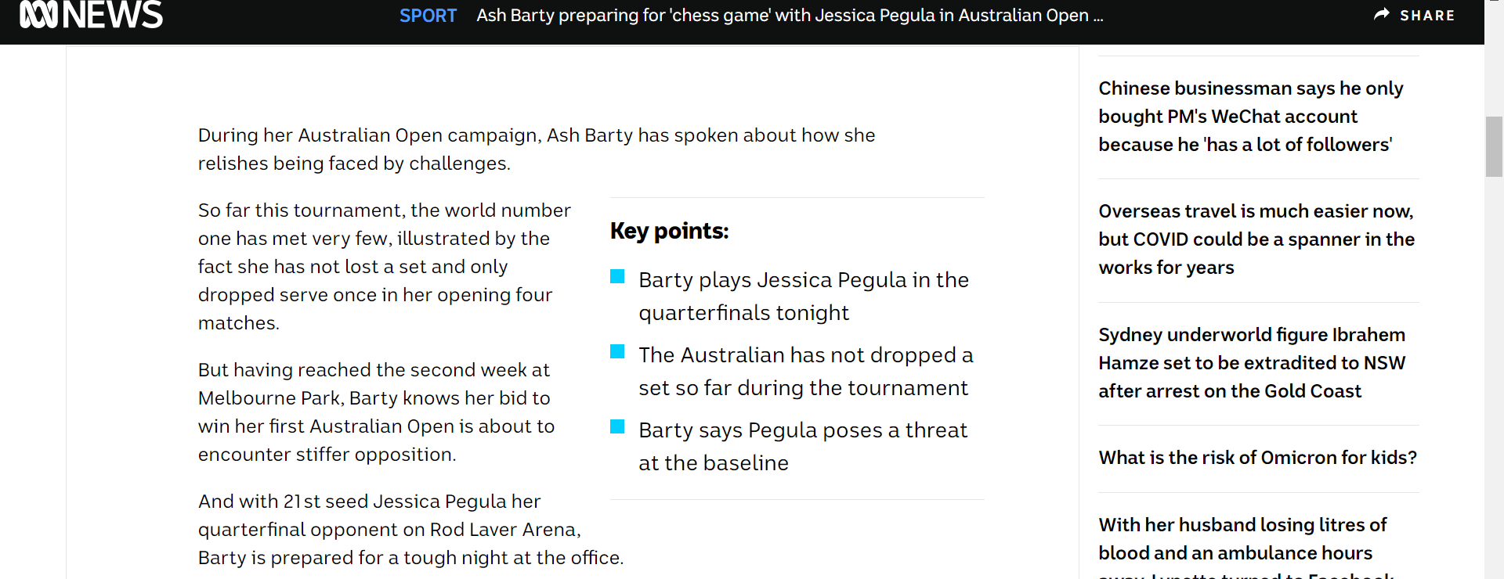
Source: ABC News Sport, 25 January 2022, http://www.abc.net.au/news/2022-01-25/australian-open-ash-barty-jessica-pegula/100778998

Slide 13
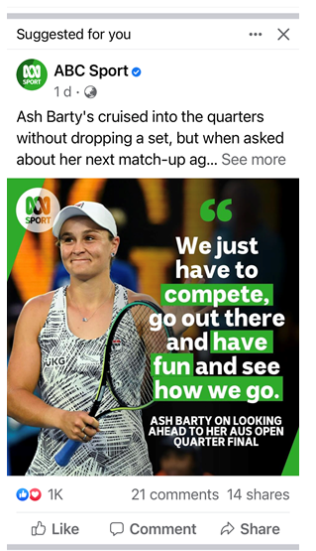
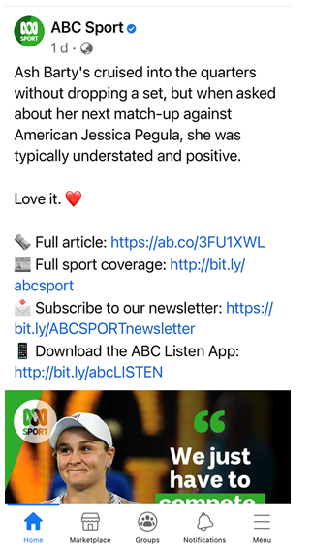
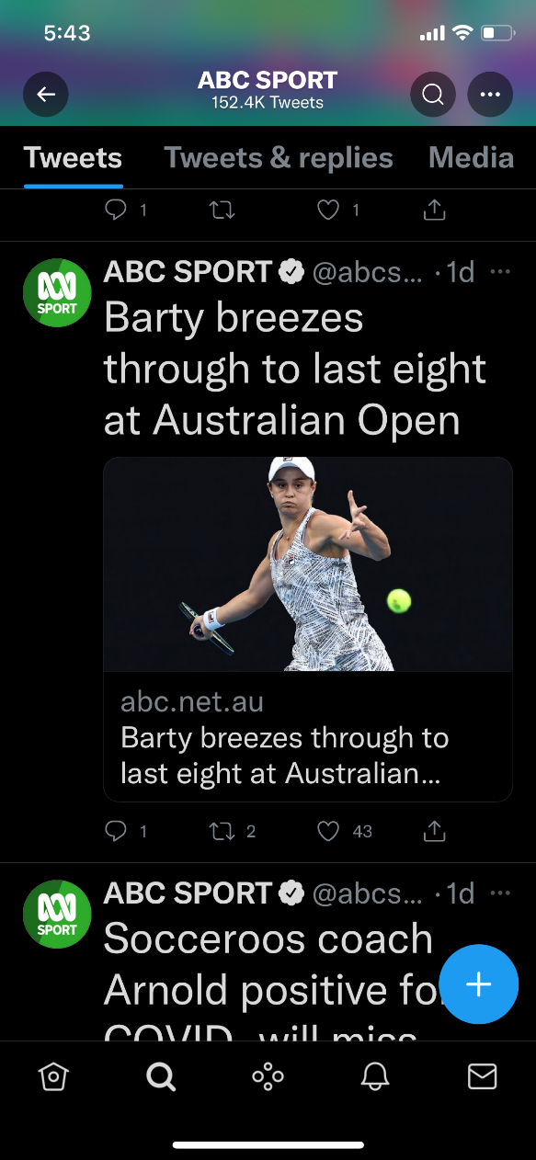
Digital platforms
Online news media sources such as ABC have a range of complementary online platforms such as Facebook, Instagram and Twitter, which they use to reach their audience and increase readership.
Here we can see examples of how the
article on Ash Barty’s Australian Open
win which featured in the ABC News
Website Sport section was also featured on Facebook and Twitter.
Source: Facebook
Source: Facebook
Source: Twitter

Slide 14
Lesson recap
In this lesson we began to explore the structural features of online news reports. We compared some of the similarities and differences in text structure between them and printed news reports.

Slide 15
Activity
Refer to the image on the next slide of The Australian newspaper.
Identify as many features of news media that you can.
In your workbook or digital journal record the feature and an example from the news text.

Slide 16
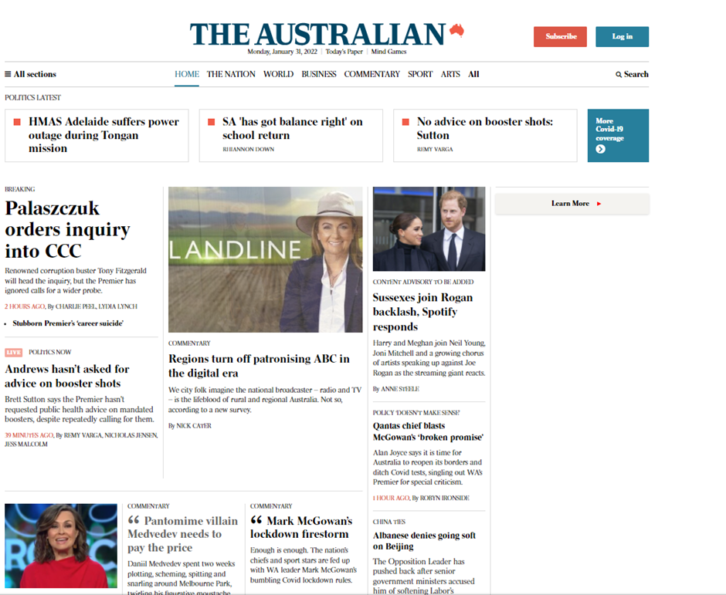
Source: The Australian, 31 January 2022, www.theaustralian.com.au

Slide 17
Daily reading routine
Choose something to read.
Read for at least 20 to 30 minutes.
After and perhaps during reading, make notes about what you’ve read (2 or more paragraphs).
If possible, have a chat about what you read with someone else.

