Slide 1

Year 8
English
Lesson 9 – infographics and data visualisations in news media

Slide 3
You will need
A pen, paper and workbook.
A digital device.

Slide 4
Learning intention
To develop knowledge and understanding of how infographics and data visualisations are used by news media to communicate information to their audience.

Slide 5
Introduction
Print news media has always used infographics.
We take in information more quickly through our senses than we do through reading text.
As news media has gone online and digital, data visualisations which combine moving visuals and sound are becoming more prevalent in news media. Infographics and data visualisations help readers organise complex information visually.

Slide 6
Infographics and data visualisations
Infographics and data visualisations help readers to effectively organise complex information visually in a number of ways. They:
make information more appealing
draw the eye, awaken interest and grab attention
summarise information in less space than the words needed to explain in sentences
lessen the cognitive load on readers who might otherwise skip to the next story or news publication.

Slide 7
Infographics and data visualisations
Help people who find that worded material is hard to access.
Break complex ideas down into a form that is easier to understand, without simplifying them.
Persuade readers.
Make information more memorable.
Lessen boredom.

Slide 8
Activity
Watch this data visualisation Discovering Jessie Webb from the Trove site and answer the following questions:
What features did you like or enjoy about this video?
Did the data visualisation engage you as a viewer?
Did the use of data visualisations help you understand the ideas that were being communicated to you?
Why do you think Trove presented information in this way?
Record your responses in your workbook or digital journal.

Slide 9
Common forms of infographics
List | Series of names, tips, components, previous events – any categories that add context to a story.
Checklist | A list of questions or guidelines that itemise key points or help readers assess their own needs.
Quiz | A short list of questions that let readers interact with a story by testing their understanding of the topic.
Public opinion poll | A survey that samples opinions on a current topic, collating responses into key categories and statistics.
Quote collection | A series of relevant comments on a topic by newsmakers, readers or random passers-by.

Slide 10
Common forms of infographics
Bar Chart | A way to compare 2 or more items visually by representing them as columns parked side by side.
Pie Chart | A way to compare the parts that make up a whole – usually measuring money or population percentages.
Ratings | A list of people or products (sports teams, movies, and so on) that lets critics make predictions or evaluations.
Timeline | A chronological table or list of events highlighting key moments in the history of a person, place or issue.
Bio Box | Brief profiles of people, places, products or organisations, itemised by key characteristics.
Fever chart | A way to measure changing quantities over time by plotting key statistics as points on a graph.

Slide 11
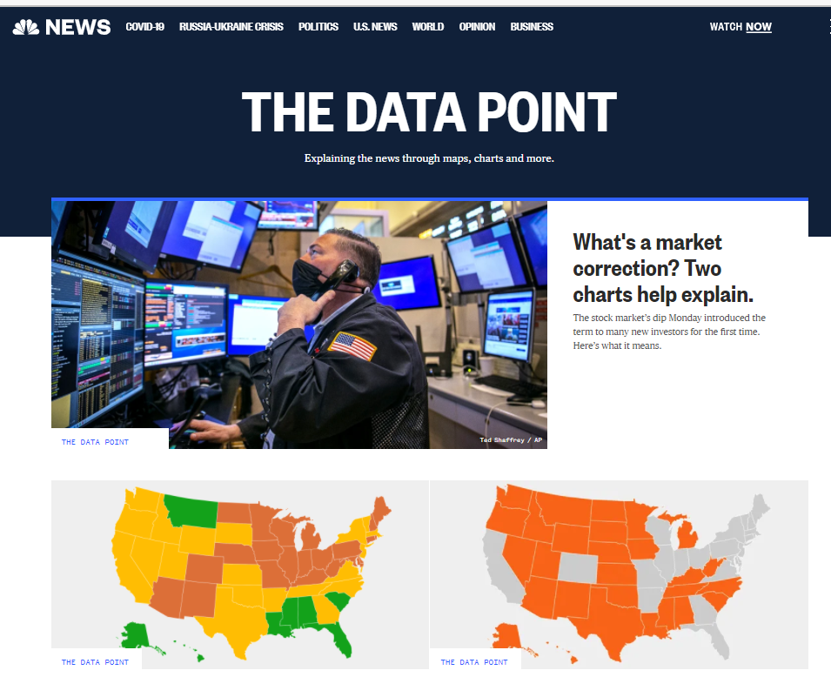
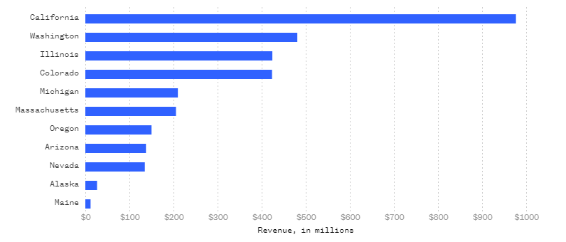
NBC News data analytics representations
Source: NBC News Data Point, 26 January 2022, https://www.nbcnews.com/datagraphics
Source: NBC News Data Point, https://www.nbcnews.com/datagraphics

Slide 12
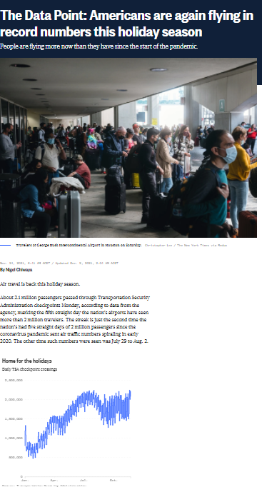
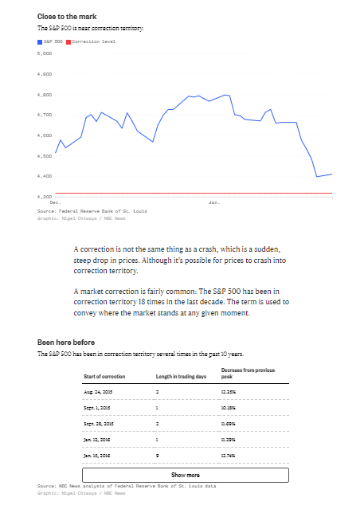
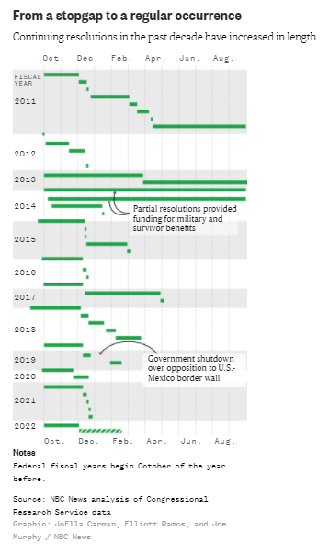
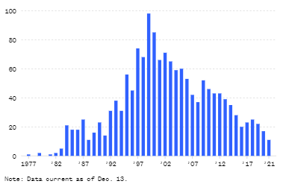
NBC News data analytics representations
Source: NBC News, https://www.nbcnews.com/datagraphics
Source: NBC News,
https://www.nbcnews.com/datagraphics
Source: NBC News,
https://www.nbcnews.com/datagraphics
Source: NBC News, https://www.nbcnews.com/datagraphics

Slide 13
Interactive elements
Print news media developed some interactive elements during the 20th century.
For example, ‘Letters to the Editor’, reader polls and vox pops.
As news media has gone online and digital, ‘clickable’ interactive elements have flourished.

Slide 14
Interactive elements
Some of the examples of interactive elements are:
• links to related content • links to other platforms
• opinion polls • message boards
• sharing functions • interactive games
• interactive quizzes • online surveys.
• comments boxes

Slide 15


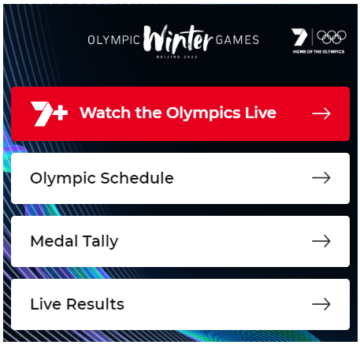
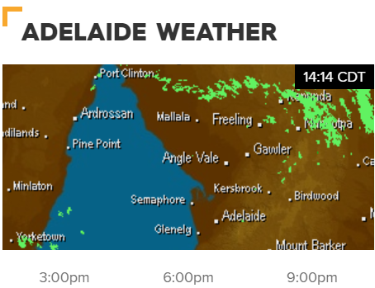

Interactive elements
Source: 9 News, http://www.9news.com.au/social-media
Source: The Australian, www.theaustralian.com.au
Source: 7plus.com.au
Source: 9 News, http://www.9news.com.au
Source: 9 News, http://www.9news.com.au

Slide 16
Lesson recap
In this lesson we began to explore how infographics and data visualisations are used by news media to communicate information to their audience.

Slide 17
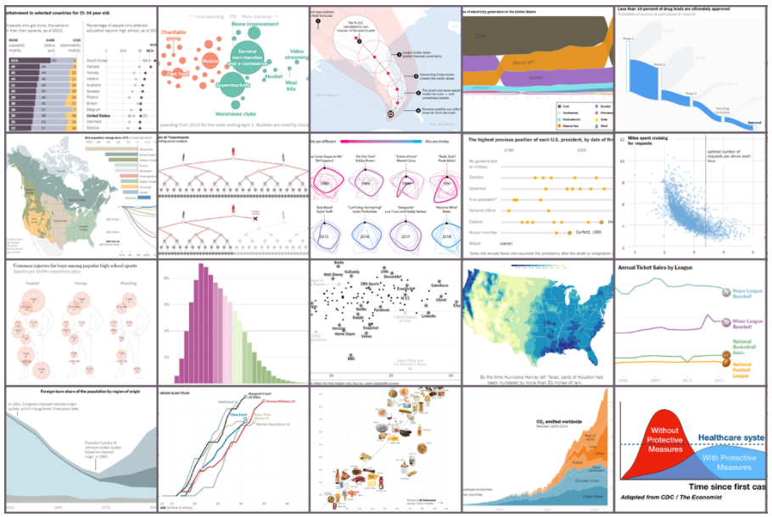
Activity: The New York Times Graphs
On each of the next three slides there is a graph
taken from The New York Times Learning Network.
Imagine that that each of the graphs is a
featured article you have written.
In your workbook or digital journal write a catchy headline
and lead paragraph that capture the main idea of each graph.
Source: The New York Times, The Learning Network, www.nytimes.com/section/learning

Slide 18
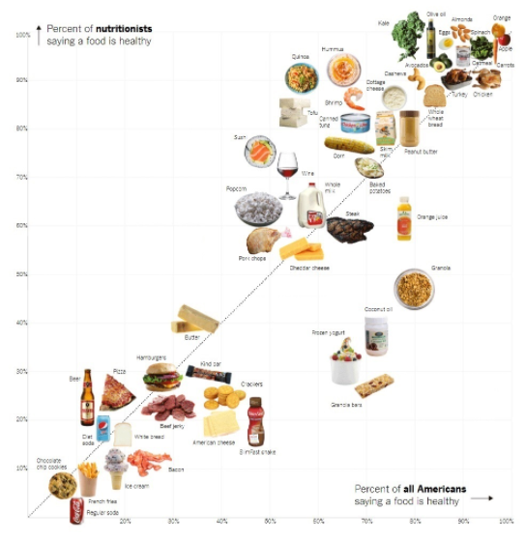
Scatter plot graph:
Is Sushi Healthy? What about Granola?
Where Americans and Nutritionists Disagree.
Source: The New York Times, 09 September 2017,
http://www.nytimes.com/2017/10/09/learning/whats-going-on-in-this-graph-oct-10-2017.html?searchResultPosition=2

Slide 19
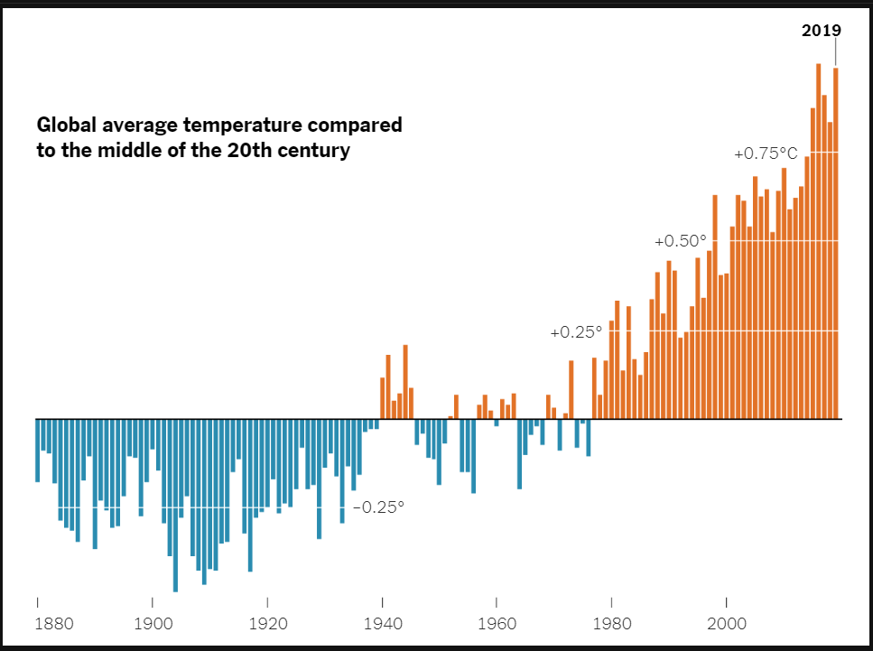
Time series with baseline:
Source: The New York Times, http://www.nytimes.com/2020/04/23/learning/whats-going-on-in-this-graph-global-temperature-change.html?searchResultPosition=1

Slide 20
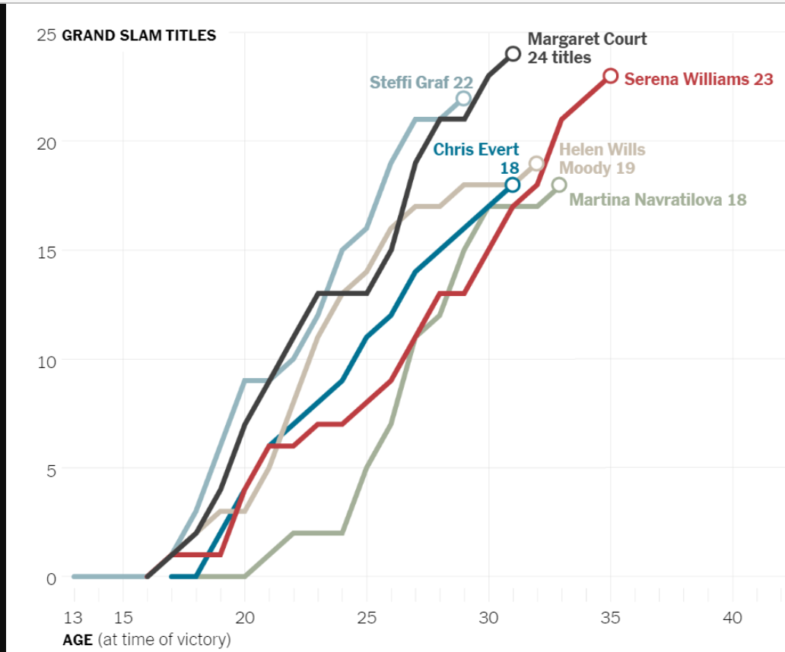
Line chart:
Serena Williams Reaches For Margaret Court
Source: The New York Times, http://www.nytimes.com/2019/09/12/learning/whats-going-on-in-this-graph-sept-18-2019.html?searchResultPosition=1

Slide 21
Daily reading routine
Choose something to read.
Read for at least 20 to 30 minutes.
After and perhaps during reading, make notes about what you’ve read (2 or more paragraphs).
If possible, have a chat about what you read with someone else.

